Slide 1
Color

Slide 2
Color theory
In the visual arts, color theory or colour theory is a body of practical guidance to color mixing and the visual effects of a specific color combination. There are also definitions (or categories) of colors based on the color wheel: primary color, secondary color andtertiary color. Although color theory principles first appeared in the writings of Leone Battista Alberti (c.1435) and the notebooks of Leonardo da Vinci (c.1490), a tradition of "colory theory" began in the 18th century, initially within a partisan controversy around Isaac Newton's theory of color (Opticks, 1704) and the nature of primary colors. From there it developed as an independent artistic tradition with only superficial reference to colorimetry and vision science.

Slide 3
Color theory
Color wheel
Color values
Color schemes

Slide 4
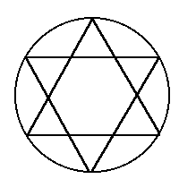
The Color wheel
The color wheel fits together like a puzzle - each color in a specific place.
Being familiar with the color wheel not only helps you mix colors
when painting, but in adding color to all your art creations.

Slide 5
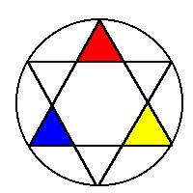
Primary colors
Primary colors are not mixed from other elements and they generate all other colors.
Red
Yellow
Blue

Slide 6
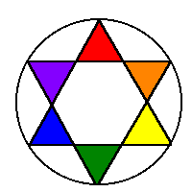
Secondary colors
By mixing two primary colors, a secondary color is created.
Red + Yellow = Orange
Yellow + Blue = Green
Blue + Red = Purple

Slide 7
Neutral colors
The principles of color mixing let us describe a variety of colors, but there are still many colors to explore. The neutral colors contain equal parts of each of the three primary colors. Black, white, gray and sometimes brown are considered "neutral”.

Slide 8
Color characteristics
Light and colour persception
A light characteristic is a graphic and text description of a navigational light sequence or colour displayed on a nautical chart or in a Light List with the chart symbol for a lighthouse, lightvessel,buoy or sea mark with a light on it. The graphic indicates how the real light may be identified when looking at its actual light output type or sequence. Different lights use different colours, frequencies and light patterns, so mariners can identify which light they are seeing.
Color perception is a fascinating series of physical and chemical reactions which allow some organisms to see in color. The process of color perception is literally all in the mind, with the eye containing the equipment which responds to light so that the brain can process it.

Slide 9
Influence of context
A context effect is an aspect of cognitive psychology that describes the influence of environmental factors on one's perception of a stimulus. The impact of contexteffects is considered to be part of top-down design. The concept is supported by the theoretical approach to perception known as constructive perception.

Slide 10
Properties of colour
Hue
Hue defines pure color in terms of "green", "red" or "magenta". Hue also defines mixtures of two pure colors like "red-yellow" (~ "orange"), or "yellow-green" (limitations to this statement will be addressed later).
Hue is usually one property of three when used to determine a certain color.
Value
Value is defined as the relative lightness or darkness of a color. It is an important tool for the designer/artist, in the way that it defines form and creates spatial illusions.
Intensity/complementary colors
Intensity refers to the purity of a hue. Intensity is also known as Chroma or Saturation. The highest intensity or purity of a hue is the hue as it appears in the spectrum or on the colorwheel. A hue reduced in intensity is called a Tone. A tone is a hue with reduced or dulled strength.

Slide 11
Color schemes
Color Schemes are a systematic way of using the color wheel to put colors together… in your art work, putting together the clothes you wear, deciding what colors to paint your room…..

Slide 12
monochromatic
“Mono” means “one”, “chroma” means “color”… monochromatic color schemes have only one color and its values. The following slide shows a painting done in a monochromatic color scheme.

Slide 13
This non-objective painting has a monochromatic color scheme - blue and the values (tints and shades) of blue.

Slide 14
Mark tansey,forward retreat 1986

Slide 15
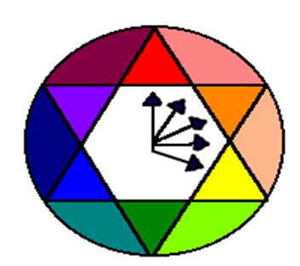
analogous
The analogous color scheme is 3-5 colors adjacent to each other on the color wheel. This combination of colors provides very little contrast.

Slide 16
Analogous
Analogous colors are illustrated here: yellow, yellow-green, green and blue-green.

Slide 17
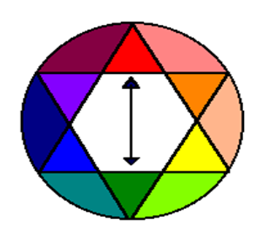
complementary
Complementary colors are opposite on the color wheel provided a high contrast - if you want to be noticed wear complementary colors!

Slide 18
This painting has complementary colors and their values - blues and oranges.

Slide 19
Vincent van gogh.the yellow house

Slide 20
Stuart davis .visa .1951

Slide 21
triadic
A triadic color scheme involves three hues equally spaced on the color wheel
Red,yellow and blue would be the most common example

Slide 22
Jan Vermeer.girl with a pearl earring(1665-1666)

Slide 23
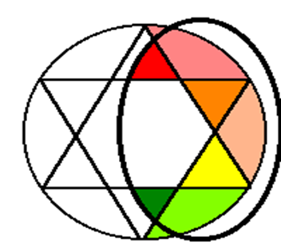
warm
Warm colors are found on the right side of the color wheel. They are colors found in fire and the sun. Warm colors make objects look closer in a painting or drawing.

Slide 24
This is an illustration of the use of warm colors - reds, oranges and yellows.

Slide 25
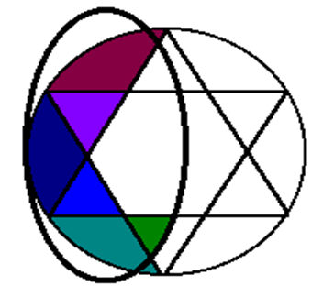
cool
Cool colors are found on the left side of the color wheel. They are the colors found in snow and ice and tend to recede in a composition.

Slide 26
Note the cool color scheme in this painting (greens, purples and blues).

