Slide 1
GESTALT
Gestalt is a general description for the concepts that make unity and variety possible in design. It is a German word that roughly translates as "whole" or "form." Gestalt theory is involved with visual perception and the psychology of art among other things. It is concerned with the relationship between the parts and the whole of a composition.

Slide 2
gestalt concepts: Figure and Ground
Closure the mind supplies the missing pieces in a composition
Continuance the eye continues in the direction it is going
Similarity what an items looks like and how that effects gestalt
Proximity where items are in relationship to each other and how that effects gestalt
Alignment lining up objects to organize and form groups
Gestalt theory first arose in 1890 as a reaction to the prevalent psychological theory of the time - atomism. The study of gestalt originated in Germany in the 1920s. It is a form of psychology that is interested in higher order cognitive processes relative to behaviorism. The aspects of gestalt theory that interests designers are related to gestalt's investigations of visual perception, principally the relationship between the parts and the whole of visual experience.

Slide 3
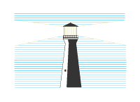
The terms figure and ground explain how we use elements of the scene which are similar in appearance and shape and group them together as a whole. Similar elements (figure) are contrasted with dissimilar elements (ground) to give the impression of a whole. In the picture to the left, the lighthouse stands out as the figure, while the horizontal blue lines are perceived as ground.

Slide 4
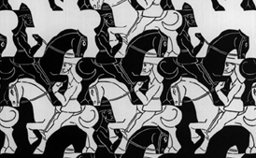
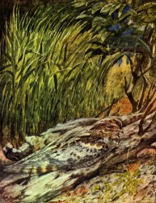
Look carefully at the M.C. Escher print to the right.
Do you see the white horses and riders?
Now look for the black horses and riders!
Escher often designed art which played around with figure and ground in interesting ways. Look at how figure and ground interchange in this print.
A breakdown of figure and ground occurs with camouflage, where the objective is to make the figure so much like the ground that it disappears from view. Notice the painting of the bird below. Only with great difficulty can you separate the bird from the log it is perched on. Figure and ground have merged together.

Slide 5
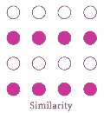
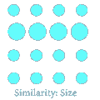
Gestalt Principle: Similarity
The principle of similarity states that things which share visual characteristics such as shape, size, color, texture, value or orientation will be seen as belonging together.
In the example to the right, the two filled lines gives our eyes the impression of two horizontal lines, even though all the circles are equidistant from each other.
In the example to the left, the larger circles appear to belong together because of the similarity in size.

Slide 6
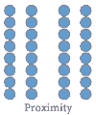
Gestalt Principle: Proximity or Contiguity
The principle of proximity or contiguity states that things which are closer together will be seen as belonging together. Looking at the picture to the right, since the horizontal rows of circles are closer together than the vertical columns, we perceive two vertical lines. Since the first two columns and the last two columns have less space between them than the center two columns, we perceive two groups of two columns.

Slide 7
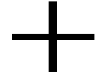
Gestalt Principle: Continuity
What do you see?
The principle of continuity predicts the preference for continuous figures. We perceive the figure as two crossed lines instead of 4 lines meeting at the center.

Slide 8
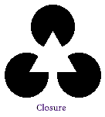
Gestalt Principle: Closure
The principle of closure applies when we tend to see complete figures even when part of the information is missing.
We see three black circles covered by a white triangle, even through it could just as easily be three incomplete circles joined together.
Our minds react to patterns that are familiar, even though we often receive incomplete information.
It is speculated this is a survival instinct, allowing us to complete the form of a predator even with incomplete information.

Slide 9
Even though the circle to the left is not joined together, we still perceive a circle due to the principle of closure.

Slide 10
Gestalt Principle: Area
The principle of area states that the smaller of two overlapping figures is perceived as figure while the larger is regarded as ground.
We perceive the smaller square to be a shape on top of the other figure, as opposed to a hole in the larger shape.
We can reverse this perception by using shading to get our message across, as seen below.
What do you see?
On a white background, this looks like a box with a hole in it.

Slide 11
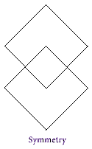
Gestalt Principle: Symmetry
The principle of symmetry describes the instance where the whole of a figure is perceived rather than the individual parts which make up the figure. What do you see to the right?
Two overlapping diamonds, or three objects, a small diamond and two irregular objects above and below it? If you are perceiving according to the principle of symmetry, you will probably see two diamonds overlapping.
PART II…

