Slide 1
Classic Graphic Design Theory*
* “classic theory” because it forms the basis for many decisions in design.

Slide 2
Elements of Design:
Line
Shape
Texture
Value & Color
Space

Slide 3
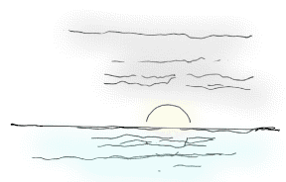
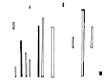
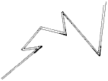
A line is a form with width and length, but no depth. Artists use lines to create edges, the outlines of objects. A line is created by the movement of the artist's pen.
Line Direction The direction of a line can convey mood.
Horizontal lines are calm and quiet,
vertical lines suggest more of a potential for movement,
while diagonal lines strongly suggest movement and give more of a feeling of vitality to a picture.

Slide 4
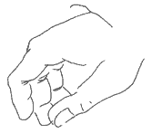
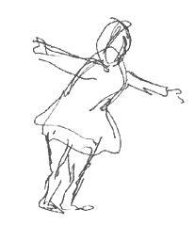
Contour and gesture
Lines used to follow the edges of forms are called contour drawings.
Drawings which seem to depict more movement than actual outline are called gesture drawings.

Slide 5
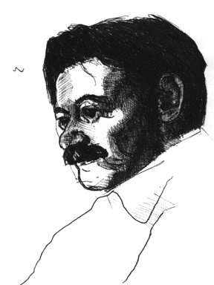
Line as Value
Lines or crosshatching can also be used to create areas of grey inside a drawing. These areas of darker shading inside a figure, called areas of value, can give a more three-dimensional feeling to an object.

Slide 6
A shape is an enclosed object. Shapes can be created by line, or by color and value changes which define their edges.
Volume and Mass
Shape is considered to be a two-dimensional element, while three-dimensional elements have volume or mass. Therefore, a painting has shapes, while a sculpture has volume and mass.
Positive/Negative shapes
In a picture, the shapes that the artist has placed are considered the positive shapes. The spaces around the shapes are the negative spaces. It is just as important to consider the negative space in a picture as the positive shapes. Sometimes artists create pieces that have no distinction between positive and negative spaces. M. C. Escher was a master at creating drawings where there was no distinction between positive and negative space. Here are two examples of Escher's work which show the interplay between positive and negative space:

Slide 7
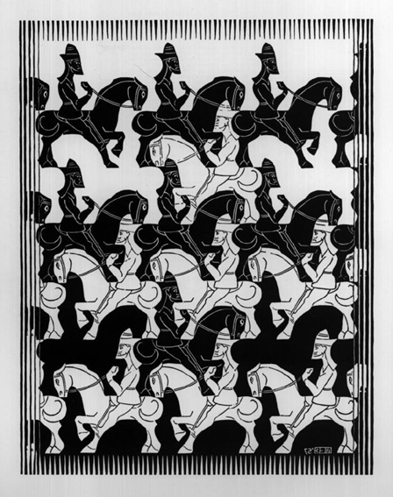
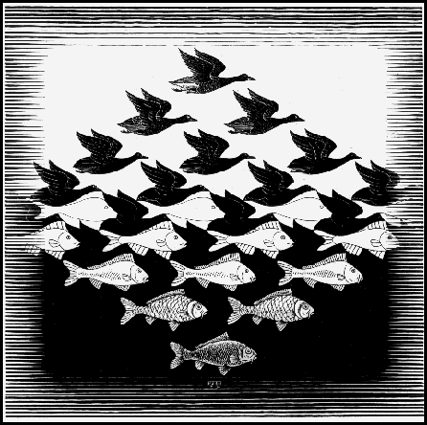
M. C. Escher print: Study of the Regular Division of the Plane with Horsemen
M. C. Escher print: Sky and Water I

Slide 8
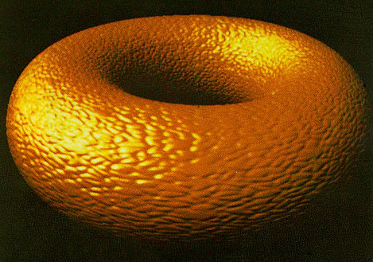

Texture is the surface quality of an object. We experience texture when we touch objects and feel their roughness, smoothness or patterns. Texture is the artist's way of mapping these tactile impressions on to the two-dimensional picture. Texture is created by varying the pattern of light and dark areas on an object. Notice how the areas of light and dark give the impression of depth to the image below.

Slide 9
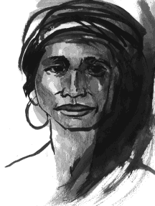
Value
Value
Value refers to the relative lightness or darkness of a certain area.
Value can be used for emphasis.
Variations in value are used to create a focal point for the design of a picture.
A light figure on a dark background will be immediately recognized as the center of attention, similarly for a dark figure on a mostly white background.
Gradations of value are also used to create the illusion of depth. Areas of light and dark can give a three-dimensional impression, such as when shading areas of a person's face.

Slide 10

Color
Color occurs when light in different wavelengths strikes our eyes.
Objects have no color of their own, only the ability to reflect a certain wavelength of light back to our eyes.
As you know, color can vary in differing circumstances. For example, grass can appear gray in the morning or evening or bright green at noon.
Colors appear different depending on whether you view them under incandescent, florescent or natural sunlight.
Colors also change according to their surroundings. You can see this by looking at the color squares below - the reddish outline box is the same color in all the examples.

Slide 11
Properties of Color
Hue:
Hue refers to the color itself. Each different hue is a different reflected wavelength of light. White light broken in a prism has seven hues: red, orange, yellow, green, blue, indigo and violet. White light occurs when all the wavelengths are reflected back to your eye, and black light occurs when no light is reflected to your eye. This is the physics of light.

Slide 12
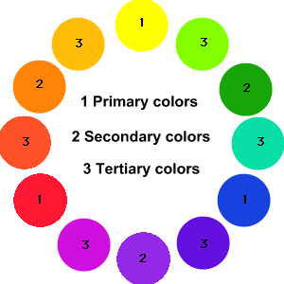


When it comes to using color in art, things get quite messy. Looking at the color wheel above, when using color pigments, the three primary colors used are yellow, blue and red. These three colors are blended together to produce other colors, called secondary colors, such as green, orange and purple. Mix enough colors together, and you get black.
Computer Colors
Printer Colors
Things get even dicier on computers when you go to print out these colors. Printing uses the CYMK convention which takes cyan (light blue), yellow, magenta (pinky red) and black inks and tries to recreate the color that your computer created with red, green and blue light.
Computer colors are produced by combining the three colors of red, green and blue together. Believe it or not, you can get yellow by combining these colors, how?? ☺

Slide 13
Color Value:
Color value refers to the lightness or darkness of the hue. Adding white to a hue produces a high-value color, often called a tint. Adding black to a hue produces a low-value color, often called a shade.
Intensity :
Intensity, also called chroma or saturation, refers to the brightness of a color. A color is at full intensity when not mixed with black or white - a pure hue. You can change the intensity of a color, making it duller or more neutral by adding gray to the color. You can also change the intensity of a color by adding its complement (this is the color found directly opposite on the traditional color wheel). When changing colors this way, the color produced is called a tone.

Slide 14
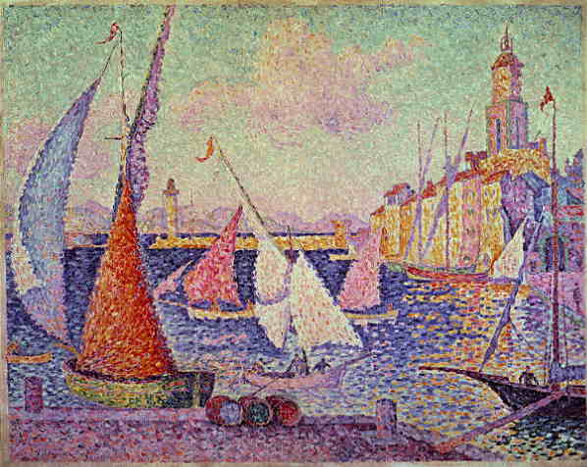
Optical Color Mixing:
When small dots of color are placed adjacent to each other, your eye will combine the colors into a blended color.
This is the principle used when printing color in magazines.
Dots of cyan, magenta, yellow and black are distributed in a pattern on the paper, and depending on the quantity of a certain dot, you will see a specific color on the page. Paul Signac used a technique called pointillism that involved creating art using the combination of dots to form images.

Slide 15
Color and Space:
Certain colors have an advancing or receding quality, based on how our eye has to adjust to see them. Warm colors such as red, orange or yellow seem to come forward while cool colors such as blue and green seem to recede slightly. In the atmosphere, distant objects appear bluish and the further away an object appears, the less colorful and distinct it becomes. Artists use this to give an illusion of depth, by using more neutral and grayish colors in the background.

Slide 16
