Slide 2
Graphic design in our culture lacks clear boundaries that give it
a simple definition.
“Graphic design is the most ubiquitous of all the art forms since it can be found everywhere and anywhere—in our homes, in the restaurants we frequent, on the streets we walk, on the highways we drive, in the movies and theaters we attend, and in every shop we enter.” …EXAMPLE???
A more contemporary definition of graphic design might
include the “art” of communication—to inform, educate,
influence, persuade, and provide a visual experience—one
that combines art and technology to communicate messages
vital to our daily lives. It is simply a cultural force.

Slide 4
The graphic designer conceives, plans, and executes a design that communicates a
direct message to a specific audience.
The term design refers to the planned arrangement of visual elements organized and prioritized into a cohesive whole that becomes the visual message.
Graphic designers work in business and industry as well as in the cultural and educational sectors of contemporary society.
Their work is mass-produced in print, film, and electronic media—books, magazines, newspapers, advertisements, corporate identity, packaging, posters, CDs and multimedia, Web sites, billboards, television and film graphics, environmental and transportation signage, maps, charts, and other forms of information design.
Basically, graphic designers develop images to represent the ideas their clients want to communicate. This is usually accomplished by combining images (photographs, film, video, art, or illustration) and words (typography) into a unified form that responds to the content and conveys a clear message.

Slide 5
I Want to Be a Graphic Designer—Where Do I Begin?
Students need to learn the basic design principles (2-D and 3-D) and observational or life drawing first.
Students need to draw and develop basic visual language vocabularies in order to communicate so that others will understand.
Visual language consists of the basic elements of two- and
three-dimensional design: line, shape, texture, value, color,
composition, volume, mass, and space, and how they combine
to create balance, unity, proportion, rhythm, and sequence.

Slide 7
1. Define the Problem and Establish Your Objectives
2. Do the Research
3. Develop Your Ideas by Brainstorming
4. Analyze Your Ideas in Terms of the Project Objectives
5. Implement the Final

Slide 8
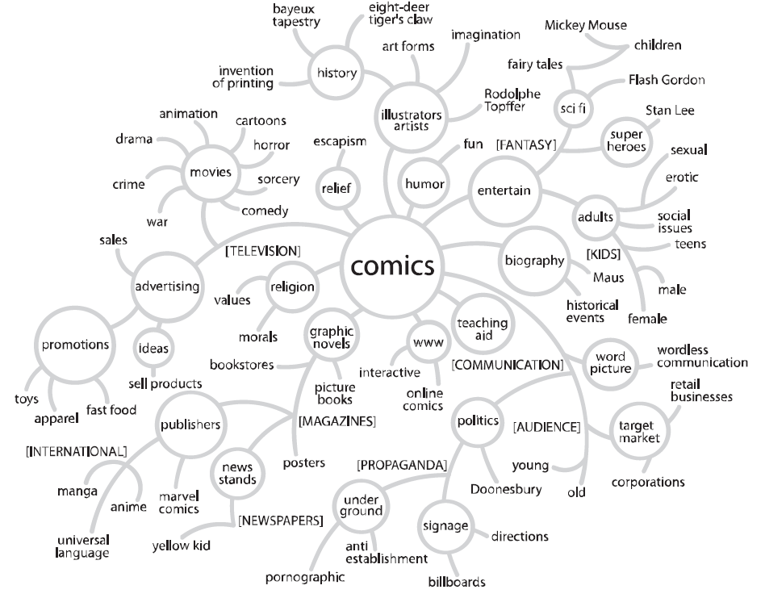
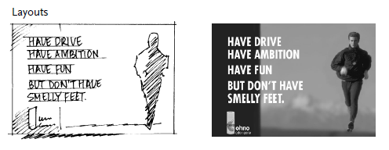
Brainstorming : verbal diagramming or “thought mapping.”
A thumbnail is a small rough sketch of a preliminary design idea. Try to generate as many of these sketches as possible because every communication problem has an infinite number of possible visual solutions. Your first ideas will probably be your most obvious ideas.
A layout is a full-size sketch of the design idea detailing its placement of type, images, and color. They are made to test whether the idea will work once it is drawn at full size. Layouts can be done with markers and a drawing pad or on the computer.

