Slide 1
Texture

Slide 2
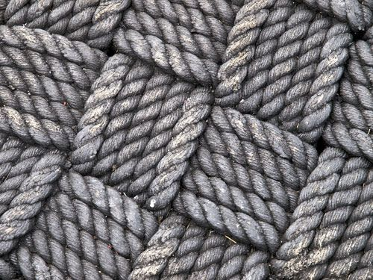
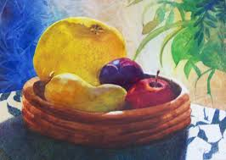
Definition
-The surface quality or feel of an object .Its smoothness ,roughness ,softness or etc
-it can be actual or implied

Slide 3
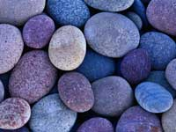
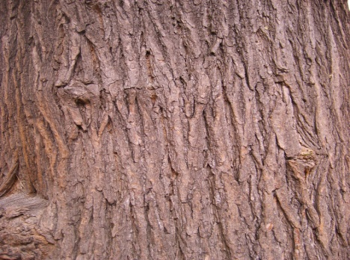
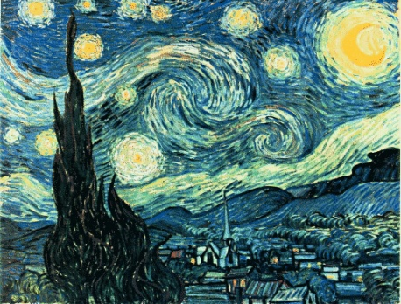
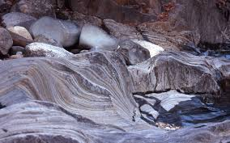
Type of Texture
Actual/Tactile Texture
Physical surface of the object
can be created by carving, incising or scratching into a surface
Visual Texture
Illusion of the surface’s texture
can be achieved using a media such as pencil, pen, paint and photography

Slide 4
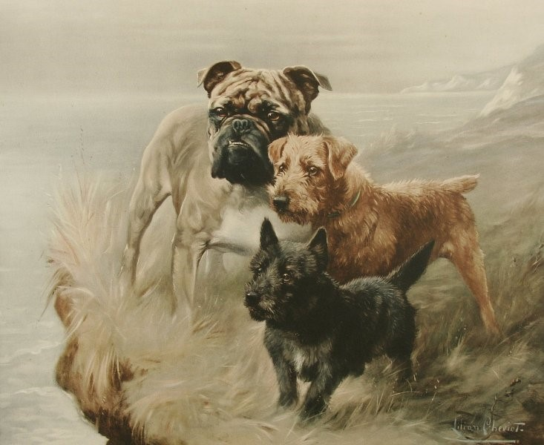
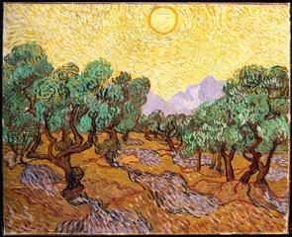
Visual Texture
Simulated Texture
accurately simulate “real life” texture
Invented Texture
consist of 2-D pattern of repeating lines and shape

Slide 5
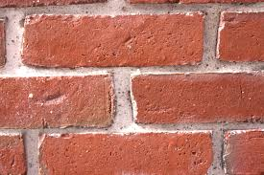
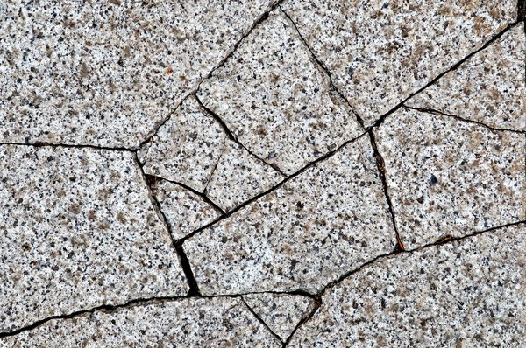
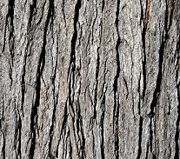
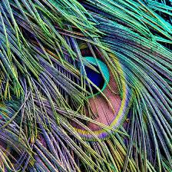
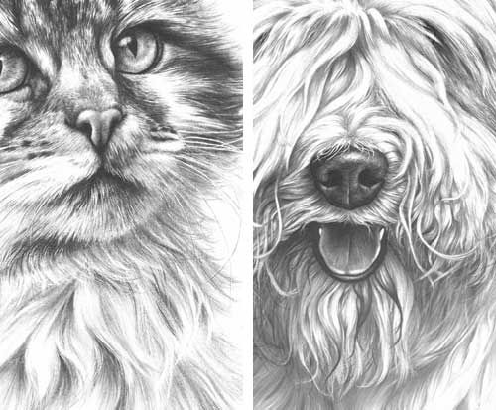
Examples
Tactile Texture
Visual Texture

