Slide 1
4
Competitive Strategy
Praise competitors. Learn from them. There are times when you can cooperate with them to their advantage and to yours.
George Mathew Adams
Summary
How can ventures create a strategy to fit the new business opportunity?
Every new venture has a strategy or approach to achieve its goals. The strategy is developed using the business model, an understanding of the industry, and the context and the key factors for success.
Chapter 4: Summary
Technology Ventures: From Idea to Enterprise

Slide 2
4
Competitive Strategy
A strategy is a plan or road map of the actions that a firm or organization will take to achieve its mission and goals, but it is not static.
A strategy is a response to opportunity.
Long term planning is difficult due to the dynamic nature of the competitive market.
Chapter 4: concept
Technology Ventures: From Idea to Enterprise

Slide 3
4
Competitive Strategy
The Management Process for Developing a Strategy
Develop the vision and mission statement, and the business model.
Describe the firm's core competencies, its customers, and its competitive advantage.
Describe the industry and context for the firm and describe the competitors.
Determine the firm's strengths and weaknesses in the context of the industry and environment.
Describe the opportunities and threats for the venture.
Identify the key factors for success using the six forces model.
Formulate strategic options and select the appropriate strategy.
Translate the strategy into action plans with suitable measures and controls.
Chapter 4: Table 4.1
Technology Ventures: From Idea to Enterprise

Slide 4
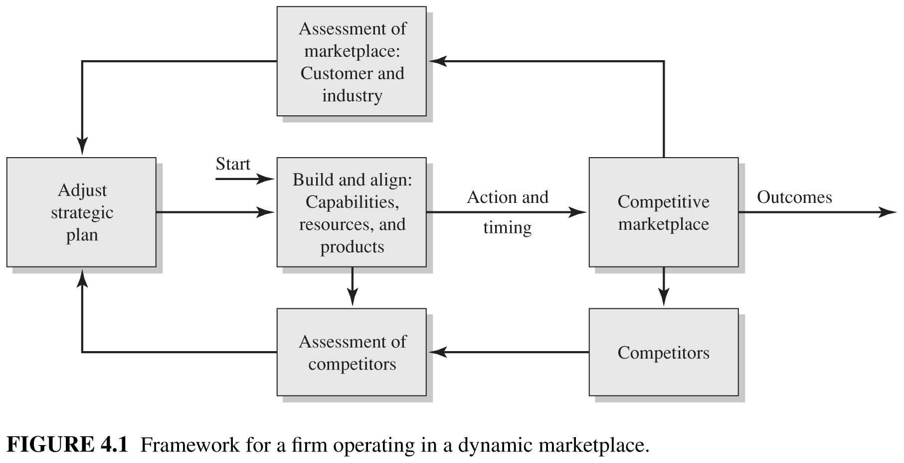

Slide 5
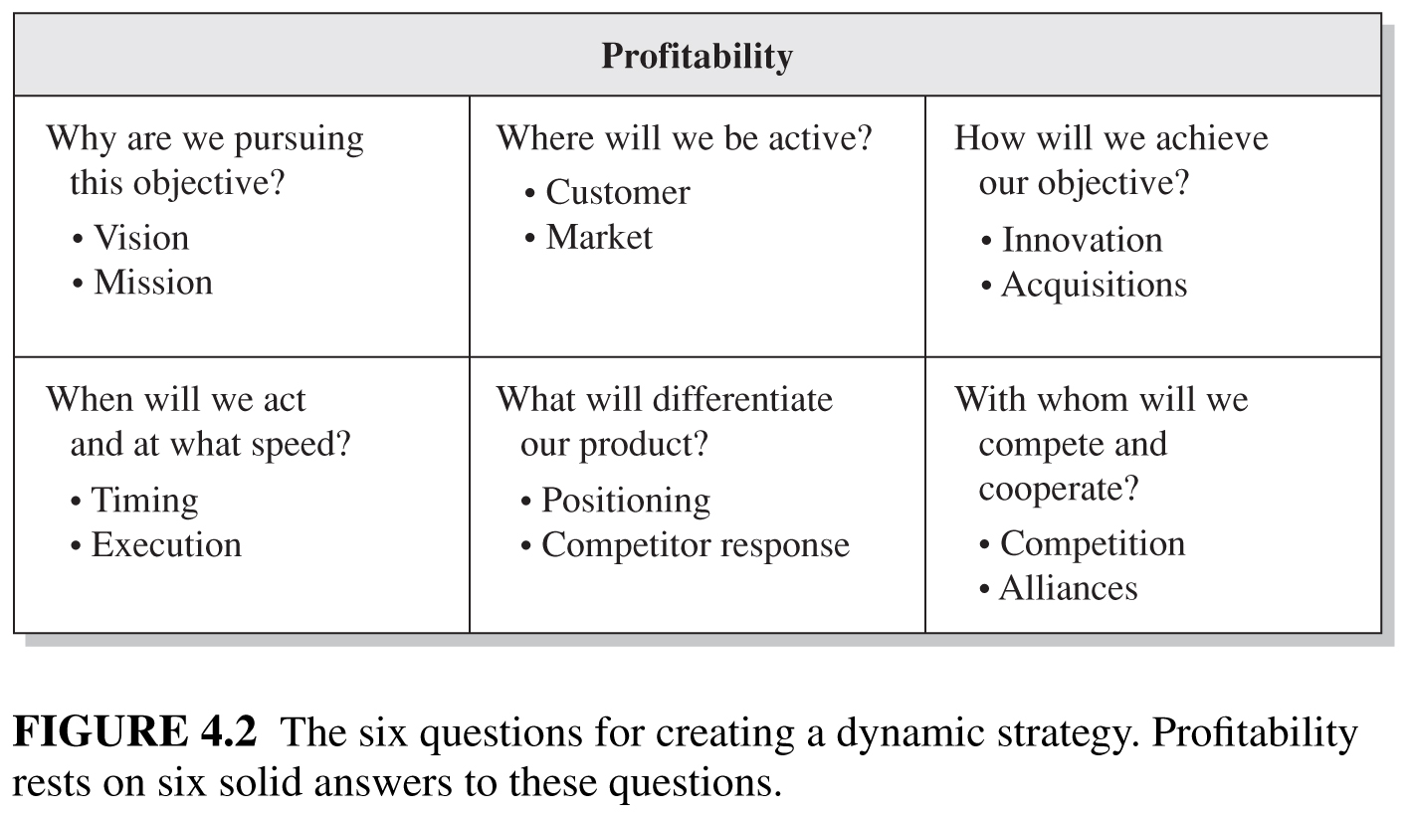
4
*A strategy can be viewed as a plan that integrates a firm’s goals and action into a cohesive whole that draws effectively on its resources and capabilities.
Competitive Strategy
Profitability
Chapter 4: Figure 4.2
Technology Ventures: From Idea to Enterprise

Slide 6
An INDUSTRY* is a group of firms producing products that are close substitutes for each other and serve the same customers.
* Must be rather focused!!

Slide 7
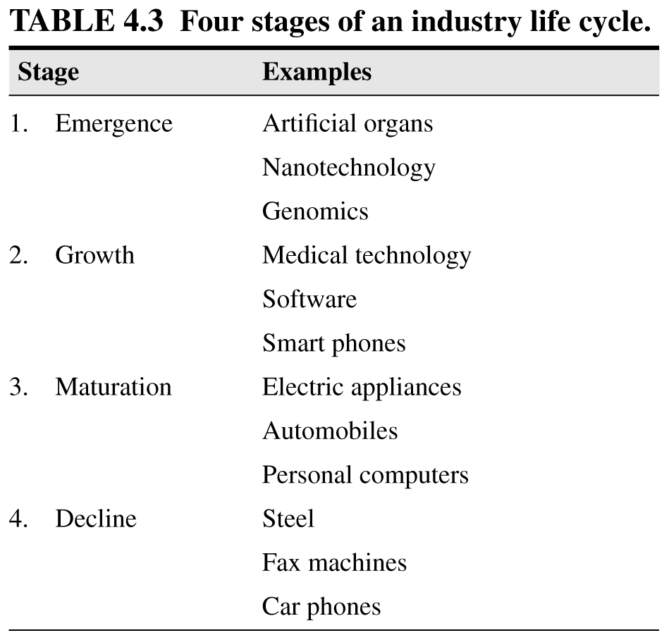
It is important to know where your industry is in the “evolution cycle”!

Slide 8
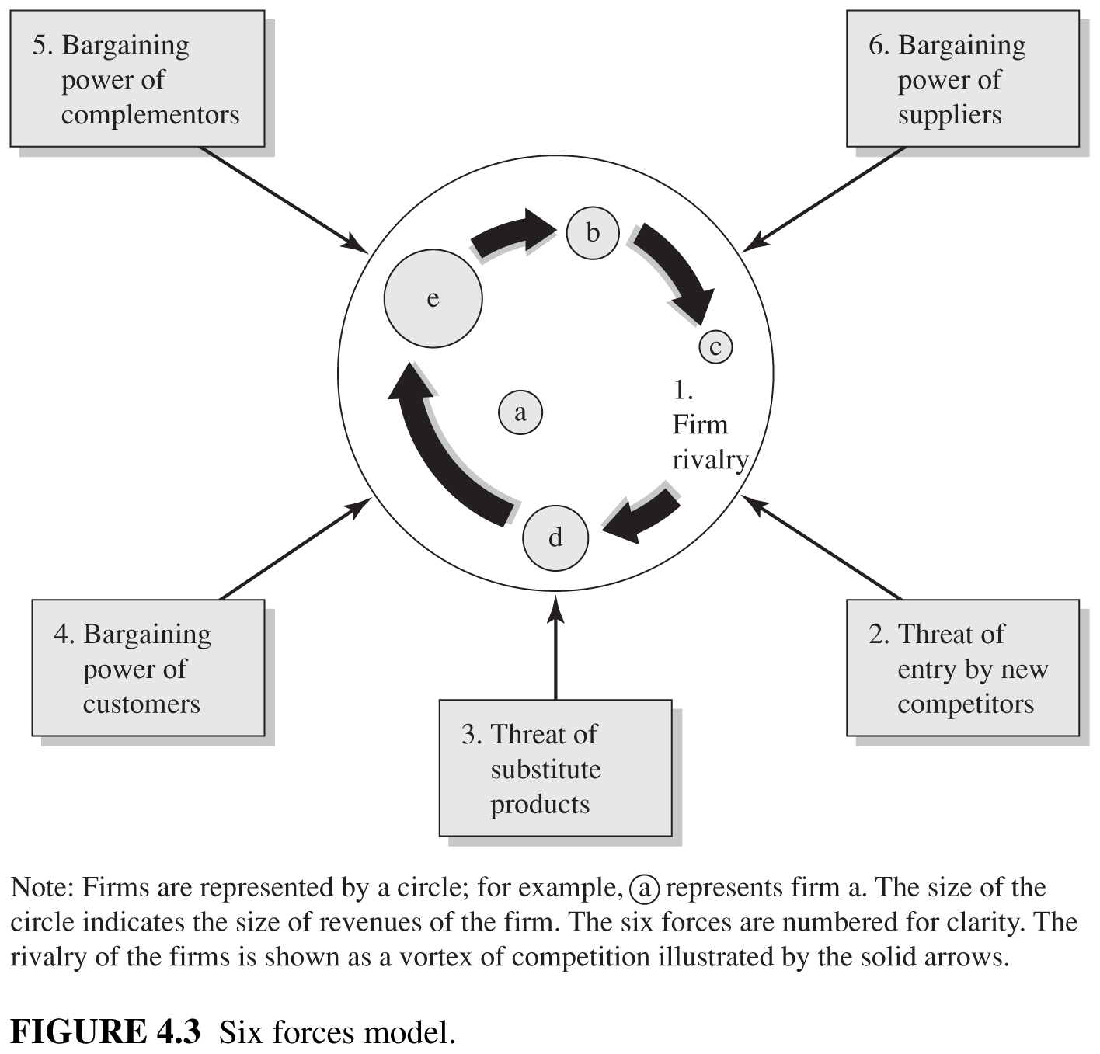
4
Competitive Strategy
Chapter 4: Figure 4.3 – 6 Forces Model
Technology Ventures: From Idea to Enterprise

Slide 9
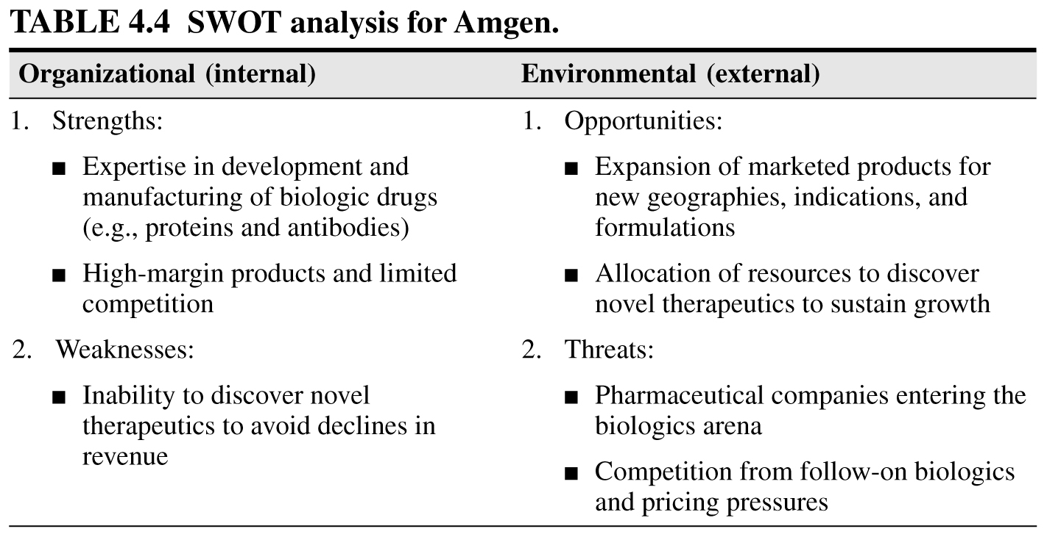
4
Competitive Strategy
Chapter 4: Table 4.4
Technology Ventures: From Idea to Enterprise

Slide 10
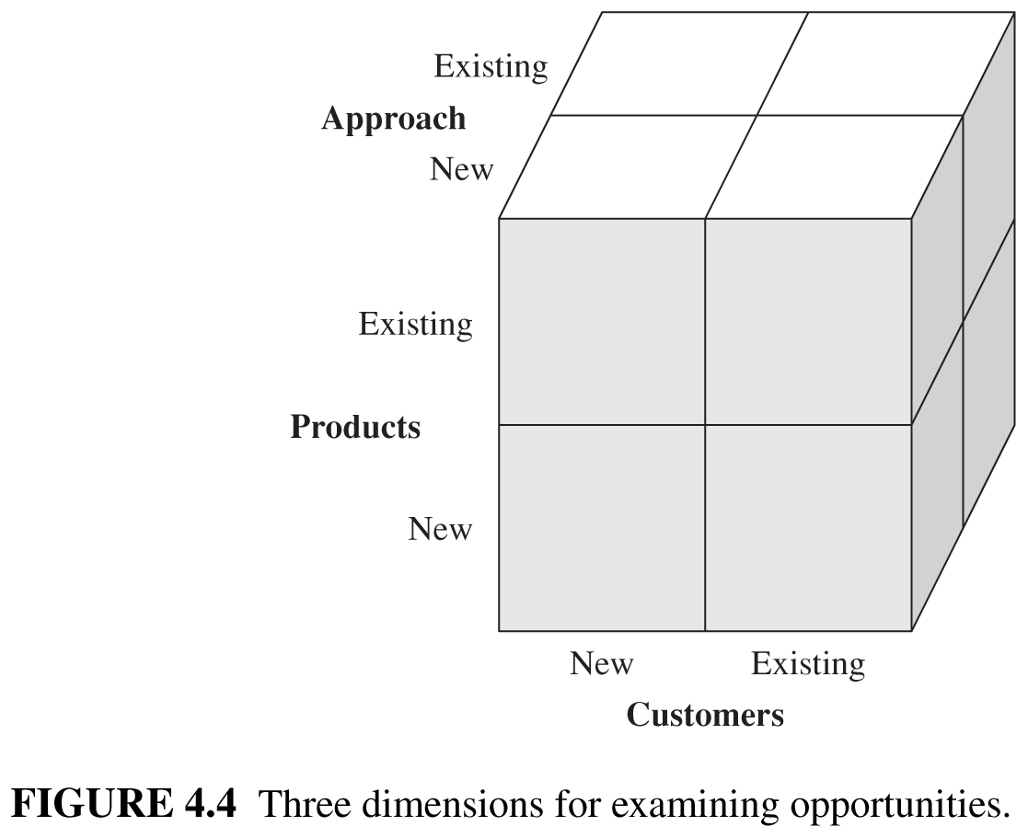
Perhaps the safest strategy is to take new products to existing customers via existing distribution channels using existing approaches.

Slide 11
4
Competitive Strategy
Barriers to entry are factors that make it costly for companies to enter an industry.
Potential Barriers to entry into an industry
Economies of Scale
Cost advantages Independent of Scale
Product Differentiation
Contrived Deterrence
Government Regulation
Switching Costs
Chapter 4: Table 4.5
Technology Ventures: From Idea to Enterprise

Slide 12
4
Competitive Strategy
Distinctive competencies lead to competitive advantage.
Chapter 4: Figure 4.5
Technology Ventures: From Idea to Enterprise

Slide 13
4
Competitive Strategy
4 common ways in which a firm will DISTINGUISH itself from competitors.
Four Common Types of Strategies and Their Characteristics
The goal of a differentiation strategy is to create a unique product based on a firm’s unique competencies.
Chapter 4: Table 4.6
Technology Ventures: From Idea to Enterprise

Slide 14
4
Competitive Strategy
A partnership or alliance is an association of two or more firms that agree to cooperate with one another to achieve mutually compatible goals that would be difficult for each to accomplish alone [Spekman and Isabella, 2000].
*Cooperative strategies.
Chapter 4
Technology Ventures: From Idea to Enterprise

Slide 15
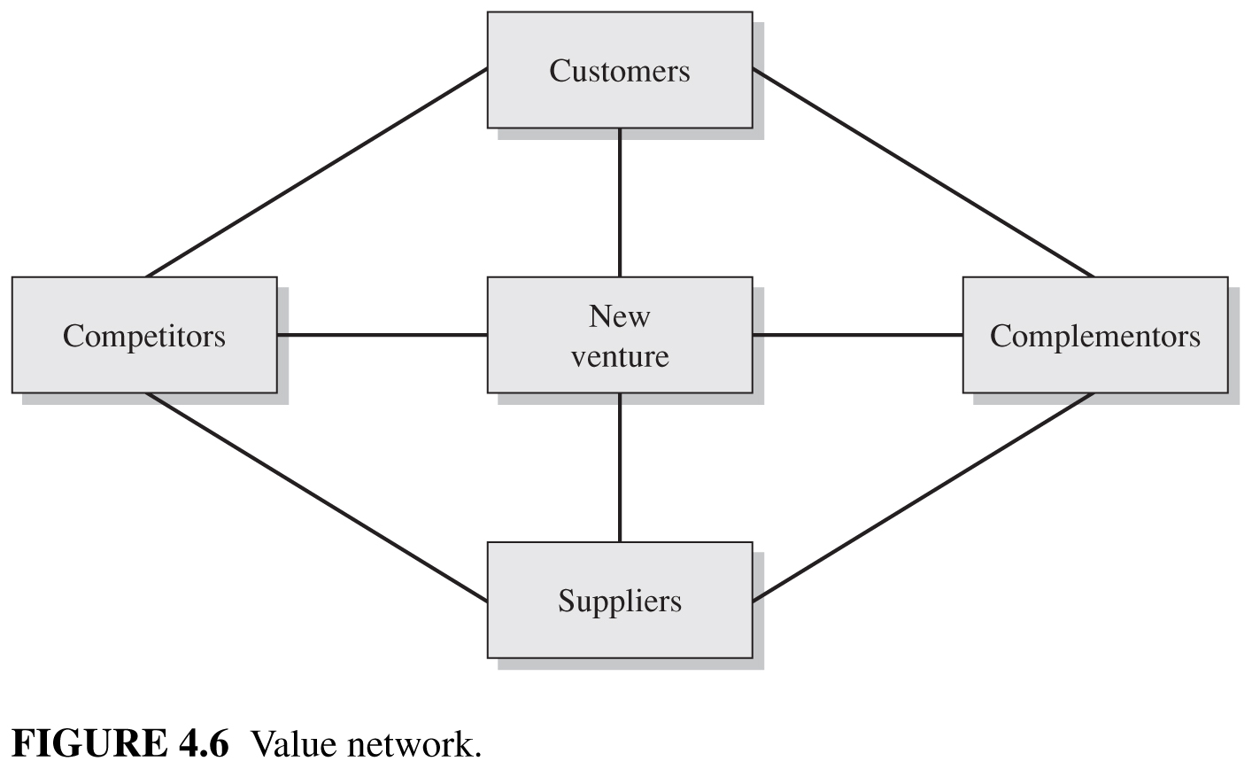

Slide 16
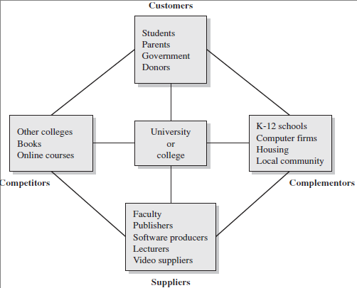
4
Competitive Strategy
Chapter 4: Figure 4.7 Value network for a university
Technology Ventures: From Idea to Enterprise

Slide 17
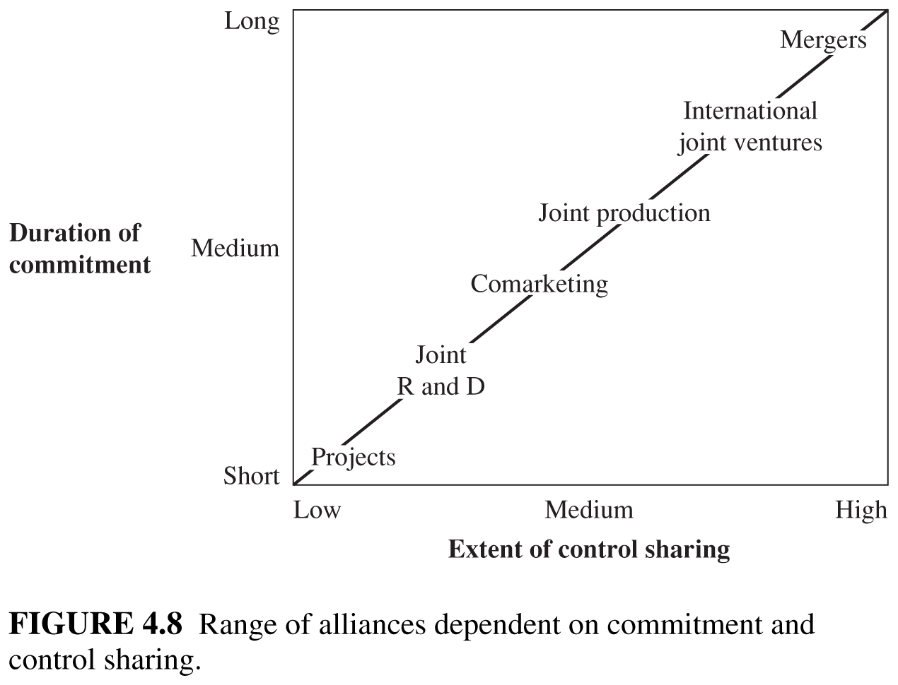
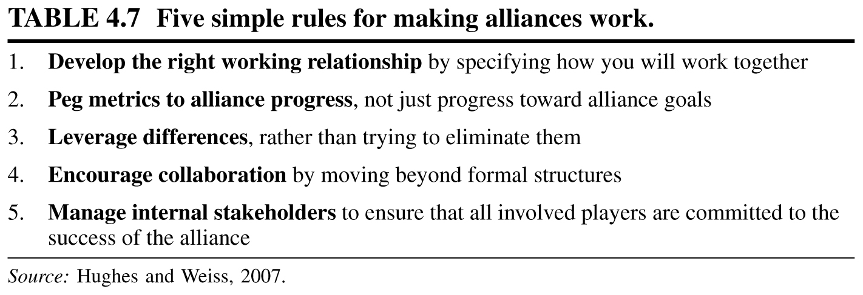

Slide 18
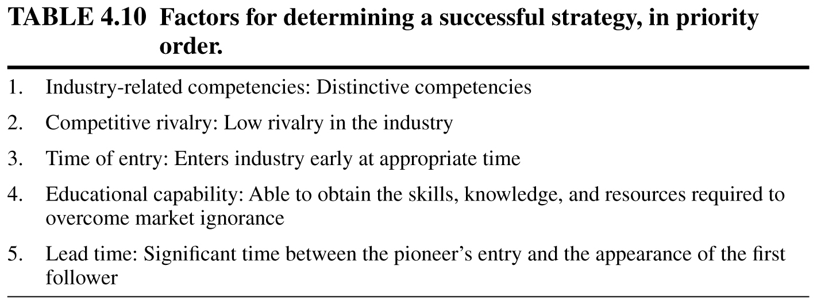
4
Competitive Strategy
Principle 4
A clear road map (strategy) for a new venture states how it will act to achieve its goals and attain a sustainable competitive advantage.
Chapter 4: Principle 4
Technology Ventures: From Idea to Enterprise

Slide 19
4
Competitive Strategy
A social entrepreneur is a person or team that acts to form a new venture in response to an opportunity to deliver social benefits while satisfying environmental and economic values.
Chapter 7: concept
Technology Ventures: From Idea to Enterprise

Slide 21
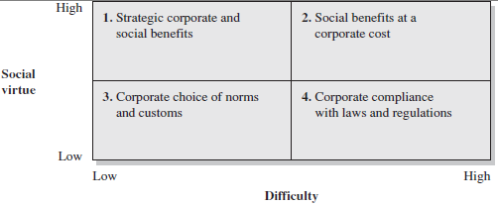
4
Competitive Strategy
The Socially Responsible Firm
Any strategy adopted by a new venture firm inevitably affects the welfare of its stakeholders: customers, suppliers, and the community.
Illustrating the FOUR possible responses to social responsibility challenges.
Chapter 4: Figure 4.11 – Social virtue matrix
Technology Ventures: From Idea to Enterprise

Slide 23
4
Competitive Strategy
Briefly describe the strategy of your college or school using the questions of Figure 4.2 and using success rather than profitability as the desired outcome.
Chapter 4: Exercise
Technology Ventures: From Idea to Enterprise

Slide 24
4
Competitive Strategy
VENTURE CHALLENGE
Develop a SWOT analysis using the format of table 4.4.
Select your strategic approach from table 4.6.
Describe your strategy in one or two sentences that could be circulated to your employees and allies.
Chapter 4: Venture Challenge
Technology Ventures: From Idea to Enterprise

Slide 25
4
Competitive Strategy
DVD Video
“Surviving Competition”
Jeff Housenbold (Shutterfly)
Chapter 4: DVD Video
Technology Ventures: From Idea to Enterprise

