Slide 1
Chapter 1
Introduction to System Administration
CSNB113 SYSTEM ADMINISTRATION
College of Information Technology
Universiti Tenaga Nasional (UNITEN)

Slide 2
Objectives
Define the system administrator’s position
Log in to root
Understand the usage of su command
Know the administrator’s roles and privileges
Able to explain the skills required to be a system administrator
Discover the UNIX architecture that includes the kernel and shell

Slide 3
Definition of System Administrator
A single-trusted person that is responsible to administrate the whole system
Known as superuser or root user (UNIX environment) - hold absolute power to the system
Use special user-id to log on to the system: root

Slide 4
root
Default user ID for system administrator – user ID and password is automatically created during installation
User ID = 0 (zero)
Use to perform administrative task

Slide 5
root (cont.)
Command for print working directory
login: root
password:
# pwd
/
#
Output: / means root directory
Prompt: # indicates login as root

Slide 6
su
su command - Switch from nonprivileged account to the superuser account
Other command: sudo <command>

Slide 7
su command with ‘-’ argument
login: surizal
password:
$ whoami
surizal
$ su –
password:
# pwd
/root
#
Argument ‘-’ ensures that the administrator is presented the same environment as he/she logged in to root
Recreates user’s environment
Runs as separate sub shell

Slide 8
su command without ‘-’ argument
To execute command as root but retain user’s current environment
login: surizal
password:
$ whoami
surizal
$ su
password:
# pwd
/home/surizal
#

Slide 9
Exit su mode
Exit sub shell
Press [Ctrl+d] or exit command
$ su –
password:
# exit
$

Slide 10
Administrator’s Privileges
Modify the contents or attributes of any files – although owned by other users
Initiate or kill any process – except essential for running the system
Change any user’s password – without entering the old password
Set the system clock
Control user’s access to;
  Scheduling service
  Networking service

Slide 11
Administrator’s Roles
Responsible for installing, supporting, and maintaining servers or other computer systems
  Installing and configuring new hardware and software
  Performing routine audits of systems and software
  Performing backups and restores
  Applying OS updates, patches, and configuration changes
  Adding, removing, or updating user accounts information such as resetting passwords

Slide 12
Administrator’s Roles (cont.)
Planning and responding to service outages and other problems that occur within the system
  Capacity planning
  Contributing and implementing Disaster Recovery (DR) and Business Continuity (BC) plans and planning
  Introducing and integrating new technologies into existing data center environments
  Analyzing system logs and identifying potential issues/problems in the systems
  Troubleshooting any reported problems

Slide 13
Administrator’s Roles (cont.)
Scripting; light programming, project management for systems-related projects, supervising or training computer operators
  Automate common or repetitive (routine) tasks
Consultant for computer problems beyond the knowledge of technical support staff
  Answering technical queries

Slide 14
Skills Required
Problem-solving skill
  On call when a computer system malfunction
  Quickly and correctly diagnose the crisis and produce the best solution
Analyzing skill
  Understand the behavior of software
    Deploy
    Troubleshoot problems

Slide 15
Skills Required
Programming skill
  Understand some various types of programming languages
  Scripting or automation of routine tasks
Soft-skills
  Users feel warm and know that their problems will be fixed in no time
  Good interaction among colleagues/team members

Slide 16
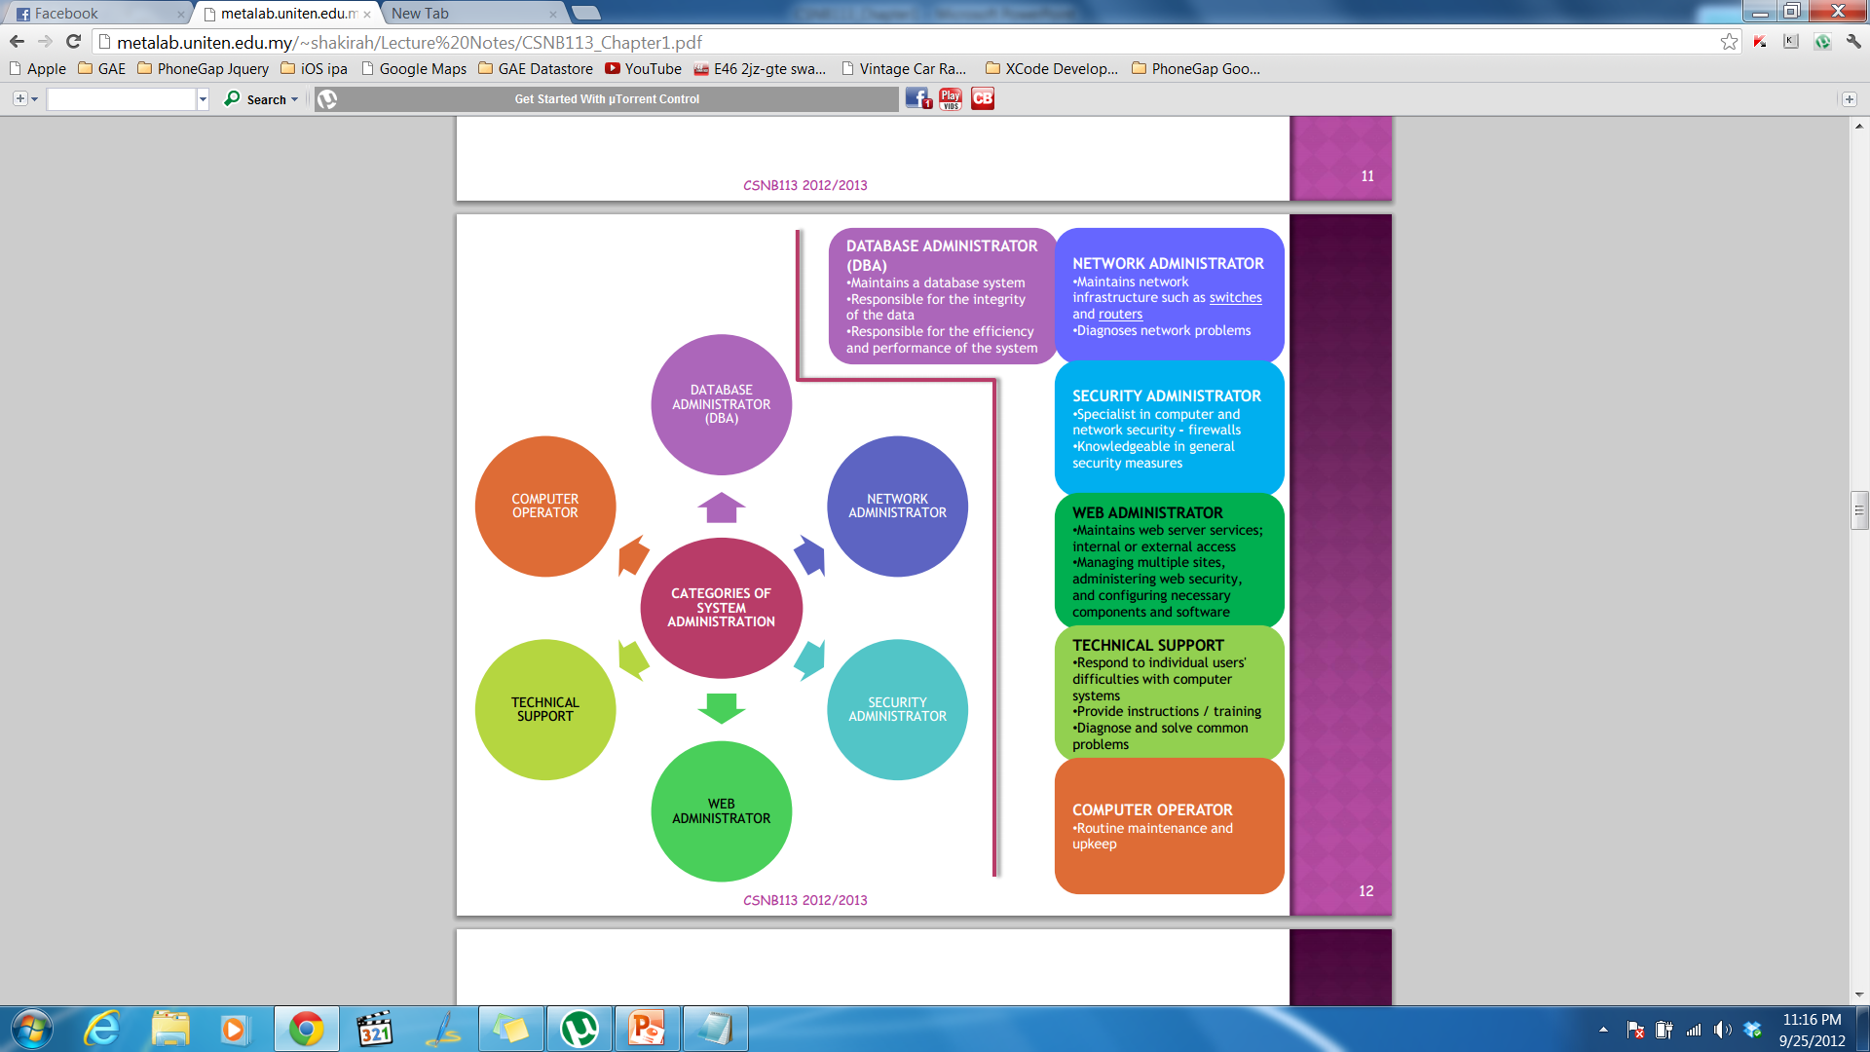
Categories of System Administrator
CATEGORIES OF SYSTEM ADMINISTRATOR

Slide 17
UNIX Architecture
Monitor
Hardware
User Interface tool
Software
Printer
CPU
Operating System
Shell
Hard Drive
Kernel
User
SN 2014
SN 2017

Slide 18
Kernel
Core of the operating system (OS)
Interacts with the machine hardware- most notably memory and CPU time
Part of the operating system that loads first, and it remains in main memory
Kernel code is usually loaded into a protected area of memory to prevent it from being overwritten by programs or other parts of the operating system.
When the computer starts, it goes through some initialization (booting) function, such as checking memory.
Perform housekeeping –memory, schedule processes, prioritize

Slide 19
Type of shell
sh
One of the original shells is Bourne shell called “sh”
Developed for Unix computers by Stephen Bourne at AT&T's Bell Labs in 1977
Offers features such as input and output redirection, shell scripting with string and integer variables, and condition testing and looping.
bash
Bourne-again Shell called bash
An upgrade for “sh” with several enhancements
Linux systems still offer the “sh” shell, but "bash“ has become the new default standard.
Ability to run “sh” shell scripts unchanged.

Slide 20
Type of shell
csh and tcsh
C-shell," csh, have been developed by Bill Joy at Berkeley University in 1978 using C syntax as a model.
Ken Greer took csh concepts a step forward with a new shell, tcsh, which Linux systems now offer.
Tcsh fixed problems in csh and added command completion, in which the shell makes educated "guesses" as you type, based on your system's directory structure and files.
Tcsh does not run bash scripts, as the two have substantial differences.
ksh
Developed by David Korn , korn shell or ksh about the time tcsh was introduced.
Compatible with sh and bash.
Improves on the Bourne shell by adding floating-point arithmetic, job control, command aliasing and command completion.
AT&T held proprietary rights to ksh until 2000, when it became open source.

Slide 21
Prompt
The prompt, $, which is called command prompt, is issued by the shell. While the prompt is displayed, you can type a command.
The shell reads your input after you press Enter. It determines the command you want executed by looking at the first word of your input. A word is an unbroken set of characters. Spaces and tabs separate words.

Slide 22
Common Term
Uptime - time that the system is running ('up'), or should be up
  Time since last reboot
  % of time the system is up
Downtime – time when the system is not running
  Scheduled (planned) downtime: the administrator purposely shuts down or reboots the system; eventually the users are informed in advance
  Unscheduled (unplanned) downtime: the system fails: 'crash', no power, BSOD (Blue Screen Of Death), kernel panic

Slide 23
Unscheduled Downtime: Precaution
Uninterruptable Power Supply (UPS)
  Provides immediately 'kick-in' continuous power supply from batteries without affecting the server operation
'Intelligent' UPS communicates with machine:
  Warning the operator/user that mains is gone
  Shuts down the machine shortly before the batteries are exhausted
Dual Power Supplies
  Each is able to power the machine on its own. When one is defunct, the other can take over immediately and completely ('Redundant‘)

Slide 24
Unscheduled Downtime: Precaution (cont.)
Dual fans
  When one fan stops functioning, a second fan sets in automatically and immediately
Redundant hard disks
  When one hard disk fails, a replacement hard disk takes over transparently

Slide 25
References
Das, S. (2012). Your UNIX/LINUX The Ultimate Guide: Third Edition. McGraw-Hill
Hahn, H. (2008). Harley Hahn's Guide to Unix and Linux. California: McGraw-Hill Higher Education

