Slide 1
Chapter 7
Installing Program &Backup Tool
CSNB113 SYSTEM ADMINISTRATION
College of Information Technology
Universiti Tenaga Nasional (UNITEN)

Slide 2
Objectives
apt as package manager
Managing program using apt
dpkg as advance package manager

Slide 3
Introduction
UNIX is quite fragmented in the area of package management
No standard tool to install and remove packages
Package is a software, including installation instructions, helper files, documentation (the famous 'man'-pages) into a package; a bit like an archive

Slide 4
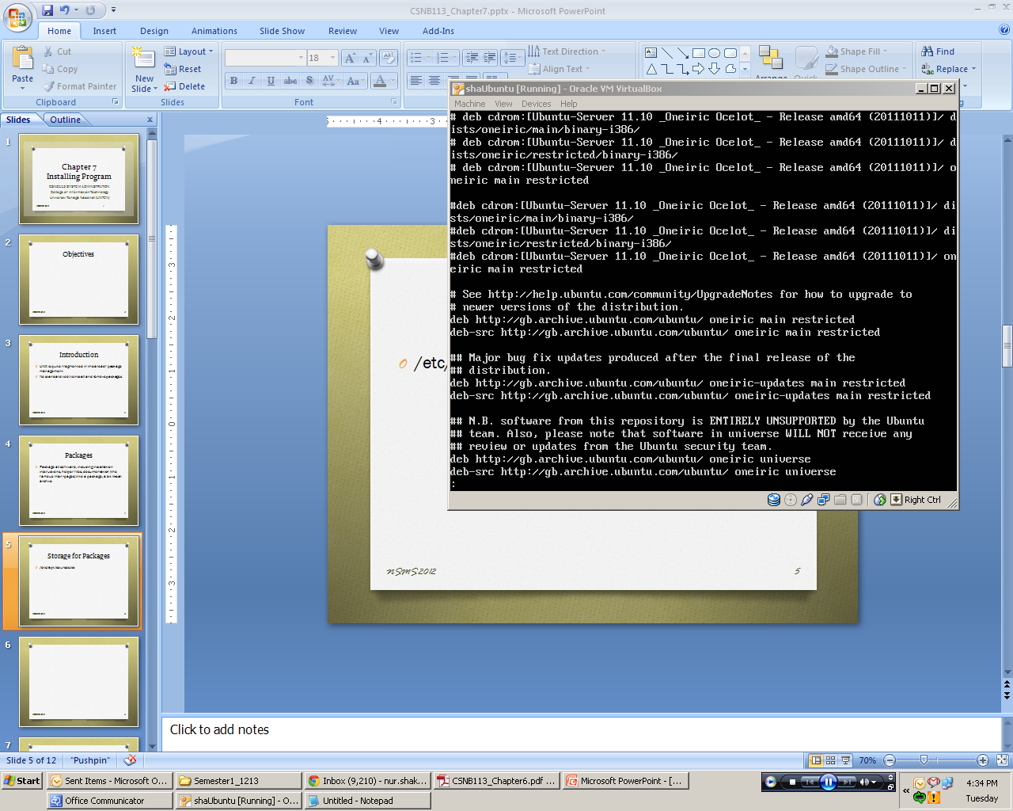
Storage for Packages
/etc/apt/sources.list

Slide 5
Packages Management
Most modern Unix-like operating systems offer a centralized mechanism for finding and installing software.
Software is usually distributed in the form of packages, kept in repositories. Working with packages is known as package management.
A package management system does much more than one-time installation of software.
It also provides tools for upgrading already-installed packages.
Package repositories help to ensure that code has been vetted for use on your system, and that the installed versions of software have been approved by developers and package maintainers.

Slide 6
Packages Management
Most package systems are built around collections of package files. A package file is usually an archive which contains compiled binaries and other resources making up the software, along with installation scripts.
Packages also contain valuable metadata, including their dependencies, a list of other packages required to install and run them.
In Debian and systems based on it, like Ubuntu, Linux Mint, and Raspbian, the package format is the .deb file.

Slide 7
Advanced Packaging Tool (APT)
APT provides commands used for most common operations: Searching repositories, installing collections of packages and their dependencies, and managing upgrades.
APT commands operate as a front-end to the lower-level dpkg utility, which handles the installation of individual .deb files on the local system, and is sometimes invoked directly.

Slide 8
Updating Packages
Resynchronize the package index files from their sources
Indexes of available packages location(s): /etc/apt/sources.list
Should perform before upgrade
# apt-get update

Slide 9
Upgrading Packages
Install newest versions of all packages currently installed on the system from the sources enumerated in /etc/apt/sources.list
An update must be performed first so that apt-get knows that new versions of packages are available
# apt-get upgrade

Slide 10
Searching Packages
Most distributions offer a graphical or menu-driven front end to package collections.
These can be a good way to browse by category and discover new software.
Often, however, the quickest and most effective way to locate a package is to search with command-line tools.
Example: : I want to search any package that consists game
# apt-cache search game

Slide 11
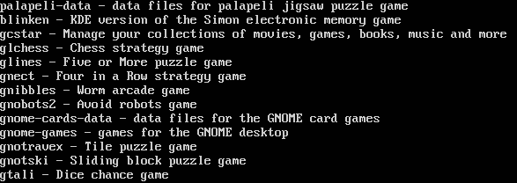
Searching Packages
Output:

Slide 12
Packages Description
When deciding what to install, it's often helpful to read detailed descriptions of packages.
Along with human-readable text, these often include metadata like version numbers and a list of the package's dependencies.
Searches package names, short descriptions, package name on all available package list
# apt-cache show gnibbles

Slide 13
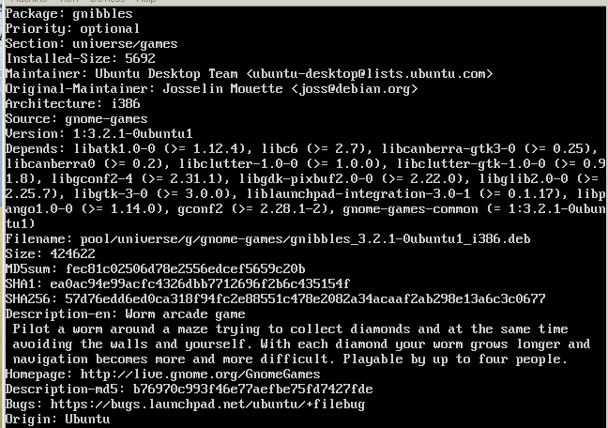
Packages Description

Slide 14
Install a Package from Repositories
Once you know the name of a package, you can usually install it and its dependencies with a single command. In general, you can supply multiple packages to install simply by listing them all.
Command | Description
# apt-get install packages | Performs installation of the packages or upgrading of the current filename
# apt-get install packages packages2 packages3 Get | Installs all listed packages.

Slide 15
Removing Packages
Since a package manager knows what files are provided by a given package, it can usually remove them cleanly from a system if the software is no longer needed.
Command | Description
# sudo apt-get remove package | Remove the selected packages
# sudo apt-get autoremove | Removes unneeded packages.

Slide 16
Install a Package from the Local Filesystem
Sometimes, even though software isn't officially packaged for a given operating system, a developer or vendor will offer package files for download.
This packages can be usually retrieve from the web browser, or via curl on the command line. Once a package is on the target system, it can often be installed with a single command:
On Debian-derived systems, dpkg handles individual package files.
sudo dpkg -i package.deb

Slide 17
Backup Tool
Backup and recovery is essential. Failure to have verified backup and recovery procedures puts your data at risk of loss.
Users often only learn this lesson after critical information they require is permanently lost. Attempting to recover from data loss can be both time consuming and extremely difficult.
So learn from others mistakes, and ensure beforehand that you have a system in place that protects your data and suits your needs.
System administrator is responsible for the safety of the data
  Action: Perform periodically backup

Slide 18
Archive
tar command: Combine a group of files into a single file (tape archive)
Key options | Description
-c | Creates an archive
-x | Extracts files from archive
-t | Displays files in archive
-v | Verbose – shows the progress
-f | Specify archive’s name

Slide 19
Create a File Archive
$ tar –cvf archive.tar index.html pic2.jpg
index.html
pic2.jpg
Note:
  c option: create a file archive
  v option: shows the progress
  f option: specify archive’s name

Slide 20
Extract a File Archive
$ tar –xvf archive.tar
index.html
pic2.jpg
Note:
  x option: extract a file archive
  v option: shows the progress
  f option: specify archive’s name

Slide 21
Display the Content of a File Archive
$ tar –tvf archive.tar
-rw-r--r-- bob/bcs 3875302 2012-Aug-01 20:11 index.html
-rw-r--r-- bob/bcs 372267 2012-Aug-01 20:11 pic2.jpg
Note:
  t option: table of contents
  v option: shows the progress
  f option: specify archive’s name

Slide 22
Compression/Decompression: gzip
Provides an extension .gz to the compressed filename and removes the original file
z option: Using with tar – creating compressed archived
Example 1: Compress and create an archive
Example 2: Decompress then extract an archive
$ tar –cvfz archive.tar.gz index.html pic2.jpg
$ tar –xvfz archive.tar.gz

Slide 23
References
Das, S. (2012). Your UNIX/LINUX The Ultimate Guide: Third Edition. McGraw-Hill
Hahn, H. (2008). Harley Hahn's Guide to Unix and Linux. California: McGraw-Hill Higher Education

