Slide 1
Chapter 8
The Shell
CSNB113 SYSTEM ADMINISTRATION
College of Information Technology
Universiti Tenaga Nasional (UNITEN)

Slide 2
Objectives
Gain an overview of the shell’s interpretive cycle
Learn the significance of metacharacters and their use in wild wards for matching multiple filenames
Know the use of escaping and quoting to remove the meaning of metacharacter
Learn the difference between the use of double and single quotes
Implementation of pipelines
Use the man command to browse the UNIX documentation
Understand the organization of the documentation
Understand shell variables

Slide 3
Objectives
Find out the users of the system with who
Use passwd to change user’s password
Display message with echo
Display system date with date
Create and remove directories with mkdir and rmdir
Navigate the file system with cd and pwd
List files with ls
Copy, rename, and delete files with cp, mv, rm
View text files with cat

Slide 4
The Shell as Command Processor
Shell issues the prompt and waits for the next command
Shell scans the command line for metacharacters
Translate metacharacters and recreate a simplified command line
User enter command
Shell passes the command to the kernel for execution
Shell waits for the command to complete
Prompt reappears
Metacharacters: >, |, *, ?

Slide 5
The Wild Cards – Pattern Matching
Metacharacters (*, ?, [ and ]) used to match filenames belong to a category
Any word containing a wild card is replaced with a sorted list of filenames that match the pattern

Slide 6
* - Asterisk
Matches any number of characters including none
Example:
$ ls
chap chap01 chap02 chap03 chap04
chapx chapy chapz draft01 draft02
$ ls chap*
chap chap01 chap02 chap03 chap04
chapx chapy chapz

Slide 7
? – Question Mark
? Matches single of character
Example:
$ ls chap
chap chap01 chap02 chap03 chap04
chapx chapy chapz draft01 draft02
$ ls chap?
chapx chapy chapz
$ ls chap??
chap01 chap02 chap03 chap04

Slide 8
[] – Rectangular Brackets
Matches single of character in the class
Example:
$ ls chap
chap chap01 chap02 chap03 chap04
chapx chapy chapz draft01 draft02
$ ls chap0[124]
chap01 chap02 chap04
$ ls chap0[1-4]
chap01 chap02 chap03 chap04
$ ls [c-d]?
chapx chapy chapz

Slide 9
Escaping
Providing a \ (backslash) before the wildcard to remove its special meaning – turned off

Slide 10
\ : Escaping the Space
Escaping the space
Example: remove a filename “My Doc”
Without the \ rm would see 2 files; My and Doc
$ ls
My Doc My Personal
$ rm My\ Doc

Slide 11
\ : Escaping the \ Itself
Escaping the \
Example:
$ echo “Escaping the \\ Itself”
Escaping the \ Itself

Slide 12
\ : Ignoring the Newline Character
Use during a long-line-single command execution
Example:
$ echo sn012345 | mailx -a CSNB113_Chap8.ppt \
> -s “Chapter8” surizal@metalab.uniten.edu.my

Slide 13
Quoting
Another way to turn off the meaning/effect of a special character;
Single quotes – protect special characters (disable)
Double quotes – lenient. Do not protect $ and ` (backquote)
  ` : shell execute the enclosed command and replaces it with the output of the command
$ echo ‘The examples of metacharacter are |, <, >, and $’
The examples of metacharacter are |, <, >, and $
$ echo “The date today is `date`”
The date today is Sat Sep 7 20:20:18 GMT 2012

Slide 14
| : Pipes
Enable command to obtain its standard input from the standard output of the other command
surizal@sn12345-csnb113:~$ ifconfig | grep inet
inet addr:172.20.16.20 Bcast:172.20.16.255 Mask: 255.255.255.0
iet6 addr: fe80 : : a00 : 27ff : febb : dc33/64 Scope : Link
inet addr:127.0.0.1 Mask : 255.0.0
iet6 addr: : : 1/128 Scope : Host
surizal@sn12345-csnb113:~$

Slide 15
man
man command – most complete and authoritative guide of UNIX manual documentation
$ man <command>

Slide 16
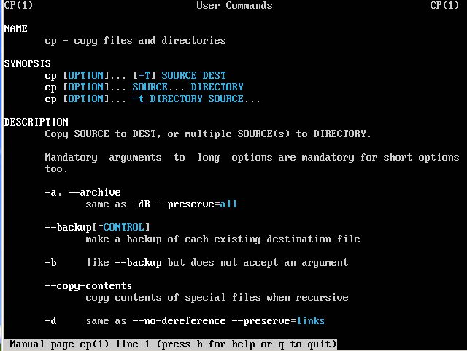
man
Example: man cp
SECTION 1: NAME
SECTION 2: SYNOPSIS
SECTION 3: DESCRIPTION

Slide 17
Sections in man
NAME – presents a one-line introduction to the command
SYNOPSIS – syntax used by the command
DESCRIPTION – provides detailed description

Slide 18
Shell Variables
Variable assignment: variable=value
Variable concatenation
$ SENTENCE1=“I study CSNB113”
$ echo $SENTENCE1
I study CSNB113
$ EXTENSION=“.avi”
$ MOVIENAME=“IronM”
$ FILENAME=$MOVIENAME$EXTENSION
$ echo $FILENAME
$ IronM.avi

Slide 19
Shell Variables
Rules and regulations
  Must begin with a letter; can contains numerals
  Case sensitive
  No type
  Can use without declaration
Remove variable
Protect variable from reassignment
$ unset SENTENCE1
$ readonly SENTENCE1

Slide 20
Shell Variables - HOME
Shell variable HOME maintains the absolute pathname of user’s directory:
$ echo $HOME
/home/sn010101

Slide 21
Common Commands

Slide 22
who
who command: shows the current user(s) logged in
surizal@sn12345-csnb113:~$ who
surizal tty1 2013-12-06 08:20
surizal@sn12345-csnb113:~$

Slide 23
whoami
whoami command: print the username associated with the current effective userid
surizal@sn12345-csnb113:~$ whoami
surizal
surizal@sn12345-csnb113:~$

Slide 24
passwd
surizal@sn12345-csnb113:~$ passwd
Changing password for surizal.
(current) UNIX password :
Enter new UNIX password :
Retype new UNIX password :
Passwd: password updated succesfully
surizal@sn12345-csnb113:~$ _
passwd command: change the user’s password
surizal@sn12345-csnb113:~$ sudo passwd sn010101
[sudo] password for surizal :
Enter new UNIX password :
Retype new UNIX password :
Passwd: password updated succesfully
surizal@sn12345-csnb113:~$ _

Slide 25
date
date command: shows the date and time to the nearest second
$ date
Sat Sep 7 20:20:18 GMT 2012

Slide 26
echo
echo command: display messages to your terminal
Can also use to evaluate shell variables
$ echo “CSNB113”
CSNB113
$ echo $PATH
/usr/local/sbin:/usr/local/bin:/usr/sbin:/usr/bin:/sbin:/bin:/usr/games

Slide 27
cat
cat command: view the content of the file
surizal@sn12345-csnb113:~$ cat file1
Hello World from file1
My name us Surizal
This is the end of file1
surizal@sn12345-csnb113:~$ _

Slide 28
pwd
pwd command: print working directory
Display absolute pathname
$ pwd
/home/surizal
$ cd dirTutorial
$ pwd
/home/surizal/dirTutorial1

Slide 29
cd
cd command: change directory
cd without argument – return to user’s home directory
$ pwd
/home/surizal
$ cd /etc
$ pwd
/etc
$ cd
$ pwd
/home/surizal

Slide 30
mkdir
mkdir command: creates one or more directories
$ mkdir dir01
$ mkdir dir02 dir03 dir04
$ mkdir tree1 tree1/sub1 tree1/sub2

Slide 31
ls
ls command: lists file – reads the current directory
Directory name as argument – display its content
l option: long listing

Slide 32
ls
$ ls
dir01 dir02 dir03 dir04 tree1
$ ls –l
drwxrwxr-x 2 surizal surizal 4096 2012-10-01 20:12 dir01
drwxrwxr-x 2 surizal surizal 4096 2012-10-01 20:15 dir02
drwxrwxr-x 2 surizal surizal 4096 2012-10-01 20:15 dir03
drwxrwxr-x 2 surizal surizal 4096 2012-10-01 20:15 dir04
drwxrwxr-x 4 surizal surizal 4096 2012-10-01 20:20 tree1
$ ls tree1
sub1 sub2

Slide 33
rmdir
rmdir command: removes empty directories
$ rmdir dir01
$ rmdir dir02 dir03 dir04

Slide 34
cp
cp command: copies one or more files or directory structures
cp <source> <destination>
$ cp /etc/apt/sources.list /home/surizal
$ pwd
/home/surizal
$ cp /etc/apt/apt.conf .

Slide 35
mv
mv command: renames a file or directory and move a/multiple file(s) to a directory
mv <oldName> <newName>
$ mv sources.list sources.list.txt
$ mv apt.conf sources.list.txt dir01

Slide 36
rm
rm command: deletes files and directories
$ pwd
/home/surizal/dir01
$ ls
apt.conf sources.list.txt
$ rm apt.conf
$ cd ..
$ rm dir01

Slide 37
References
Das, S. (2012). Your UNIX/LINUX The Ultimate Guide: Third Edition. McGraw-Hill
Hahn, H. (2008). Harley Hahn's Guide to Unix and Linux. California: McGraw-Hill Higher Education

