Slide 1
CHAPTER 14
Introduction to System Administration

Slide 2
Definition of System Administrator
A single-trusted person that is responsible to administrate the whole system
Known as administrator or root user (UNIX environment) - hold absolute power to the system
Use special user-id to log on to the system: root

Slide 3
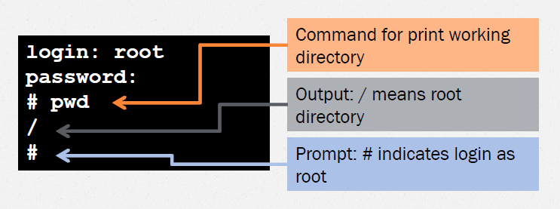
root
Default user ID for system administrator – user ID and password is automatically created during installation
User ID = 0 (zero)
Use to perform administrative task

Slide 4
Administrator’s Privileges
Modify the contents or attributes of any files – although owned by other users
Initiate or kill any process – except essential for running the system
Change any user’s password – without entering the old password
Set the system clock
Control user’s access to;
Scheduling service
Networking service

Slide 5
Administrator’s Roles
Responsible for installing, supporting, and maintaining servers or other computer systems
Installing and configuring new hardware and software
Performing routine audits of systems and software
Performing backups and restores
Applying OS updates, patches, and configuration changes
Adding, removing, or updating user accounts information such as resetting passwords

Slide 6
Administrator’s Roles (cont.)
Planning and responding to service outages and other problems that occur within the system
Capacity planning
Contributing and implementing Disaster Recovery (DR) and Business Continuity (BC) plans and planning
Introducing and integrating new technologies into existing data center environments
Analyzing system logs and identifying potential issues/problems in the systems
Troubleshooting any reported problems

Slide 7
Administrator’s Roles (cont.)
Scripting; light programming, project management for systems-related projects, supervising or training computer operators
Automate common or repetitive (routine) tasks
Consultant for computer problems beyond the knowledge of technical support staff
Answering technical queries

Slide 8
Skills Required
Problem-solving skill
  On call when a computer system malfunction
  Quickly and correctly diagnose the crisis and produce the best solution
Analyzing skill
  Understand the behavior of software
    Organize
    Troubleshoot problems

Slide 9
Skills Required
Programming skill
  Understand some various types of programming languages
  Scripting or automation of routine tasks
Soft-skills
  Users feel warm and know that their problems will be fixed in no time
  Good interaction among colleagues/team members

Slide 11
Understanding System Software:
Two basic types of software
  Application software
  System software

Slide 12
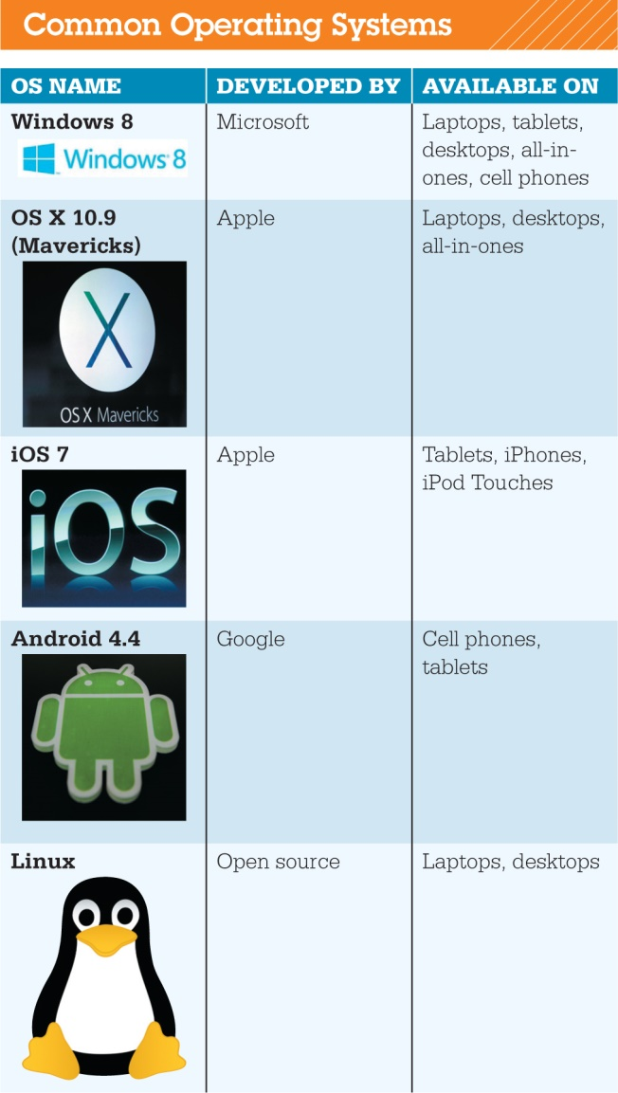
Operating System
Categorized by device
  Mainframes
  Network computers
  Personal computers
  Mobile devices
  Robots

Slide 13
Operating System
Operating System Fundamentals
    Multitasking
    Networking capabilities
    Categorized by type

Slide 14
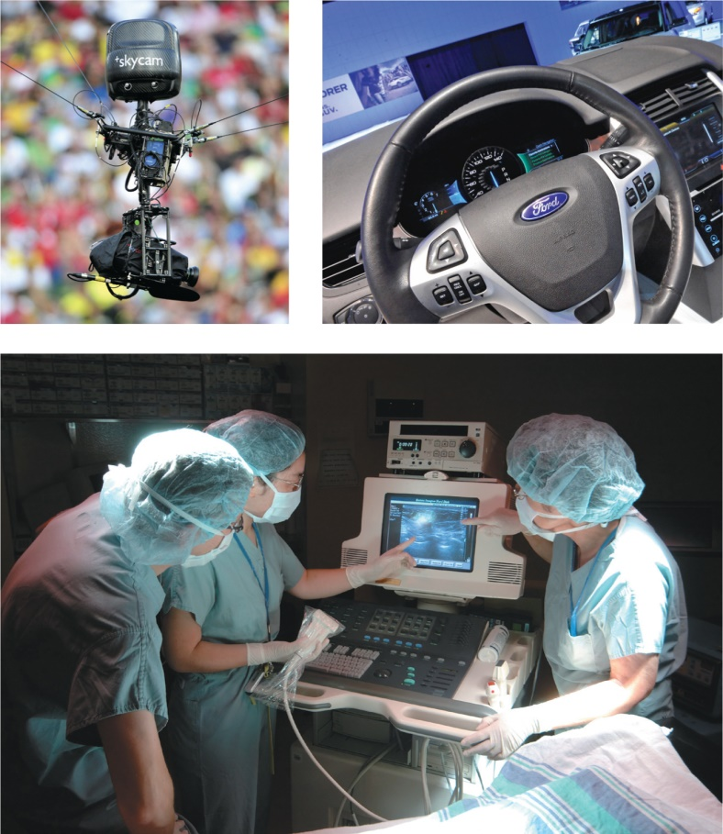
Type of OS : Real-Time Operating Systems
Used for machinery
Minimal user interaction
  Car engines
  Medical devices
  Common appliances
  Robotic cameras

Slide 15
Type of OS : Operating Systems for Networks, Servers, and Mainframes
Multiuser operating system
Networks
Manage user requests
Examples
  Windows Server
  Linux
  UNIX
UNIX
  Multiuser, multitasking operating system
  Network operating system
  The Open Group

Slide 16
Types of OS: Operating Systems for Mobile Devices
Smartphones
  Multitasking capabilities
Gaming systems and personal media players
  Require system software developed for the device

Slide 17
Types of OS: Operating Systems for Personal Computers
Top three operating systems
  Windows
  Max OS X
  Linux

Slide 18
Types of OS : Operating Systems for Personal Computers
Mac OS
  El Capitan
  Mac OS X based on UNIX

Slide 19
Types of OS : Operating Systems for Personal Computers
Linux
  Open source OS
  Personal computer and network OS
  Stable OS
  Quickly modified or updated

Slide 20
Types of OS : Operating Systems for Personal Computers
Cloud-based OS
  Prototypes being developed
  Still need a computer, operating system, and web browser
  Enables users to access applications and content via the web anywhere, on any machine, and at any time
  Google is taking steps toward developing a complete web-based operating system

Slide 21
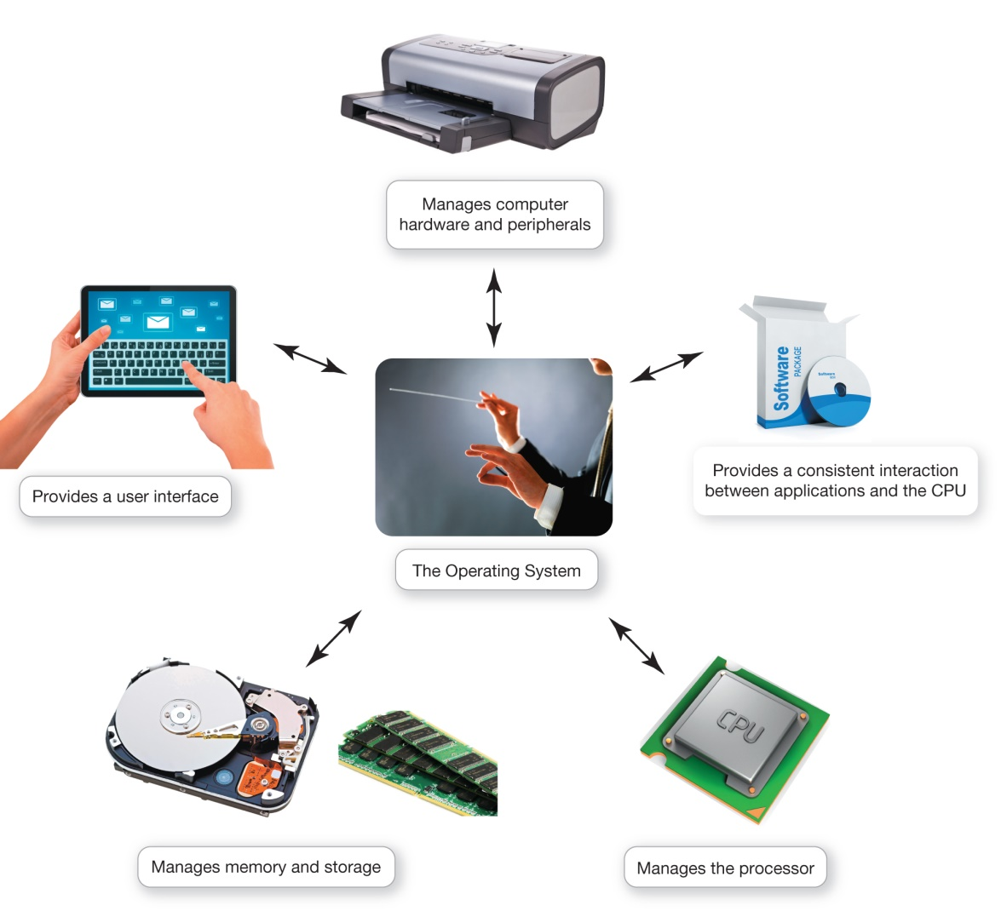
What the Operating System Does
OS: Coordinates and directs the flow of data and information through the computer system

