Slide 1
CHAPTER 10
MEMORY
CSNB153 COMPUTER SYSTEM
CSNB153 coMPUTER System

Slide 2
Limitation in Computer Performance
CGMB143 COMPUTER SYSTEM
CSNB153 COMPUTER SYSTEM
Memory speed slower than the processor’s speed

Slide 3
Objective
CGMB143 COMPUTER SYSTEM
CSNB153 COMPUTER SYSTEM
To study the development of an effective memory organization that supports the processing power of the CPU

Slide 4
Key Characteristics of Computer Memory Systems
CGMB143 COMPUTER SYSTEM
CSNB153 COMPUTER SYSTEM
Location
  Internal
  External
Capacity
  Number of words
  Number of bytes
Unit of transfer
  Word
  Block
Access method
  Sequential
  Direct
  Random
  Associative
Performance
  Access time
  Cycle time
  Transfer rate

Slide 5
Key Characteristics of Computer Memory Systems (Cont.)
CGMB143 COMPUTER SYSTEM
CSNB153 COMPUTER SYSTEM
Physical type
  Semiconductor
  Magnetic
  Optical
  Magneto-optical
Physical characteristics
  Volatile/nonvolatile
  Erasable/nonerasable
Organization
  Memory modules

Slide 6
Terminology
CGMB143 COMPUTER SYSTEM
CSNB153 COMPUTER SYSTEM
Terminology | Description
Capacity | Amount of information that can be contained in a memory unit (word / bytes)
Word | Natural unit of organization in the memory. 1 byte or word = 8 bits
Addressable unit | Fundamental data element size that can be addressed in the memory
Unit of transfer | Number of data elements transferred at a time Bits – main memory Word – secondary memory
Transfer rate | Rate at which data is transferred to/from the memory device

Slide 7
Terminology (Cont.)
CGMB143 COMPUTER SYSTEM
CSNB153 COMPUTER SYSTEM
Terminology | Description
Access time | RAM – time to address unit and transfer Secondary storage – time to position R/W head over the location
Memory cycle time | Access time taken before starting the next access
Access technique | Method to access the memory’s content

Slide 8
Access Method
CGMB143 COMPUTER SYSTEM
CSNB153 COMPUTER SYSTEM
Sequential
Direct
Random
Associative

Slide 9
Access Method - Sequential
CGMB143 COMPUTER SYSTEM
CSNB153 COMPUTER SYSTEM
Start at the beginning and read through in order
Access time depends on location of data and previous location
Example: tape
S
T
A
R
T
D1
D2
D3
D4
D5
D6
D7
901
902
903
904
905
906
907

Slide 10
Access Method - Direct
CGMB143 COMPUTER SYSTEM
CSNB153 COMPUTER SYSTEM
Individual blocks have unique address
Access is by jumping to vicinity plus sequential search
Access time depends on location and previous location
Example: Disk

Slide 11
Access Method – Direct (Cont.)
CGMB143 COMPUTER SYSTEM
CSNB153 COMPUTER SYSTEM
S
T
A
R
T
Block 1
Block 2
Block 3
D1
D2
D3
D4
D5
D6
D8
D9
D10
D11

Slide 12
Access Method - Random
CGMB143 COMPUTER SYSTEM
CSNB153 COMPUTER SYSTEM
Individual addresses identify locations exactly
Access time is independent of location or previous access
Example: RAM
D1
D2
D3
D4
D5
D6
D7
901
902
903
904
905
906
907

Slide 13
Access Method - Associative
CGMB143 COMPUTER SYSTEM
CSNB153 COMPUTER SYSTEM
Data is located by a comparison with contents of a portion of the store
Access time is independent of location or previous access
Example: cache

Slide 14
Memory Hierarchy
CSNB153 COMPUTER SYSTEM
Design objectives
  Adequate capacity
  Performance
  Cost

Slide 15
Memory Hierarchy
CSNB153 COMPUTER SYSTEM
How to achieve the design objectives?
  Hierarchy of storage devices
  Automatic space allocation methods - efficient
  Virtual memory techniques
  Design the memory and its related interconnection structure – compatible with processor speed

Slide 16
Memory Hierarchy - Basis
Registers internal to the CPU - temporary data storage (small in number but very fast)
External storage for data and programs (large and fast)
External permanent storage (much larger and much slower)

Slide 17
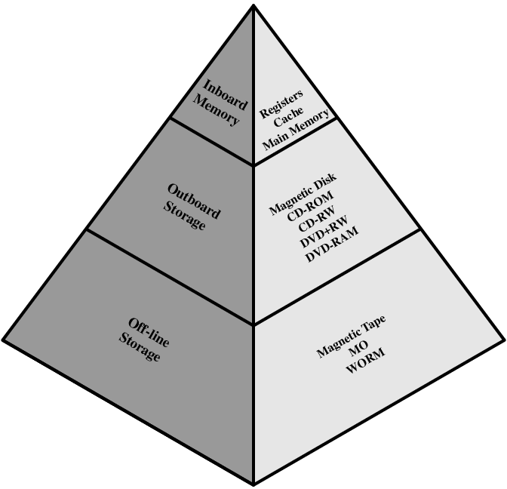
Memory Hierarchy - Basis

Slide 18
Memory Hierarchy - Characteristic
Consists of distinct “levels” of memory components
Each level characterized by its size, access time, and cost per bit
Each lower level in the hierarchy consists of modules of larger capacity, slower access time, and lower cost/bit

Slide 19
Common Memory Parameters
Memory Type | Technology | Size | Access Time
Cache | Semiconductor RAM | 128-512 KB | 10 ns
Main Memory | Semiconductor RAM | 4-128 MB | 50 ns
Magnetic Disk | Hard Disk | Gigabyte | 10 ms,10 MB/sec
Optical Disk | CD-ROM | Gigabyte | 300 ms, 600 KB/sec
Magnetic Tape | Tape | 100s MB | Sec-min.,10MB/min

Slide 20
Hierarchy List
Registers
L1 Cache
L2 Cache
Main memory
Disk cache
Disk
Optical
Tape

Slide 21
Cache Memory
CGMB143 COMPUTER SYSTEM
CSNB153 COMPUTER SYSTEM

Slide 22
Cache Memory
Critical component of the memory hierarchy
  Size – smaller than main memory
  Operates +- speed of the processor
  Expensive than main memory
  Stores copies of section of main memory

Slide 23
Cache
Small amount of fast memory
Sits between normal main memory and CPU
May be located on CPU chip or module

Slide 24
Cache and Main Memory – Single Cache
CGMB143 COMPUTER SYSTEM
CSNB153 COMPUTER SYSTEM
CPU
Cache
Main Memory

Slide 25
Cache and Main Memory – Three-level Cache Organization
CGMB143 COMPUTER SYSTEM
CSNB153 COMPUTER SYSTEM
Main Memory
Level 2 (L2) Cache
Level 3 (L3) Cache
CPU
Level 1 (L1)
Cache

Slide 26
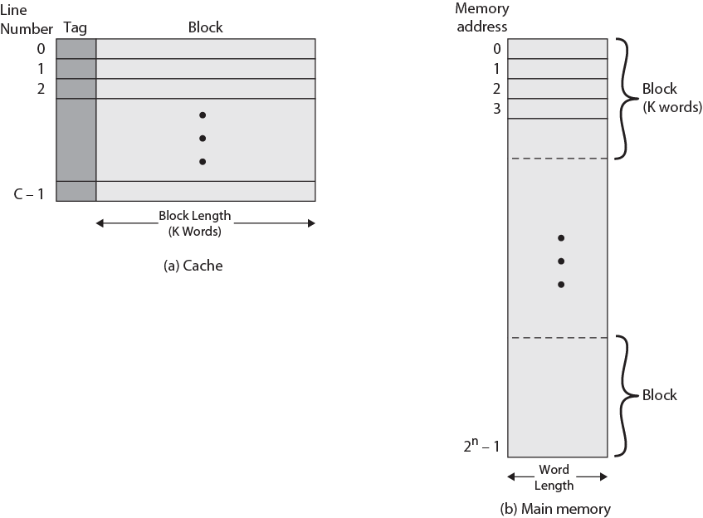
Cache/Main Memory Structure

Slide 27
Cache Operation - Overview
CPU requests contents of memory location
Check cache for this data
If present, get from cache (fast)
If not present, read required block from main memory to cache
Then deliver from cache to CPU
Cache includes tags to identify which block of main memory is in each cache slot

Slide 28
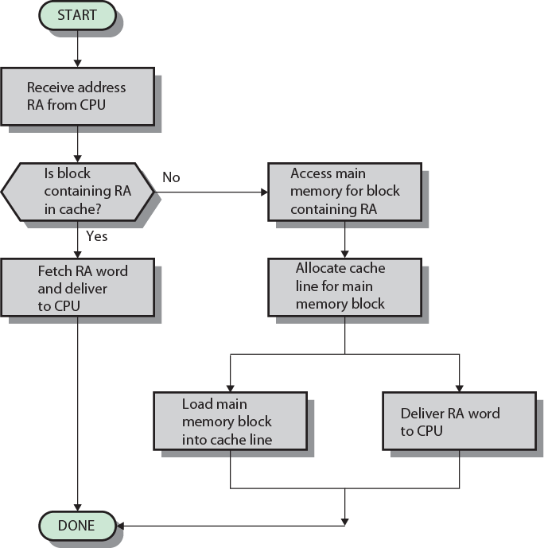
Cache Read Operation

Slide 29
Locality of Reference
Memory references made by the processor, for both instructions and data, tend to cluster together
  Instruction loops, subroutines
  Data arrays, tables
Keep these clusters in high speed memory to reduce the average delay in accessing data
Over time, the clusters being referenced will change -- memory management must deal with this

Slide 30
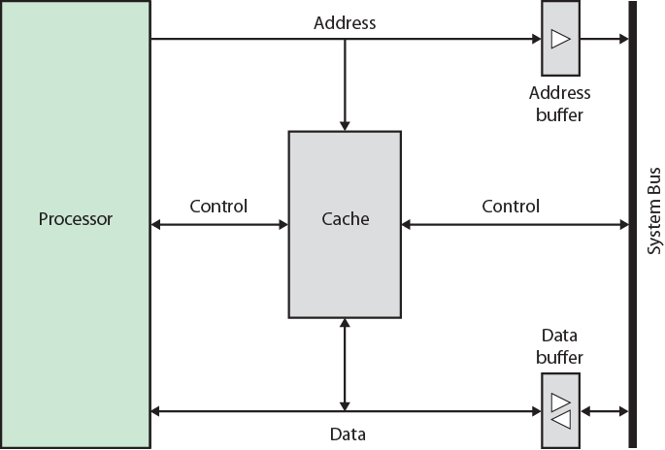
Typical Cache Organization

Slide 31
Elements of Cache Design
CSNB153 COMPUTER SYSTEM
Cache address
  Logical
  Physical
Cache size
Mapping Function
  Direct
  Associative
  Set Associative
Line Size
Number of caches
  Single or two level
  Unifies or split
Replacement algorithm
  Least recently used (LRU)
  First in first out (FIFO)
  Lease frequently used (LFU)
  Random
Write policy
  Write through
  Write back
  Write once

Slide 32
Cache Address
Location
  Between processor and virtual Memory Management Unit (MMU)
  Between MMU and main memory
Logical
Physical
MMU function – to translate each virtual address into physical address in main memory.

Slide 33
Logical address
Physical address
Processor
MMU
Main Memory
Cache
Data
Logical Cache
Physical address
Processor
MMU
Main Memory
Cache
Physical Cache

Slide 34
Cache Address - Logical
Stores data using virtual addresses
Processor accesses cache directly, not thorough physical cache
Cache access faster, before MMU address translation
Virtual addresses use same address space for different applications
  Must flush cache on each context switch – changing from one thread/process to another.

Slide 35
Cache Address - Physical
Stores data using main memory physical address

Slide 36
Cache Size
Cost
  More cache is expensive
Speed
  More cache is faster (up to a point)
  Checking cache for data takes time

Slide 37
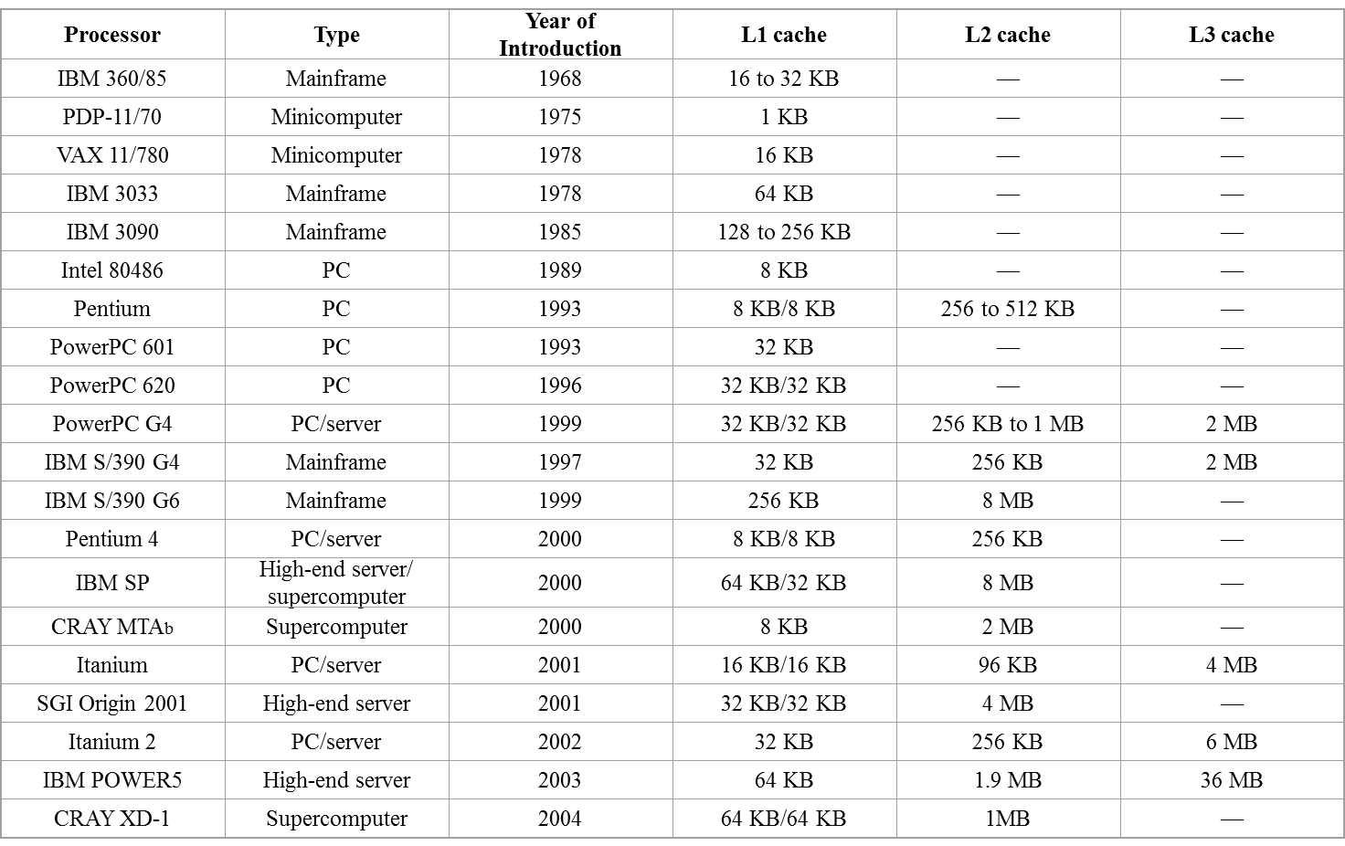
Cache Size on Some Processors

Slide 38
Mapping Function
Determines how a block from the main memory is placed in the cache
Mapping techniques;
  Direct
  Associative
  Set associative

Slide 39
To be used as sample
Cache of 64kByte
Cache block of 4 bytes
  i.e. cache is 16k (2¹⁴) lines of 4 bytes
16MBytes main memory
24 bit address
  (2²⁴=16M)

Slide 40
Direct Mapping
Each block of main memory maps to only one cache line
Address is in two parts
  Least Significant w bits identify unique word
  Most Significant s bits specify one memory block
    The MSBs are split into a cache line field r and a tag of s - r (most significant)

Slide 41
Direct Mapping Address Structure
Tag s - r
Line or Slot r
Word w
8
14
2
24 bit address
2 bit word identifier (4 byte block)
22 bit block identifier
8 bit tag (=22-14)
14 bit slot or line
No two blocks in the same line have the same Tag field
Check contents of cache by finding line and checking Tag

Slide 42
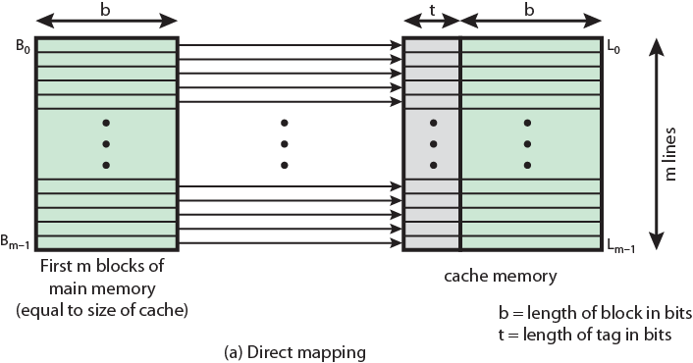
Direct Mapping from Cache to Main Memory

Slide 43
Direct Mapping Cache Line Table
Cache line | Main Memory blocks assigned
0 | 0, m, 2m, 3m…2^{s}-m
1 | 1,m+1, 2m+1…2^{s}-m+1
…
m-1 | m-1, 2m-1,3m-1…2^{s}-1

Slide 44
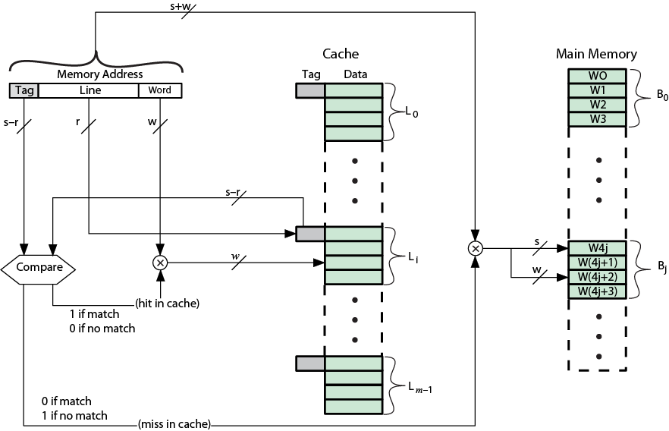
Direct Mapping Cache Organization

Slide 45
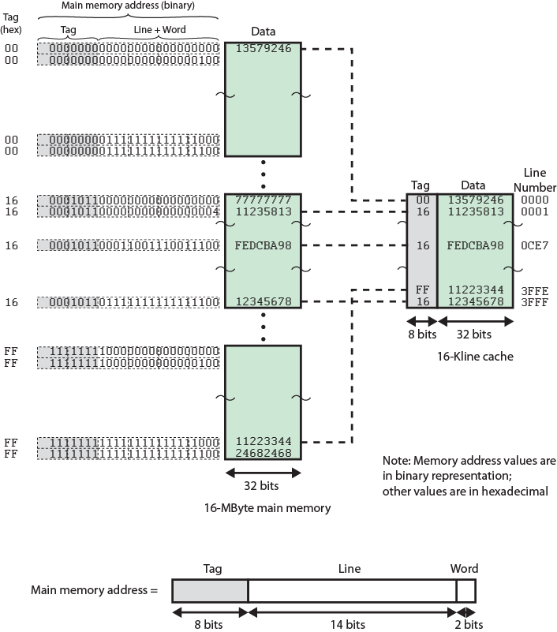
Direct Mapping Example

Slide 46
Direct Mapping - Steps
Steps to calculate the number of bit for tag, line and word in main memory address
  1.Find Bit-address
  2.Find word, w
  3.Find line, l
  4.Find Tag
Tag | Line | Word
Bit address (length)

Slide 47
Step 1: Find Bit Address
Example:
◦ Cache capacity= 64 Kbyte
◦Cache block capacity = 4 bytes
◦Main memory capacity = 16
If bit-address is given, just use it
If bit-address is not given, use the capacity of main memory
Example: Capacity main memory = 16Mbytes
  16MB = 2⁴.2²⁰ = 2²⁴
Bit address (length) = 24 bit
Important to remember:
1MB = 2²⁰
1KB = 2¹⁰
Tag | Line | Word
Bit address (length)= 24 bit

Slide 48
Step 2 :Find word, w
Example:
◦ Cache capacity= 64 Kbyte
◦Cache block capacity = 4 bytes
◦Main memory capacity = 16
If word is given, just use it
If word is not given, use the block size or line size
  Example: Cache Block of 4 Byte
  Cache Block Size, 2^{w} = 2² = 4B
  w = 2
Tag | Line | Word 2
Bit address (length)= 24 bit

Slide 49

Step 3 :Find lines, r
Example:
◦ Cache capacity= 64 Kbyte
◦Cache block capacity = 4 bytes
◦Main memory capacity = 16
If line is given, just use it
If line is not given, 𝐶𝑎𝑐ℎ𝑒 𝑙𝑖𝑛𝑒=
Example: Cache size = 64KB, Cache Block capacity 4Byte
𝐶𝑎𝑐ℎ𝑒 𝑙𝑖𝑛𝑒=64k/4= 16 000 = 2⁴ x 2¹⁰= 2¹⁴
Cache line = 14
Tag | Line 14 | Word 2
Bit address (length)= 24 bit

Slide 50
Step 4 :Find tag, r
Example:
◦ Cache capacity= 64 Kbyte
◦Cache block capacity = 4 bytes
◦Main memory capacity = 16
If tag is given, just use it
If tag is not given,
Tag = Bit address – word - line
  Example: Bit address = 24, word = 2, line = 14
  Tag = 24 – 2 – 14 = 8
Tag 8 | Line 14 | Word 2
Bit address (length)= 24 bit

Slide 51
Direct Mapping Pros & Cons
Pros
  Simple
  Inexpensive
Cons
  Fixed location for given block
    If a program accesses 2 blocks that map to the same line repeatedly, cache misses are very high

Slide 52
Direct Mapping Summary
Address length = (s + w) bits
Number of addressable units = 2^{s+w} words or bytes
Block size = line size = 2^{w} words or bytes
Number of blocks in main memory = 2^{s+w} /2^{w} = 2^{s}
Number of lines in cache = m = 2^{r}
Size of tag = (s – r) bits

Slide 53
Associative Mapping
A main memory block can load into any line of cache
Memory address is interpreted as tag and word
Tag uniquely identifies block of memory
Every line’s tag is examined for a match
Cache searching gets expensive

Slide 54
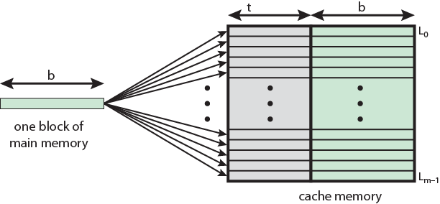
Associative Mapping from Cache to Main Memory

Slide 55
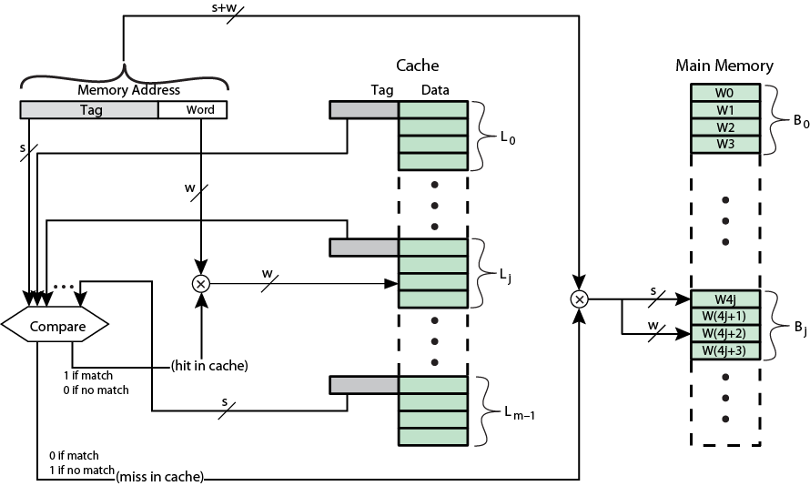
Fully Associative Cache Organization

Slide 56
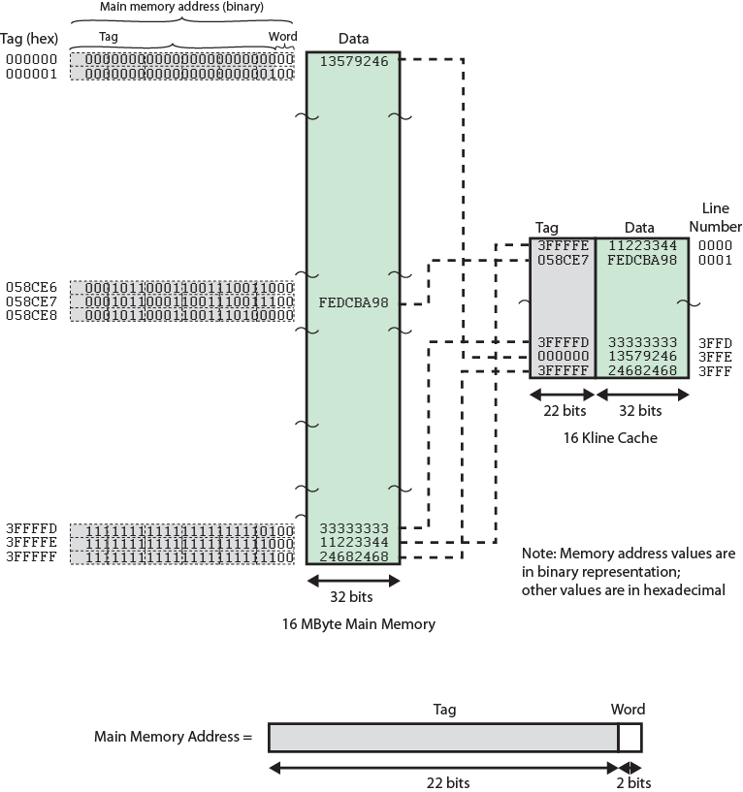
Associative Mapping Example

Slide 57
Associative Mapping Address Structure
Tag
Word w
22
2
22 bit tag stored with each 32 bit block of data
Compare tag field with tag entry in cache to check for hit
Least significant 2 bits of address identify which 16 bit word is required from 32 bit data block
e.g.
Address Tag Data Cache line
FFFFFC FFFFFC 24682468 3FFF

Slide 58
Associative Mapping - Steps
1.Find Bit-address
2.Find word, w
3.Find Tag
Tag | Word
Bit address (length)

Slide 59
Step 1: Find Bit Address
Information given:
◦Cache capacity= 64kByte
◦Cache block capacity = 4 Bytes
◦Main memory capacity = 16MBytes
If bit-address is given, just use it
If bit-address is not given, use the capacity of main memory
  Example: Capacity main memory = 16MB
  16MB = 2⁴ x 2²⁰ = 2²⁴
Bit address = 24
Tag | Word
Bit address (length) = 24

Slide 60
Step 2: Find word, w
Information given:
◦Cache capacity= 64kByte
◦Cache block capacity = 4 Bytes
◦Main memory capacity = 16MBytes
If word is given, just use it
If word is not given, use the block size or line size
  Example: Cache Block of 4Byte
Cache Block Size, 2^{w} = 2² = 4B
w = 2
Tag | Word 2
Bit address (length) = 24

Slide 61
Step 3: Find tag
Information given:
◦Cache capacity= 64kByte
◦Cache block capacity = 4 Bytes
◦Main memory capacity = 16MBytes
If tag is given, just use it
If tag is not given,
  Tag = Bit address – word
  Example: Bit address = 24, word = 2
  Tag = 24 – 2 = 22
Tag 22 | Word 2
Bit address (length) = 24

Slide 62
Associative Mapping Summary
Address length = (s + w) bits
Number of addressable units = 2^{s+w} words or bytes
Block size = line size = 2^{w} words or bytes
Number of blocks in main memory = 2^{s+w} /2^{w} = 2^{s}
Number of lines in cache = undetermined
Size of tag = s bits

Slide 63
Set Associative Mapping
Exhibits the strengths of both the direct and associative approaches while reducing their disadvantages
Cache is divided into a number of sets
Each set contains a number of lines
A given block maps to any line in a given set
  e.g. Block B can be in any line of set i
e.g. 2 lines per set
  2 ways associative mapping
  A given block can be in one of 2 lines in only one set

Slide 64
Set Associative Mapping
Example
13 bit set number
Block number in main memory is modulo 213
000000, 00A000, 00B000, 00C000 … map to same set

Slide 65
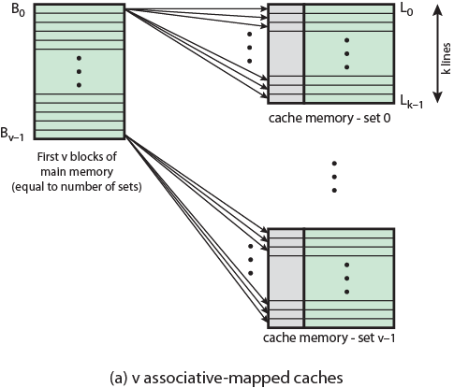
Mapping from Main Memory to Cache: v Associative

Slide 66
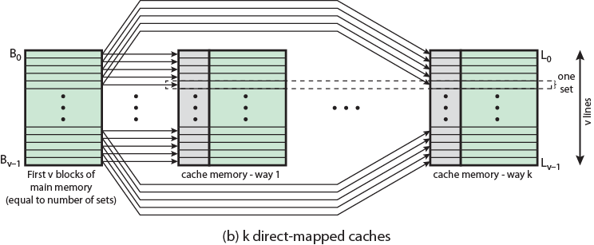
Mapping from Main Memory to Cache: k-way Associative

Slide 67
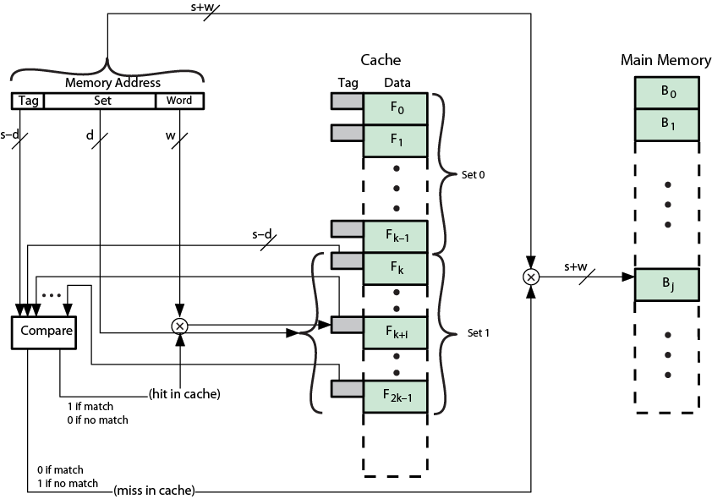
k-way Set Associative Cache Organization

Slide 68
Set Associative Mapping Address Structure
Tag
Set
Word w
9
13
2
Use set field to determine cache set to look in
Compare tag field to see if we have a hit
e.g
Address Tag Data Set number
1FF 7FFC 1FF 12345678 1FFF
001 7FFC 001 11223344 1FFF

Slide 69
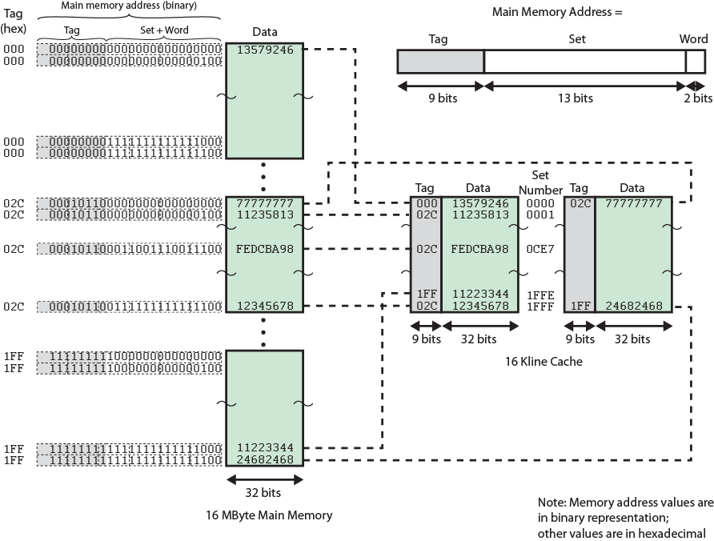
Two Way Set Associative Mapping Example

Slide 70
Set Associative K-ways - Steps
1.Find Bit-address
2.Find word, w
3.Find set. If 2 ways, 2 lines per set. If 4 ways, 4 lines per set.
4.Find Tag
Tag | Set | Word
Bit address (length)

Slide 71
Step 1: Find Bit Address
Information given:
◦Cache capacity= 64kByte
◦Cache block capacity = 4 Bytes
◦Main memory capacity = 16MBytes
If bit-address is given, just use it
If bit-address is not given, use the capacity of main memory
  Example: Capacity main memory = 16MB
  16MB = 2⁴ x 2²⁰ = 2²⁴
  Bit address = 24
Tag | Set | Word
Bit address (length) = 24

Slide 72
Step 2: Find Word, w
Information given:
◦Cache capacity= 64kByte
◦Cache block capacity = 4 Bytes
◦Main memory capacity = 16MBytes
If word is given, just use it
If word is not given, use the block size or line size.
  Example: Cache Block of 4Byte
  Cache Block Size, 2^{w} = 2² = 4B
  w = 2
Tag | Set | Word 2
Bit address (length) = 24

Slide 73
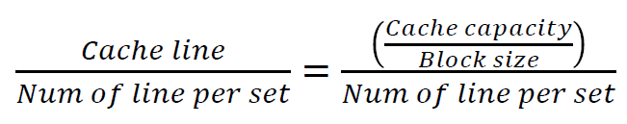
Step 3: Find set
Information given:
◦Cache capacity= 64kByte
◦Cache block capacity = 4 Bytes
◦Main memory capacity = 16MBytes
If set is given, just use it
If set is not given, 𝑆𝑒𝑡=
Example: If cache line is not given.
  Cache size = 64KB, Cache Block of 4Byte
  𝑆𝑒𝑡= (64000/4)/2 = 8000 = 2³ X 2¹⁰ ⁼ 2¹³
  Set = 13
(Cache capacity/block size) / num of line perset
Tag | Set 13 | Word 2
Bit address (length) = 24

Slide 74
Step 4: Find tag
Information given:
◦Cache capacity= 64kByte
◦Cache block capacity = 4 Bytes
◦Main memory capacity = 16MBytes
If tag is given, just use it
If tag is not given,
Tag = Bit address – word – set
  Example: Bit address = 24, word = 2, set= 13
  Tag = 24 – 2 – 13 = 9
Tag 9 | Set 13 | Word 2
Bit address (length) = 24

Slide 75
Set Associative Mapping Summary
Address length = (s + w) bits
Number of addressable units = 2^{s+w} words or bytes
Block size = line size = 2^{w} words or bytes
Number of blocks in main memory = 2^{d}
Number of lines in set = k
Number of sets = v = 2^{d}
Number of lines in cache = kv = k * 2^{d}
Size of tag = (s-d) bits

Slide 76
Exercise 1
Assume a computer A has a memory with the capacity 128KB. The cache is capable of storing 512 bytes with 16 bytes on line of cache.
  (a) Using the 2-ways set associative mapping technique, show how the main memory address is divided into tag, set, and word/byte.
  (b) Using the 4-ways set associative mapping technique, show how the main memory address is divided into tag, set, and word/byte.

Slide 77
Exercise 2
Assume a computer has a memory with the capacity of 2MB. Suppose a cache has 32 lines and each cache line can store 8 bytes.
Using the 2-ways set associative mapping technique, show how the main memory address is divided into tag, set, and word/byte.
Using the 4-ways set associative mapping technique, show how the main memory address is divided into tag, set, and word/byte

Slide 78
Direct and Set Associative Cache Performance Differences
Significant up to at least 64kB for 2-way
Difference between 2-way and 4-way at 4kB much less than 4kB to 8kB
Cache complexity increases with associativity
Not justified against increasing cache to 8kB or 16kB
Above 32kB gives no improvement
(simulation results)

Slide 79
Replacement Algorithm

Slide 80
Replacement Algorithm:
Direct Mapping
No choice
Each block only maps to one line
Replace that line

Slide 81
Replacement Algorithm:
Associative & Set Associative
Hardware implemented algorithm (speed)
Least Recently used (LRU)
e.g. in 2 way set associative
  Which of the 2 block is lru?
First in first out (FIFO)
  replace block that has been in cache longest
Least frequently used
  replace block which has had fewest hits
Random

Slide 82
Write Policy
Must not overwrite a cache block unless main memory is up to date
Multiple CPUs may have individual caches
I/O may address main memory directly
Techniques;
  Write through
  Write back

Slide 83
Write through
All writes go to main memory as well as cache
Multiple CPUs can monitor main memory traffic to keep local (to CPU) cache up to date
Lots of traffic
Slows down writes

Slide 84
Write back
Updates initially made in cache only
Update bit for cache slot is set when update occurs
If block is to be replaced, write to main memory only if update bit is set
Other caches get out of sync
I/O must access main memory through cache
% of memory references are writes = 15%

Slide 85
Additional Reference
William Stallings, Computer Organization and Architecture: Designing for Performance, 8th. Edition, Prentice-Hall Inc., 2010

