Slide 1
CHAPTER 11 INPUT OUTPUT
CSNB153 COMPUTER SYSTEM
CSNB153 coMPUTER oRGANIZATION

Slide 2
Importance of Peripheral Devices
COMPUTER SYSTEM
Interaction between computer and the outside world – make it functional

Slide 3
I/O Modules
COMPUTER SYSTEM
Contains logic → perform communication function between the peripheral and the bus
Interface to the system bus/central switch
Control peripheral devices

Slide 4
Importance of I/O Module
COMPUTER SYSTEM
Varieties of peripheral devices → various operation
  Not practical – burden the processor
  Hard to control – data transfer rate is slower than processor and memory
  Use different data formats and word lengths

Slide 5
Major Function of I/O
COMPUTER SYSTEM
Interface
  to the processor and memory via system bus/central switch
  to one/more peripheral devices

Slide 6
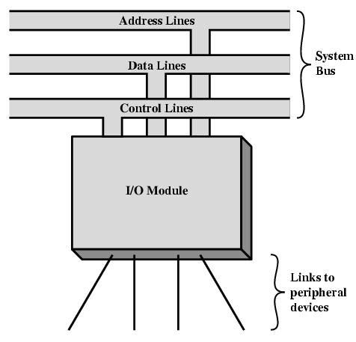
External Device (ED)
COMPUTER SYSTEM
ED connected to computer by a link to an I/O module
Use of link;
  Exchange;
    Status
    Control
    Data

Slide 7
Classification of ED
COMPUTER SYSTEM
Human Readable
Human readable device
E.g.; printer, monitor
Machine readable
Machine readable device
e.g.; Magnetic disk/tape, optical disk
Communication
Allow data exchange with a remote computer

Slide 8
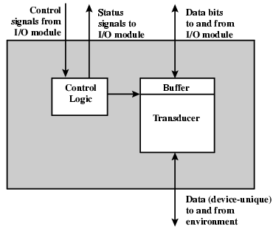
Interface to I/O Module
COMPUTER SYSTEM
Control signals
Data
Status signals
Instruction for operation to be performed (read/write)
Format in bit
State of the device (ready or not)

Slide 9
Interface to I/O Module (Cont.)
COMPUTER SYSTEM
Term | Description
Control logic | controls the device’s operation
Transducer | converts data; From electrical to other forms of energy (output) From other forms to electrical (input)
Buffer | related to transducer-hold data temporarily , size 8 to 16 bits

Slide 10
Categories of Major Function for I/O Module
COMPUTER SYSTEM
Control & Timing
Device comm.
Data Buffering
Error Detection
Processor comm.

Slide 11
Categories of Major Function for I/O Module (Cont.)
COMPUTER SYSTEM
Control & Timing
Device comm.
Data Buffering
Error Detection
Processor comm.
To coordinate the flow of traffic between internal resources and ED
E.g. data transfer from ED to CPU
  Check device status - CPU ask I/O module
  I/O module returns device status
    Ready – CPU request data
  I/O module get data from ED
  Transfer data

Slide 12
Categories of Major Function for I/O Module (Cont.)
COMPUTER SYSTEM
Control & Timing
Device comm.
Data Buffering
Error Detection
Processor comm.
To communicate between internal resources and ED
Operations;
  Command decoding
    Accept command from CPU send to control bus
  Data
    Exchange between CPU and I/O module over data bus
  Status reporting
    Status of ED
  Address recognition
    Know address for each I/O device

Slide 13
Categories of Major Function for I/O Module (Cont.)
COMPUTER SYSTEM
Control & Timing
Device comm.
Data Buffering
Error Detection
Processor comm.
The I/O module must able to perform DC
Operations;
  Command
  Data
  Status information

Slide 14
Categories of Major Function for I/O Module (Cont.)
COMPUTER SYSTEM
Control & Timing
Device comm.
Data Buffering
Error Detection
Processor comm.
Data comes from main memory in rapid burst and must be buffered by the I/O module, then send to the device at device’s rate

Slide 15
Categories of Major Function for I/O Module (Cont.)
COMPUTER SYSTEM
Control & Timing
Device comm.
Data Buffering
Error Detection
Processor comm.
I/O module responsible for;
  error detection
    Transmission error
  report errors to the CPU

Slide 16
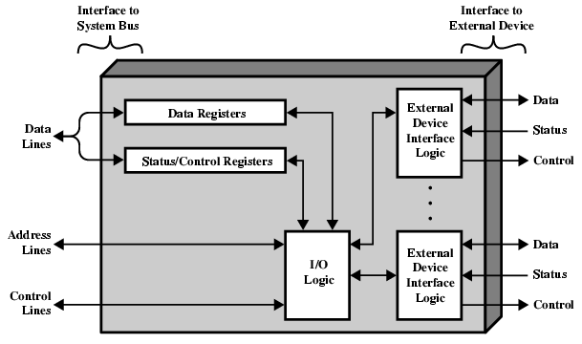
I/O Module Structure
COMPUTER SYSTEM
Term | Description
System bus | Connect I/O module to the computer
Data registers | Buffer the in/out data into/from I/O module
Status/Control registers | Provide register’s status
Control signal lines | - Allow I/O module logic interacts with CPU - CPU issue command to the IO module
Address lines | Know and generate device’s address
External device interface logic | Device interfaces to the device it’s control
I/O Logic | Used in primitive I/O module

Slide 17
I/O Techniques
COMPUTER SYSTEM
Programmed I/O
Direct Memory Access (DMA)
Interrupt Driven I/O

Slide 18
Programmed I/O
COMPUTER SYSTEM
Programmed I/O
DMA
Interrupt Driven I/O
I/O Techniques
The processor executes a program that gives it direct control of the I/O operation such as sensing devices status, sending a read/write command and transferring the data

Slide 19
Programmed I/O (Cont.)
COMPUTER SYSTEM
Programmed I/O
DMA
Interrupt Driven I/O
I/O Techniques
I/O Command
I/O Instruction
The CPU issues a command then waits for I/O operations to be complete.
As the CPU is faster than the I/O module, the problem with programmed I/O is that the CPU has to wait a long time for the I/O module of concern to be ready for either reception or transmission of data.
The CPU, while waiting, must repeatedly check the status of the I/O module, and this process is known as Polling.
As a result, the level of the performance of the entire system is severely degraded.

Slide 20
Programmed I/O (Cont.)
COMPUTER SYSTEM
Programmed I/O
DMA
Interrupt Driven I/O
I/O Techniques
I/O Command
I/O Instruction
Programmed I/O basically works in these ways:
  CPU requests I/O operation
  I/O module performs operation
  I/O module sets status bits
  CPU checks status bits periodically
  I/O module does not inform CPU directly
  I/O module does not interrupt CPU
  CPU may wait or come back later

Slide 21
Interrupt Driven I/O
COMPUTER SYSTEM
Programmed I/O
Interrupt Driven I/O
I/O Techniques
DMA
Overcomes CPU waiting
No repeated CPU checking of device
I/O module interrupts when ready

Slide 22
Interrupt Driven I/O (Cont.)
COMPUTER SYSTEM
Basic operations
  CPU issues read command
  I/O module gets data from peripheral whilst CPU does other work
  I/O module interrupts CPU
  CPU requests data
  I/O module transfers data
Programmed I/O
Interrupt Driven I/O
I/O Techniques
DMA
CPU
1
I/O Module
ED
2
3
4
5

Slide 23
Interrupt Driven I/O (Cont.) – Design Issue
COMPUTER SYSTEM
Two design issues
  How does the CPU determine which ED issued the interrupt?
  If multiple interrupt occured, how does the CPU decide which one to process?

Slide 24
Interrupt Driven I/O (Cont.) – Design Issue
COMPUTER SYSTEM
Consider device identification. 4 categories;
  Multiple interrupt lines
  Software poll
  Daisy chain
  Bus arbitration

Slide 25
Interrupt Driven I/O (Cont.) – Design Issue
COMPUTER SYSTEM
Multiple interrupt lines
  Straightforward approach
  Located between CPU and I/O Modules
  Impractical to dedicate more than a few bus lines or CPU pins to interrupt lines
    Each line attach to multiple I/O modules

Slide 26
Interrupt Driven I/O (Cont.) – Design Issue
COMPUTER SYSTEM
Software poll
  CPU detects interrupt – branches to an interrupt-service routine → job it is to poll each I/O module → determine which module caused the interrupt
  CPU asks each module in turn – slow (time consuming)

Slide 27
Interrupt Driven I/O (Cont.) – Design Issue
CGMB143 COMPUTER SYSTEM
Daisy chain
  Interconnection of computer devices, peripherals, or network nodes in series, one after another
  All I/O modules share a common interrupt request line
  The interrupt acknowledge line is daisy chained (hardware poll) through the modules
  When the CPU senses the interrupt, it send out an interrupt acknowledge
  This signal propagates via a series of I/O modules till reach a requesting module
  The requesting model respond and place a word on the data lines

Slide 28
Interrupt Driven I/O (Cont.) – Design Issue
COMPUTER SYSTEM
Bus arbitration
  I/O Module must claim the bus before it can raise interrupt
  Only one module can raise the interrupt at a time
  When the CPU detects the interrupt, it responds on the interrupt acknowledge line
  The requesting module then places its vector on the data lines

Slide 29
Direct Memory Access (DMA)
COMPUTER SYSTEM
Programmed I/O
Interrupt Driven I/O
I/O Techniques
DMA
Function
Additional Module (hardware) on the system bus
Mimic the CPU – control of the system
Use system bus for data transferring;
  when the processor does not need it
  Force CPU to suspend

Slide 30
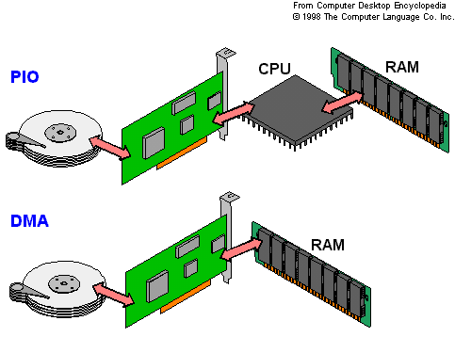
Direct Memory Access (DMA) (Cont.)
COMPUTER SYSTEM
Programmed I/O
Interrupt Driven I/O
I/O Techniques
DMA

Slide 31
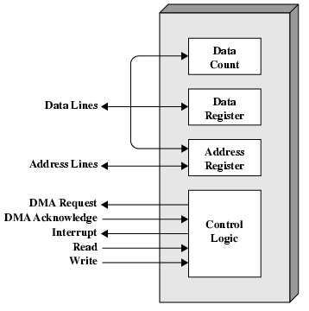
Direct Memory Access (DMA) (Cont.)
COMPUTER SYSTEM
DMA Block Diagram
Programmed I/O
Interrupt Driven I/O
I/O Techniques
DMA

Slide 32
Direct Memory Access (DMA) (Cont.)
CGMB143 COMPUTER SYSTEM
Programmed I/O
Interrupt Driven I/O
I/O Techniques
DMA
DMA Operation
CPU tells DMA controller:-
  Read/Write
  Device address
  Starting address of memory block for data
  Amount of data to be transferred
CPU carries on with other work
DMA controller deals with transfer
DMA controller sends interrupt when finished

Slide 33
Direct Memory Access (DMA) (Cont.)
COMPUTER SYSTEM
Programmed I/O
Interrupt Driven I/O
I/O Techniques
DMA
DMA Transfer – Cycle stealing
DMA controller takes over bus for a cycle
Transfer of one word of data
Not an interrupt
  CPU does not switch context
CPU suspended just before it accesses bus
Slows down CPU but not as much as CPU doing transfer

Slide 34
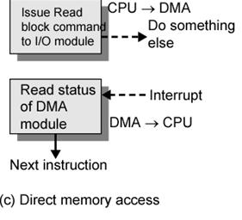
Direct Memory Access (DMA) (Cont.)
COMPUTER SYSTEM
DMA Transfer – Cycle stealing (Cont.)
CPU delegates the I/O operation to DMA module
The DMA module transfer the entire block of data one at a time directly to or from memory
When transfer completes - DMA module sends an interrupt signal to the CPU
CPU only involved at the beginning and end of transmission
Advantage:
  DMA is faster than programmed I/O and Interrupt I/O for multiple-word I/O transfer.

Slide 35
Direct Memory Access (DMA) (Cont.)
CGMB143 COMPUTER SYSTEM
Programmed I/O
Interrupt Driven I/O
I/O Techniques
DMA
DMA Configuration
Single-bus, detached DMA
Single-bus, integrated DMA I/O
I/O bus

Slide 36
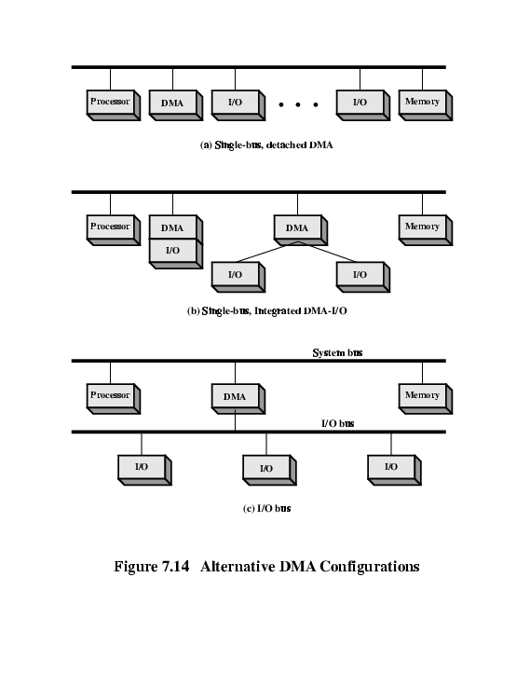
Direct Memory Access (DMA) (Cont.)
COMPUTER SYSTEM
DMA Configuration –
Single-bus, detached DMA
All modules share the same system bus
Each transfer uses bus twice
  I/O to DMA then DMA to memory

Slide 37
Direct Memory Access (DMA) (Cont.)
COMPUTER SYSTEM
DMA Configuration –
Single-bus, integrated DMA I/O
Controller may support >1 device
Each transfer uses bus once
  DMA to memory

Slide 38
Direct Memory Access (DMA) (Cont.)
COMPUTER SYSTEM
DMA Configuration –
I/O Bus
Separate I/O Bus
Bus supports all DMA enabled devices
Each transfer uses bus once
  DMA to memory

Slide 39
Additional Reference
COMPUTER SYSTEM
William Stallings, Computer Organization and Architecture: Designing for Performance, 8th. Edition, Prentice-Hall Inc., 2010

