Slide 1
CHAPTER 2
COMPUTER EVOLUTION
CSNB153 COMPUTER SYSTEM
CSNB153 COMPUTER SYSTEM

Slide 2
COMPUTER SYSTEM
A long time ago, human are using their fingers, stones etc to do calculation.
At the same time, they are trying to create an apparatus that could facilitate the calculation process.
After a few trial, finally the complex and advance calculation system has been produced and it is known as a computer.

Slide 3
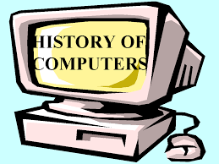
COMPUTER SYSTEM
The History & Evolution Of Computer Basically, the history of computer development is divided into 2 parts :
before 1940 & after 1940 .

Slide 4
BEFORE 1940
COMPUTER SYSTEM

Slide 5
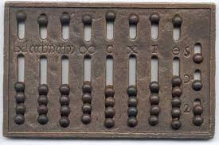
Abacus Counting Device
COMPUTER SYSTEM
Created on 3000 B.D. at Babylonia.
Was the first mechanical counting device in the world.
Able to execute addition and subtraction operation .

Slide 6
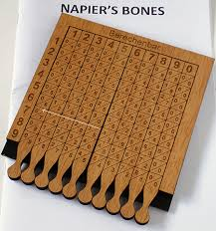
John Napier's Bone
COMPUTER SYSTEM
Created on 1614 by John Napier.
Facilitate multiplication and division processes – faster & easier.
The first logarithm table has been created.

Slide 7
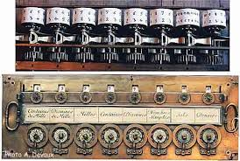
Pascaline Machine
COMPUTER SYSTEM
Created on 1642 by Braise Pascal.
Was the first mechanical machine or calculator in the world.
Able to execute addition and subtraction processes.

Slide 8
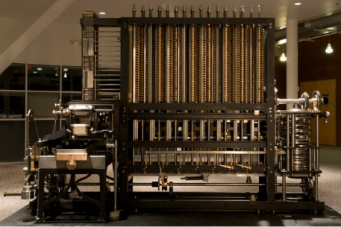
Babbage Differentiation Machine
COMPUTER SYSTEM
Created by Charles Babbage on 1821.
Was the first mechanical machine which is used the steam power.
Able to do a calculation and printing the output automatically.

Slide 9
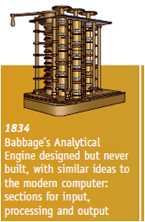
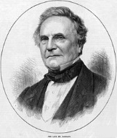
Babbage Analytical Engine
COMPUTER SYSTEM
It has five (5) main parts :
  Input unit
  Output unit
  Processing Unit
  Control unit
  Memory unit
His invention has became a theory model for today's computer technology. Because of that, Charles Babbage has been known as The Ancestor of A Modern Computer

Slide 10
After 1940
COMPUTER SYSTEM

Slide 11
Evolution
COMPUTER SYSTEM
First Generation
ENIAC
UNIVAC
IBM
Von Neumann Machine
MARK 1
Second Generation
Transistors
Third Generation
Integrated Circuit
Later Generation
Microprocessor

Slide 12
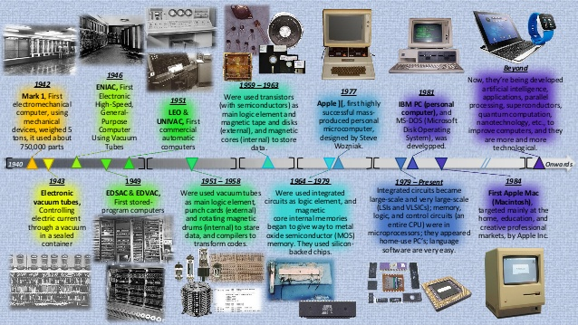
http://www.slideshare.net/CarmenBI98/4-in-fbuenocarmentimeline
COMPUTER SYSTEM

Slide 13
COMPUTER SYSTEM
MARK 1
UNIVAC
Von Neumann / Turing Machine
IBM
ENIAC

Slide 14
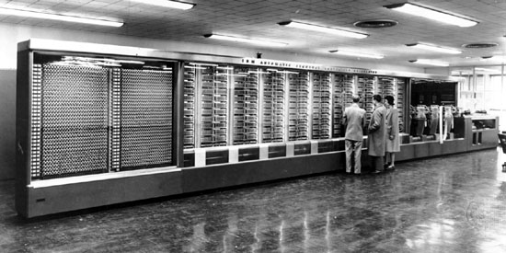
Mark 1
COMPUTER SYSTEM
Created on 1941 by Dr. Howard Aikern in conjunction with IBM.
Was the first electro-mechanical computer.
Size : 55 feet long, 8 feet height and connected with 800 km of wire.
Age of computers-The trilogy(ii) - www.boddunan.com

Slide 15
COMPUTER SYSTEM
MARK 1
UNIVAC
Von Neumann / Turing Machine
IBM
ENIAC

Slide 16
ENIAC
COMPUTER SYSTEM
Electronic Numerical Integrator And Computer
Eckert and Mauchly
University of Pennsylvania
Trajectory tables for weapons
Started 1943
Finished 1946
  ENIAC was created to help with the war effort against German forces.Used until 1955

Slide 17
ENIAC
COMPUTER SYSTEM
Decimal (not binary)
20 accumulators of 10 digits
Programmed manually by switches
18,000 vacuum tubes
30 tons
15,000 square feet
140 kW power consumption
5,000 additions per second
1000 times faster than Mark 1.

Slide 18

CGMB143 COMPUTER SYSTEM
COMPUTER SYSTEM
http://www.computerhope.com/jargon/e/eniac.htm

Slide 19
COMPUTER SYSTEM
ENIAC
UNIVAC
Von Neumann / Turing Machine
IBM
MARK 1

Slide 20
Stored-program concept
The task of entering and altering program is tedious for ENIAC. Suppose a program could be represented in a form suitable for storing in memory alongside data. Then computer could get its instruction by reading them from memory and program could be set or altered by settings the values of a portion of memory. This idea is known as stored-program concept an developed by Von Neumann referred to IAS computer.

Slide 21
Von Neumann / Turing Machine
COMPUTER SYSTEM
Stored Program concept
  Main memory storing programs and data
  ALU operating on binary data
  Control unit interpreting instructions from memory and executing
Input and output equipment operated by control unit

Slide 22
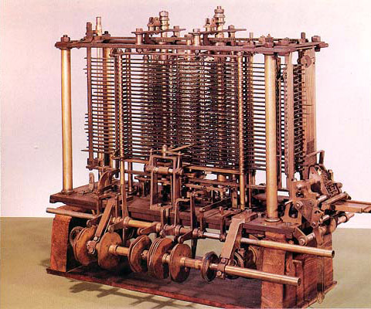
Von Neumann / Turing Machine - Example
COMPUTER SYSTEM
http://www.arcadefire.com/wp/wp-content/uploads/2010/10/turing11.jpg

Slide 23
Von Neumann Machine - Structure
COMPUTER SYSTEM
Main Memory (M)
Central Processing Unit (CPU)
I/O Equipment (I,O)
Arithmetic Logic Unit (CA)
Program Control Unit (CC)

Slide 24
Von Neumann earlier proposal
First – since the device is primarily a computer, it will have to perform addition, subtraction, multiplication or addition therefore it need special organs to do it, therefore come the CA
Second- The logical control of the device that is the proper sequencing of its operation, carried out by central control organ, therefore come the second part, CC

Slide 25
Von Neumann earlier proposal
Third – Any device that is to carried out long and complicated operation need considerable memory, therefore come the third specific part of the device, M
These three specific part called CC, CA and M correspond to the associative neurons nervous system

Slide 26
Fourth- The device need an organ to transfer from R to specific part of C or M, these organ form its input called, I.
Fifth – The device must have an organ to transfer from C or M to R outside specific medium. These organ form O, output.

Slide 27
Von Neumann / Turing Machine (2)
COMPUTER SYSTEM
Princeton Institute for Advanced Studies
  IAS
Completed 1952

Slide 28
IAS
COMPUTER SYSTEM
1000 x 40 bit words
  Binary number
  2 x 20 bit instructions
Set of registers (storage in CPU)
  Memory Buffer Register – contains word to be stored/received from in memory or sent to i/o unit.
  Memory Address Register – specifies the address in memory of the word to be written from or read into MBR.
  Instruction Register - contains 8-bit operation code instruction being executed.
  Instruction Buffer Register – to hold temporarily the instruction
  Program Counter – contain address of the next instruction.
  Accumulator
    hold temporarily operands and result of ALU
  operation.
  Multiplier Quotient

Slide 29
IAS – Structure
COMPUTER SYSTEM
Arithmetic-logic Unit (ALU)
I/O Equipment (I,O)
AC
MQ
Arithmetic-logic Circuits
MBR
Program Control Unit
IBR
PC
Main Memory (M)
IR
MAR
Control Circuits
Control Signals

Slide 30
IAS operation
The opcode of the next instruction is loaded into the IR and the address portion is loaded into MAR. The instruction may by be taken from IBR or it can be taken from memory by loading a word into MBR, then down to IBR, IR and MAR.
Once in the IR, the control circuitry interprets the opcode and execute the instruction by sending the right signal to moved the data or an operation to be performed by the ALU.

Slide 31
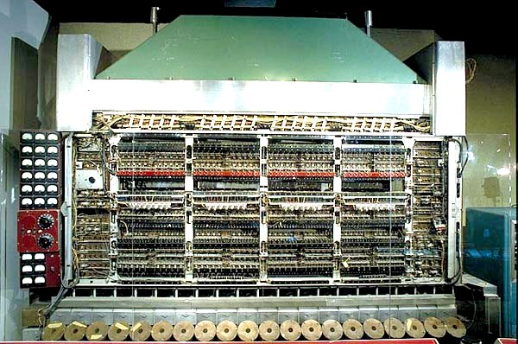
IAS Computer - Example
COMPUTER SYSTEM
http://www.comsci.us/history/images/ias.jpg

Slide 32
COMPUTER SYSTEM
ENIAC
UNIVAC
Von Neumann / Turing Machine
IBM
MARK 1

Slide 33
Universal Automatic Computer (UNIVAC)
COMPUTER SYSTEM
1947
UNIVAC I
Eckert-Mauchly Formed Computer Corporation
(to manufacture computer commercially)
Late 1950
UNIVAC II
Part of Sperry-Rand Corporation
Faster & more memory

Slide 34
UNIVAC
UNIVAC I – the first successful commercial computer. Used for scientific and commercial application ie, matrix algebraic computation, statistical problem, premium billings, or life insurance company and logistic problem.
UNIVAC II – greater memory capacity and higher performance

Slide 35
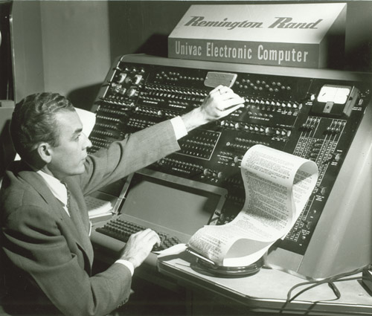
UNIVAC - Example
COMPUTER SYSTEM
http://archive.computerhistory.org/resources/still-image/UNIVAC/Univac_1.charles_collingwood.1952.102645279.lg.jpg

Slide 36
COMPUTER SYSTEM
ENIAC
UNIVAC
Von Neumann / Turing Machine
IBM
MARK 1

Slide 37
Second Generation Machine
COMPUTER SYSTEM

Slide 38
IBM
COMPUTER SYSTEM
1953
The 701
IBM 1st stored program computer
Scientific Calculations
1955
The 702
Business Applications
700/7000 series

Slide 39
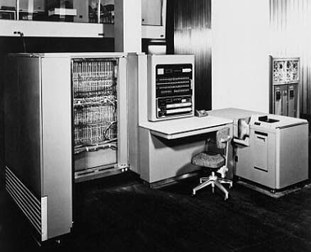
IBM 701
COMPUTER SYSTEM
http://www-03.ibm.com/ibm/history/exhibits/701/images/141511_Large.jpg

Slide 40
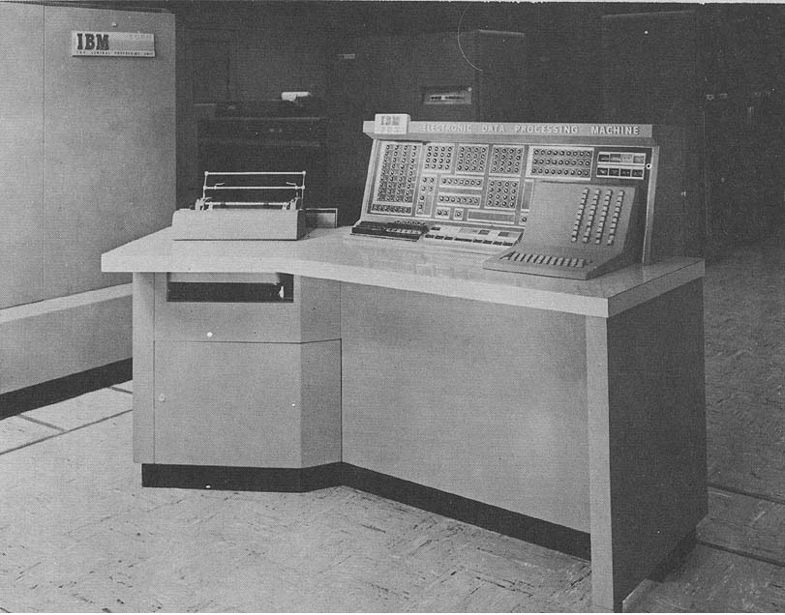
IBM 702
COMPUTER SYSTEM
http://www.ed-thelen.org/comp-hist/BRL61-0396.jpg

Slide 41
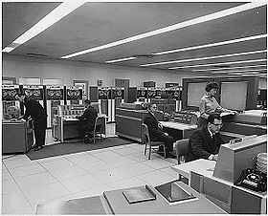
IBM 700/7000
COMPUTER SYSTEM
https://upload.wikimedia.org/wikipedia/commons/thumb/b/b9/NASAComputerRoom7090.NARA.jpg/280px-NASAComputerRoom7090.NARA.jpg

Slide 42
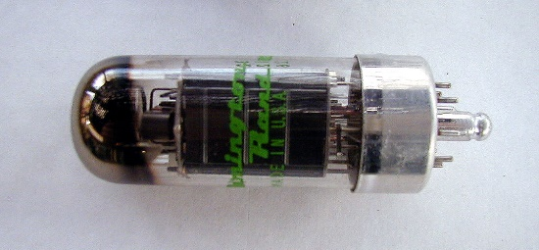
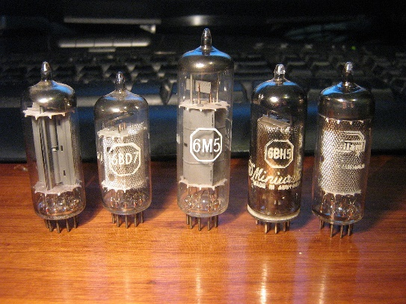
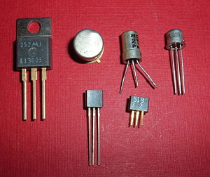
Transistors
COMPUTER SYSTEM
Made from Silicon (Sand)
Invented 1947 at Bell Labs
William Shockley et al.
Replaced vacuum tubes: wires, metal plates, glass capsule and vacuum.
Solid State device made from silicon.

Slide 43
Advantages of Transistors
COMPUTER SYSTEM
Smaller
Cheaper
Less heat dissipation

Slide 44
Transistors Based Computers
COMPUTER SYSTEM
Second generation machines
NCR & RCA produced small transistor machines
IBM 7000
Digital Equipment Corporation(DEC) - 1957
  Produced PDP-1 – first mini computer phenomenon.

Slide 45
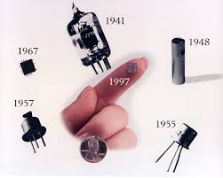
COMPUTER SYSTEM

Slide 46
Third Generation Machine
COMPUTER SYSTEM

Slide 47
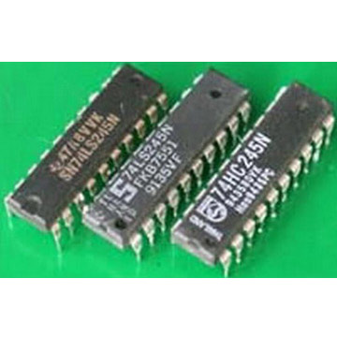
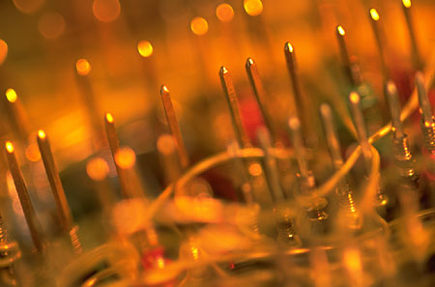
Integrated Circuit/Microelectronics
COMPUTER SYSTEM
Literally - “small electronics”
Transistors were replaced by integrated circuits(IC)
One IC could replace hundreds of transistors
This made computers even smaller and faster.

Slide 48
Integrated circuit
In 1958, came an achievement that revolutionized electronics and started the era of microelectronic, the invention of integrated circuit, defined the third generation of computer.
Initially only a few gates and memory cells, could be reliably manufactured together. As time went on, it become possible to pack more and more component on the same chip

Slide 49
The cost of chip remained unchanged during the period growth of density. This means the cost of memory circuitry has fallen at a dramatic rate
Because logic and memory elements are placed closer together on more densely packed chips, the electrical path length is shortened, increasing operating speed.

Slide 50
The computer become smaller
Reduction in power and cooling requirement
The interconnection of integrated circuit are more reliable than solder connection.

Slide 51
In the same year IBM shipped PDP-8 from DEC. PDP 8 was immediate hit and made DEC fortune. PDP-8 established the concept minicomputer.

Slide 52
Later Generation Computers
COMPUTER SYSTEM

Slide 53
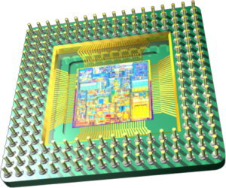
Later Generation Computers
COMPUTER SYSTEM
In 1970 the Intel Corporation invented the Microprocessor: an entire CPU on one chip
This led to microcomputers-computers on a desk

Slide 54
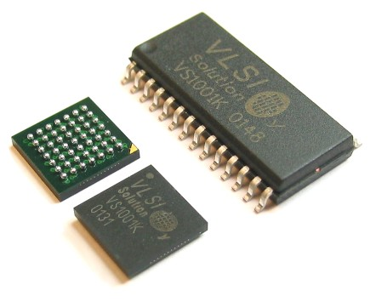
Later Generation Computers
COMPUTER SYSTEM
This transformation was a result of the invention of the microprocessor.
A microprocessor (uP) is a computer that is fabricated on an integrated circuit (IC).
Computers had been around for 20 years before the first microprocessor was developed at Intel in 1971.

Slide 55
Microprocessor
More than 1000 component can be placed on a single integrated chip. VLSI achieved more than 10000 component on single chip.
Just as density of element of memory chips has continue to rise, so has the density of elements on processor chips. As time went on, more and more elements were placed on each chip, so that fewer and fewer chips were needed to construct. a single computer processor. A breakthrough is achieved on 1971.

Slide 56
Intel
COMPUTER SYSTEM
Year | Computer Name | Description
1971 | 4004 | First microprocessor All CPU components on a single chip 4 bit
1972 | 8008 | 8 bit Both designed for specific applications
1974 | 8080 | Intel’s first general purpose microprocessor

Slide 57
Additional Reference
COMPUTER SYSTEM
William Stallings, Computer Organization and Architecture: Designing for Performance, 8th. Edition, Prentice-Hall Inc., 2010

Slide 58
Exercise
What is stored-program concept?
Before 1940, what kind of device that we are using to calculate,
How many generation of computer do we have? Named three of them
Based on Q3, describe and explain one of the generation of computer that you are interested and why?

Slide 59
5) Describe the Von Neumann earlier proposal of a computer
6) Explain how IAS send its instruction and execute them, i.e using MBR or IR, how’s the flow?
7) what is the advantage of integrated circuit?

