Slide 1
Chapter 3:
Operating System Overview
CSNB153 COMPUTER SYSTEM

Slide 2
Operating System
CGMB143 COMPUTER SYSTEM
CSNB153 COMPUTER SYSTEM
Definition:
A program that controls the execution of application programs
An interface between applications and hardware
An OS is a program which acts as an interface between computer system users and the computer hardware. It provides a user-friendly environment in which a user may easily develop and execute programs. Otherwise, hardware knowledge would be mandatory for computer programming. So, it can be said that an OS hides the complexity of hardware from uninterested users.

Slide 3
Operating system Objectives
CSNB153 COMPUTER SYSTEM
CSNB153 COMPUTER SYSTEM
1. Convenience
Makes the computer more convenient to be use – as a user/computer interface
2. Efficiency
Allows computer system resources to be used in an efficient manner – as a resource manager
3. Ability to evolve
Permit effective development, testing, and introduction of new system functions without interfering with service.

Slide 4
Obj. 1: OS as a User/Computer Interface
CGMB143 COMPUTER SYSTEM
CSNB153 COMPUTER SYSTEM
Obj. 1: OS as a User/Computer Interface
Hardware and software used in providing applications to a user can be viewed in a
layered or hierarchical fashion as shown in figure below:
a set of system programs used in assisting program creation,
management of files and controlling I/O. Application running and
will call this utilities to perform function.

Slide 5
OS as a User/Computer Interface
CGMB143 COMPUTER SYSTEM
CSNB153 COMPUTER SYSTEM
OS in the 3rd layer:
Act as a mediator, making it easier for the programmer and for application programs to access and use those facilities and services.

Slide 6
OS as a User/Computer Interface..
CGMB143 COMPUTER SYSTEM
CSNB153 COMPUTER SYSTEM
OS typically provides services in the following areas:
Program development
Provides editors and debuggers (as utilities program) to assist programmer in creating programs.
Program execution
A number of steps need to be performed to execute a program; loaded data to memory, initializes the I/O devices and files, prepared the processor. OS will handled these scheduling duties for the user.

Slide 7
OS as a User/Computer Interface..
CGMB143 COMPUTER SYSTEM
CSNB153 COMPUTER SYSTEM
Access to I/O devices
Provides a uniform interface where programmer can access the I/O using simple read and write
Controlled access to files
Provide protection mechanisms to control access to the files.
System access
For shared or public systems OS controls access to the system.

Slide 8
OS as a User/Computer Interface..
CGMB143 COMPUTER SYSTEM
CSNB153 COMPUTER SYSTEM
Error detection and response
Errors occur while computer run:
– Internal and external hardware errors
– Software errors
– OS cannot grant request of application
OS provide response that clear the error condition with least impact to running applications
– Ending program that cause error
– Retrying the operation
– Reporting error to application

Slide 9
OS as a User/Computer Interface..
CGMB143 COMPUTER SYSTEM
CSNB153 COMPUTER SYSTEM
Accounting
-collect statistics
-monitor performance
-used to anticipate future enhancements

Slide 10
CSNB153 COMPUTER SYSTEM
Obj. 2: OS as Resource Manager
A computer is a set of resources for the movement, storage and processing of data and for the control of these functions.
OS is responsible for managing the resources.
In the alternative view, the job of the operating system is to provide an orderly and controlled allocation of the processors, memories, and i/o devices among the various programs competing for them.

Slide 11
Obj. 3: Ease of Evolution of an OS
CSNB153 COMPUTER SYSTEM
OS will evolved over the time because:
  Hardware upgrades and new types of hardware
  New services
  Fix faults

Slide 12
CSNB153 COMPUTER SYSTEM
Evolution of OS
Serial Processing
Simple Batch System
Multiprogrammed Batch System
Time Sharing System

Slide 13
CSNB153 COMPUTER SYSTEM
Serial Processing
No operating system
User interact directly with computer hardware.
Machines run from a console with display lights and toggle switches.
This mode of operation could be termed as serial processing because users have access to the computer in series.

Slide 14
CSNB153 COMPUTER SYSTEM
Serial Processing..
How it works?
  Programs in machine code were loaded via the input device (e.g.. Card Reader)
  If there is an error (indicating by the lights) → halt the program.
  Then the programmer will proceed to examine processor registers and main memory to determine the cause of error.
  If the program proceeds to normal completion, the output will be printed.

Slide 15
CSNB153 COMPUTER SYSTEM
Serial Processing..
Has TWO main problems:
  Scheduling
  Setup Time
processor idle most of the time
» Doing nothing, waiting to execute a job

Slide 16
CSNB153 COMPUTER SYSTEM
Serial Processing..
Scheduling
How user “used” the machine
User reserve a machine time
– Used a hardcopy sign-up sheet
Problem arise when user sign up more than the time needed or can’t complete their job with in the time reserved.
– Reserved for 1 hour, but completed execute job for 20 minutes → 40 minutes is a processor idle time
– Reserved for 1 hour, but job did not completed.
because of error occurs →need to reserve another time

Slide 17
CSNB153 COMPUTER SYSTEM
Serial Processing..
Setup time
Many steps involve in running a single program/job
– load the compiler + source program to memory
– saving the compiled program
– load and link the object program and common functions
– each of these steps involving mounting or dismounting tapes
If error occurred, user had to go back to the beginning setup step.
Much of the time is spending on setting up program.

Slide 18
CSNB153 COMPUTER SYSTEM
Serial Processing..
Over the time, various system software tools were developed to attempt to make serial processing more efficient.
  Libraries of common functions, linkers, loaders, debuggers and I/O driver routines.

Slide 19
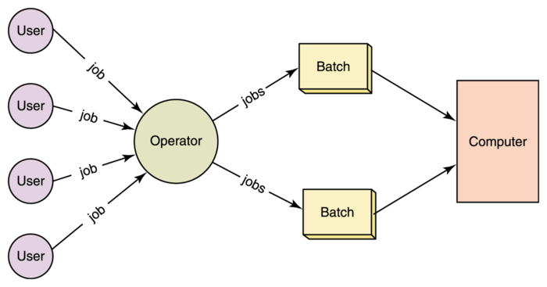
CSNB153 COMPUTER SYSTEM
Simple Batch Systems
Early machine was so expensive so it is important to maximize machine utilization → min the idle time of the processor.
To improve utilization, the concept of a batch OS was developed.
Central idea behind the simple batch processing scheme was the used of software known as the monitor.

Slide 20
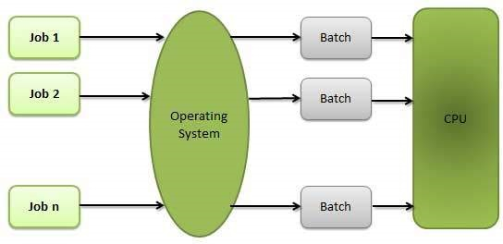
CSNB153 COMPUTER SYSTEM
Simple Batch Systems
With monitor user have no longer direct access to the machine.
Monitors:
Software that controls the running programs
Batch jobs together
Program branches back to monitor when finished
A part of the monitor call “Resident monitor” is in main memory and available for execution.
Monitor

Slide 21
CSNB153 COMPUTER SYSTEM
Simple Batch Systems
Resident Monitor

Slide 22
CSNB153 COMPUTER SYSTEM
Simple Batch Systems
How monitor works:
Monitor reads jobs one at a time from the input device
Monitor places a job in the user program area
A monitor instruction branches to the start of the user program
Execution of user program continues until
  End of program occurs
  Error occurs
This will cause the CPU to fetch its next instruction from monitor

Slide 23
CSNB153 COMPUTER SYSTEM
Simple Batch Systems
With each job, instructions are included in a primitive form of job control language (JCL)
Special type of programming language used to provides instruction to the monitor
  what compiler to use
  what data to use

Slide 24
CSNB153 COMPUTER SYSTEM
Simple Batch Systems
Example of job format using FORTRAN language:
$JOB
$FTN
…
FORTRAN Program
…
$LOAD
$RUN
…
DATA
…
$END
Instruction start with a $ is a JCL language

Slide 25
CSNB153 COMPUTER SYSTEM
Simple Batch Systems
With JCL:
Each read instruction (in user program) causes one line of input to be read
Causes input routine (OS) to be invoke
  Checks for not reading JCL line
  Skip to the next JCL line at completion of user program

Slide 26
CSNB153 COMPUTER SYSTEM
Simple Batch Systems
In summary, the monitor or batch OS:
It is a computer program
Relies on the:
ability of the processor to fetch instructions from the various portions of the main memory to alternately seize and relinquish control.

Slide 27
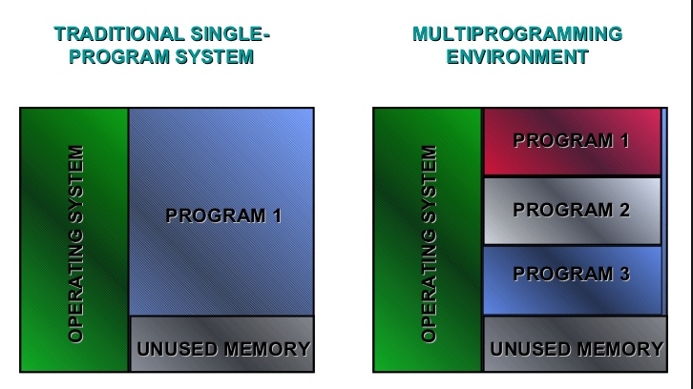
CSNB153 COMPUTER SYSTEM
Multiprogramming System
Simple Batch OS implement uniprogramming technique.
Uniprogramming:
  Processor execute a job, when job need for I/O, processor must wait for I/O instruction to complete before proceed to execute the other job.

Slide 28
CSNB153 COMPUTER SYSTEM
Multiprogramming System..
Multiprogramming:
Processor execute a job, When job needs to wait for I/O, the processor can switch to the other job

Slide 29
CSNB153 COMPUTER SYSTEM
Multiprogramming System..

Slide 30
CSNB153 COMPUTER SYSTEM
Time Sharing
A need to provide a mode in which the user interacts directly with the computer.
  Transaction processing
Batch multiprogramming does not support interactions with users.
Time sharing extends multiprogramming to handle multiple interactive jobs.
It is called time sharing because the processor’s time is shared among multiple users.

Slide 31
CSNB153 COMPUTER SYSTEM
Evolution of Operating Systems..
Both batch OS and time sharing implement multiprogramming.

Slide 32
CSNB153 COMPUTER SYSTEM
Major Achievements
OS is the most complex pieces of software ever developed.
Five major theoretical advances/progresses in the development of OS:
Memory Management
Process
Information Protection and Security
Scheduling and resource management
System Structure
Notes:
ADVANCES - IMPROVMENT

Slide 33
CSNB153 COMPUTER SYSTEM
Major Achievements – Process
Introduced to obtain a systematic way of monitoring and controlling program execution.
Definitions of process:
A program in execution
An instance of a program running on a computer
The entity that can be assigned to and executed on a processor
A unit of activity characterized by a single sequential thread of execution, a current state, and an associated set of system resources

Slide 34
CSNB153 COMPUTER SYSTEM
Major Achievements – Process..
Difficulties with Designing OS (with regards to process)
Improper synchronization
  ensure a process waiting for an I/O device receives the signal
Failed mutual exclusion
  Must permit only one program at a time to perform a transaction on a portion of data.
Non-determinate program operation
  When program share memory , their execution is interleaved by the processor, they may interfere with each other by overwriting common memory area.

Slide 35
CSNB153 COMPUTER SYSTEM
Major Achievements – Process..
Deadlocks
  Two or more programs wait endlessly after each other to perform an operation.
Consists of three components
An executable program
Associated data needed by the program
Execution context of the program
All information the CPU needs to execute the process
All information the operating system needs to manage the process

Slide 36
CSNB153 COMPUTER SYSTEM
Major Achievements –
Memory Management
Five principle storage management responsibilities:
Process isolation
  The OS must prevent independent processes from interfering with each other’s memory, both data and instructions.
Automatic allocation and management
  Programs should be dynamically allocated across the memory hierarchy as required. Allocation should be straightforward to the programmer.
Support for modular programming
  Programmers should be able to define program modules, and to create, destroy, and alter the size of modules dynamically
Protection and access control
  The OS must provide different ways to access memory by various users.
Long-term storage
  Many application programs require means for storing information for extended periods of time, after the computer has been powered down.

Slide 37
Major Achievements –
Information Protection and Security..
CSNB153 COMPUTER SYSTEM
Protection of information is needed since the growth in the use of time-sharing systems and
computer network.
Work in security and protection as it relates to OS can be roughly grouped into four
categories.
Availability
Protecting the system against interruption
Confidentiality
Assures that user cannot read data for which access is unauthorized

Slide 38
CSNB153 COMPUTER SYSTEM
Major Achievements –
Information Protection and Security..
Data Integrity
Protection of data from unauthorized modification
Authenticity
Proper verification of identity of users and the validity of messages or data

Slide 39
CSNB153 COMPUTER SYSTEM
Major Achievements –
Scheduling and Resource Management
A key task of the OS is to manage the various resources available and to schedule their use by the various active process.
Resource allocation and scheduling policy must consider three factors:
Fairness
give equal and fair access to all processes
Differential responsiveness
discriminate between different classes of jobs

Slide 40
Major Achievements –
Scheduling and Resource Management
Efficiency
maximize output, minimize response time, and accommodate as many uses as possible

Slide 41
CSNB153 COMPUTER SYSTEM
Major Achievements –
System Structure
Because of it’s enormous complexity, the OS can be viewed as a series of levels
Each level performs a related subset of functions
Each level relies on the next lower level to perform more primitive functions
Well defined interfaces: one level can be modified without affecting other levels
This decomposes a problem into a number of more manageable sub problems

Slide 42
CSNB153 COMPUTER SYSTEM
Characteristics of Modern OS
New design elements were introduced recently.
In response to new hardware development
multiprocessor machines
high-speed networks
faster processors and larger memory
In response to new software needs
multimedia applications
Internet and Web access
Client/Server applications

Slide 43
CSNB153 COMPUTER SYSTEM
Characteristics of Modern OS
Changes not only in modification and enhancement to existing architectures but also in new ways of organizing the operating system.
Much of the works fits into:
1. Microkernel architecture
2. Multithreading
3. Symmetric multiprocessing
4. Distributed OS
5. Object-oriented design.

Slide 44
CSNB153 COMPUTER SYSTEM
Characteristics of Modern OS -
Microkernel Architecture
Only a few essential functions in the kernel
primitive memory management (address space)
Inter process communication (IPC)
basic scheduling
Other OS services are provided by processes running in user mode Such as device drivers, file system, virtual memory
Provide more flexibility, extensibility, portability
Notes:
Microkernel – part of OS
Stored only functions yg penting…cth seperti diatas. Fungsi2 lain are provided by running process.

Slide 45
CSNB153 COMPUTER SYSTEM
Characteristics of Modern OS -
Multithreading
A process is a collection of one or more threads that can run simultaneously.
Useful when the application consists of several tasks that do not need to be serialized.
Gives the programmer a greater control over the timing of application-related events.
All threads within the same process share the same data and resources and a part of the process’s execution context

Slide 46
CSNB153 COMPUTER SYSTEM
Characteristics of Modern OS -
Symmetric Multiprocessing
Refers to a computer hardware architecture and also to the operating system behavior
that reflects that architecture.
Standalone computer system with the following characteristics:
A computer with multiple processors
These processors share the same main memory and I/O facilities, interconnected by a communication bus or other internal connection scheme.

Slide 47
CSNB153 COMPUTER SYSTEM
Characteristics of Modern OS -
Symmetric Multiprocessing..
All processor can perform the same functions.
Existence of multiple processors is transparent to the user.
Advantages over uniprocessor architecture:
1. Performance
2. Availability
3. Incremental Growth

Slide 48
Performance – If the work to be done by a computer can be organized so that some portions of the work can be done in parallel, then a system with multiple processor will yield a greater performance than one single processor
Availability – the failure of a single processor does not halt the system.
Incremental growth – A user can enhanced the performance of a system by adding an additional processor.

Slide 49
CSNB153 COMPUTER SYSTEM
Characteristics of Modern OS -
Distributed OS
DOS is a collection of independent computers that appears to the users of the system as a single computer.
Provides the illusion of a single main memory and single secondary memory space, i.e. appearing as a single system.
E.g.. Cluster computer.

Slide 50
CSNB153 COMPUTER SYSTEM
Characteristics of Modern OS -
Object Oriented Design
Used for adding modular extensions to a small kernel
Enables programmers to customize an operating system without disrupting system integrity

Slide 51
CSNB153 COMPUTER SYSTEM
THE END

