Slide 1
CHAPTER 4
TOP LEVEL VIEW OF COMPUTER FUNCTION AND INTERCONNECTION
CGMB143 COMPUTER SYSTEM
Cgmb143 coMPUTER SYSTEM

Slide 2
What is a program?
CGMB143 COMPUTER SYSTEM
A sequence of steps
arithmetic or logical operation is done
a different set of
control signals is needed

Slide 3
Computer Components
CGMB143 COMPUTER SYSTEM
Computer
PC = Program Counter
IR = Instruction Register
MAR = Memory Address Register
MBR = Memory Buffer Register
I/O AR = Input/Output Address Register
I/O BR = Input/Output Buffer Register
Central Processing Unit (CPU)
PC
MAR
System
Bus
Main Memory
.
MBR
.
IR
.
0
1
2
.
.
.
I/O AR
Instruction
Execution Unit
Instruction
I/O BR
.
.
.
Data
I/O Module
Buffers
Data
.
.
.
.
.

Slide 4
Instruction Cycle
CGMB143 COMPUTER SYSTEM
Two steps
  Fetch cycle
  Execute cycle
Fetch cycle
Execution cycle
Fetch Next Instruction
Execute Instruction
Start
Halt

Slide 5
Fetch Cycle
CGMB143 COMPUTER SYSTEM
Program Counter (PC)
Holds address of next instruction to fetch
Processor
Fetch instruction from memory location pointed to by PC
Increment PC
Instruction Register (IR)
Load the instruction
Processor
Interprets instruction
Perform required actions

Slide 6
Execute Cycle
CGMB143 COMPUTER SYSTEM
Processor I/O
Execution Cycle
Processor -Memory
Data Processing
Control

Slide 7
Interrupts
CGMB143 COMPUTER SYSTEM
Mechanism by which other modules (e.g. I/O) may interrupt normal sequence of processing

Slide 8
Interrupt Cycle
CGMB143 COMPUTER SYSTEM
Added to instruction cycle
Fetch cycle
Execution cycle
Interrupt cycle
Interrupts disabled
Fetch Next Instruction
Execute Instruction
Check for interrupt; process interrupt
Start
Interrupts enabled
Halt

Slide 9
Interrupt Cycle (Cont.)
CGMB143 COMPUTER SYSTEM
Processor checks for interrupt
  Indicated by an interrupt signal
If no interrupt, fetch next instruction
If interrupt pending:
  Suspend execution of current program
  Save context
  Set PC to start address of interrupt handler routine
  Process interrupt
  Restore context and continue interrupted program

Slide 10
Interconnection Structures
CGMB143 COMPUTER SYSTEM
Collection of paths connecting the various modules
Modules:
  Memory
  Processor
  I/O module

Slide 11
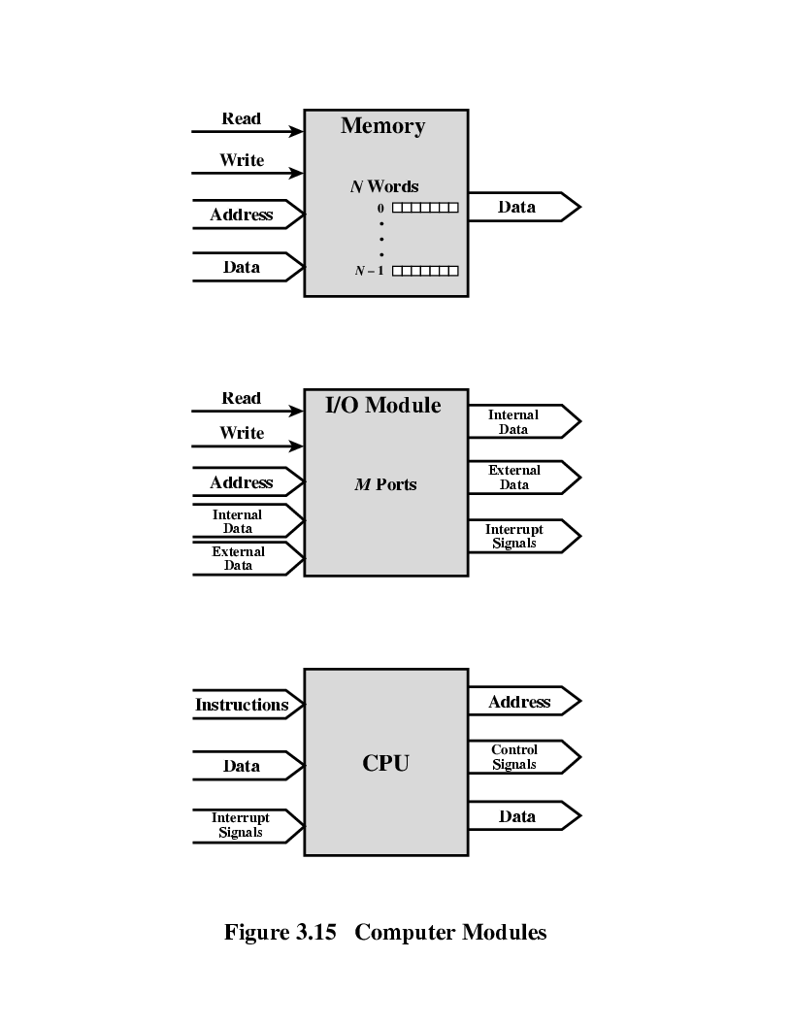
Modules: Major Form of Input and Output - Memory
CGMB143 COMPUTER SYSTEM
Word of data - Read from or written into the memory
  Assigned a unique numerical address
Nature of the operation – indicated by read and write control signals
Address – specify the location for the operation

Slide 12
Modules: Major Form of Input and Output - Processor
CGMB143 COMPUTER SYSTEM
Reads instruction and data
Writes out data (after processing)
Sends control signals to other units
Receives (& acts on) interrupts

Slide 13
Modules: Major Form of Input and Output – I/O Module
CGMB143 COMPUTER SYSTEM
Operations;
  Read
  Write
Control more than one external device
External data path – input and output of data
Send interrupt signals to CPU

Slide 14
Modules:
Major Form of Input and Output
CGMB143 COMPUTER SYSTEM

Slide 15
Types of Transfers
CGMB143 COMPUTER SYSTEM
Memory to processor: Processor reads instruction/data from memory
Processor to memory: Processor writes data to memory
I/O to processor: Processor reads data from I/O device (via I/O module)
Processor to I/O: Processor sends data to I/O device
I/O to/from memory: allowed to exchange data using Direct Memory Access (DMA) – exclude processor

Slide 16
Bus Interconnection
CGMB143 COMPUTER SYSTEM
Communication pathway connecting two or more devices
Key characteristic: shared transmission medium
Consists of multiple communication pathways/lines
  Lines – transmit signals representing binary 1 and 0 – one data at a time

Slide 17
System Bus
CGMB143 COMPUTER SYSTEM
A bus that connects major computer components (CPU, memory, I/O)
Computer interconnection structures – use one or more system buses
Consists of 50 to hundreds of separate lines
  Each line – function. E.g: power

Slide 18
Data Line
CGMB143 COMPUTER SYSTEM
Provide a path for moving data among system modules
Collective – data bus

Slide 19
Data Bus
CGMB143 COMPUTER SYSTEM
Collective of data lines
Width of the data bus - Number of lines;
  32, 64, 128 …
  Key factor in determining overall system performance
Number of data lines – represents number of data can be transferred at a time

Slide 20
Address Lines
CGMB143 COMPUTER SYSTEM
Designate the source or destination of the data on data bus

Slide 21
Address Bus
CGMB143 COMPUTER SYSTEM
Collective of address lines
Width of the address bus determines the maximum possible memory capacity of the system

Slide 22
Control Lines
CGMB143 COMPUTER SYSTEM
Used to control the access to and the use of the data and address lines
Control signals transmit both command and timing information among system modules
  Command signals – specify operations to be performed
  Timing signals – validity of data and address information

Slide 23
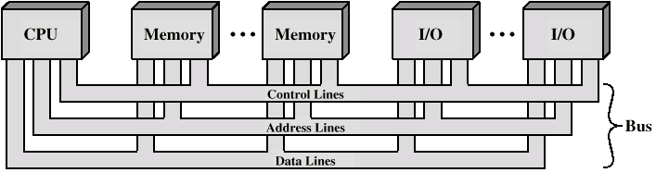
Bus Interconnection Scheme
CGMB143 COMPUTER SYSTEM

Slide 24
Operation of the Bus
CGMB143 COMPUTER SYSTEM
Send data
  Obtain the use of the bus
  Transfer data via the bus
Request data
  Obtain the use of the bus
  Transfer a request to the other module over appropriate control and address lines

Slide 25
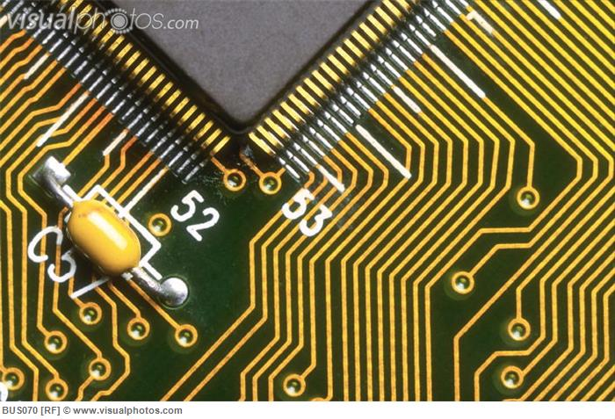
System Bus - Physical
CGMB143 COMPUTER SYSTEM
Number of parallel electrical conductors – metal lines on the circuit board

Slide 26
Single Bus - Problem
CGMB143 COMPUTER SYSTEM
Many of devices on one bus leads to:
  Propagation delays
    Long data paths mean that co-ordination of bus use can harmfully affect performance
    If aggregate data transfer approaches bus capacity
Most systems use multiple buses to overcome these problems

Slide 27
Types of Bus
CGMB143 COMPUTER SYSTEM
Dedicated
  Separate data & address lines
Multiplexed
  Shared lines
  Address valid or data valid control line
  Advantage
    Fewer lines
  Disadvantages
    More complex control
    Reduction in performance

Slide 28
Question
1) Draw the component of a computer.
2)How many steps needed to perform instruction in a computer. Draw the cycle of instruction cycle.
3) What is interrupt?
4) There are 3 main modules on a computer. Explain the operation of these three modules.
5) Draw the bus interconnection scheme and explain about address line, data line and control lines.

Slide 29
END

