Slide 1
CHAPTER 5
CSNB153 COMPUTER SYSTEM
Process Description and Control

Slide 2
Process Description and Control
CSNB153 COMPUTER SYSTEM
All multiprogramming OS are build around the concept of processes
A process is sometimes called a task

Slide 3
Major Requirements of an OS
CSNB153 COMPUTER SYSTEM
CGMB143 COMPUTER SYSTEM
OS must interleave the execution of several processes to maximize processor usage while providing reasonable response time.
OS must allocate resources to processes while avoiding deadlock.- when a process A enters a waiting state because a resource requested is being held by Process B, which in turn is waiting resource held by process A.
OS must support inter process communication and user creation of processes.

Slide 4
Process
CGMB143 COMPUTER SYSTEM
CSNB153 COMPUTER SYSTEM
A process is created for a program to be executed.
Also called a task
We can characterized the behavior of an individual process by listing the sequence of instruction that execute for that process. Such listing is referred to as a trace of the process

Slide 5
Process Trace
CGMB143 COMPUTER SYSTEM
CSNB153 COMPUTER SYSTEM
Figure 3.1 shows a memory layout of three processes.
Assume no used of virtual memory.
All of the process are fully loaded in the main memory.
There is dispatcher program that switches the processor from one process to another.

Slide 6
CGMB143 COMPUTER SYSTEM
CSNB153 COMPUTER SYSTEM

Slide 7
Process Trace..
CGMB143 COMPUTER SYSTEM
CSNB153 COMPUTER SYSTEM
Figure 3.2 shows the trace of three processes during early part of their execution.
First 12 instructions executed in processes A and C are shown.
Process B executes four instructions and assume that the fourth instruction invokes and I/O operation for which the process must wait.

Slide 8
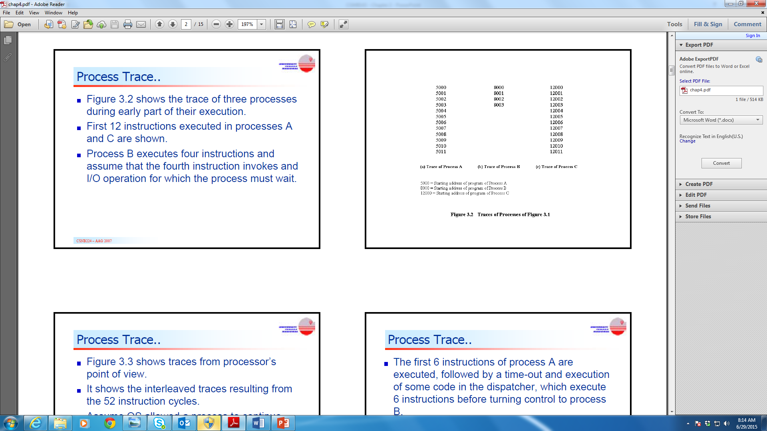
CGMB143 COMPUTER SYSTEM
CSNB153 COMPUTER SYSTEM

Slide 9
Process Trace..
CGMB143 COMPUTER SYSTEM
CSNB153 COMPUTER SYSTEM
Figure 3.3 shows traces from processor’s point of view.
It shows the interleaved traces resulting from the 52 instruction cycles.
Assume OS allowed a process to continue execution for a maximum of 6 instruction cycles, then the process will be interrupted, thus its prevent single process from monopolizing processor

Slide 10
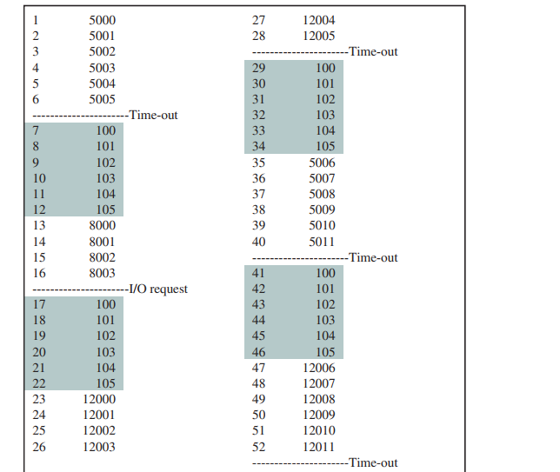

Slide 11
Process Trace..
CGMB143 COMPUTER SYSTEM
CSNB153 COMPUTER SYSTEM
The first 6 instructions of process A are executed, followed by a time-out and execution of some code in the dispatcher, which execute 6 instructions before turning control to process B
After 4 instructions are executed, process B request and I/O action for which it must wait.

Slide 12
Process Trace..
CGMB143 COMPUTER SYSTEM
CSNB153 COMPUTER SYSTEM
The processor stops executing process B and moves on to process C.
After time-out, the processor moves back to process A.
When the process times out, process B is still waiting for I/O operation to complete, so the dispatcher moves on to process C again.

Slide 13
Dispatcher
CSNB153 COMPUTER SYSTEM
Is an OS program that moves the processor from one process to another.
It prevents a single process from monopolizing processor time.
It decides who goes next according to a scheduling algorithm.
The CPU will always execute instructions from the dispatcher while switching from process A to process B

Slide 14
Process Creation
CSNB153 COMPUTER SYSTEM
Reasons for process creation:
  Submission of a batch job
  User logs on
  Created to provide a service such as printing (ex: printing a file).
  Process creates another process (Process Spawning)

Slide 15
Process Termination
CSNB153 COMPUTER SYSTEM
General reasons for process termination:
  Batch job issues Halt instruction
  User logs off
  Process executes a service request to terminate (Quit an application)
  Parent process terminate
  Parent ask to terminate the child
  Error and fault conditions

Slide 16
Process Termination..
CSNB153 COMPUTER SYSTEM
Reasons for error and fault condition :
  Time limit exceeded
  Memory unavailable
  Bounds violation -attempted access of (non-existent) 11th element of a 10-element array
  Protection error
    example write to read-only file
  Arithmetic error - attempted division by zero

Slide 17
Process Termination..
CSNB153 COMPUTER SYSTEM
  Time overrun -process waited longer than a specified maximum for an event
  I/O failure
  Invalid instruction - when a process tries to execute data (text)
  Operating system intervention - to resolve a deadlock

Slide 18
Two-State Process Model
CSNB153 COMPUTER SYSTEM
Process may be in one of two states
  Running
  Not-running

Slide 19
Two-State Process Model..
CSNB153 COMPUTER SYSTEM
When OS creates a new process, it enters that process into Not Running State.
The existence of the process is known by the OS and is waiting for an opportunity to execute.
Running process will be interrupted from time to time and dispatcher will select a new process to run.
Process will moves from the Running state to Not Running state, another process will moves to the Running state.

Slide 20
Two-State Process Model..
CSNB153 COMPUTER SYSTEM
Each process must be represented in some way so that OS can keep track of it.
  There must be some information relating to each process, including current state and location of main memory.
Process that are not running must be kept in some sort of queue, waiting their turn to be execute.
Figure 3.4b suggests a structure to deploy two state process model.

Slide 21
Not-Running Process in a Queue
CSNB153 COMPUTER SYSTEM

Slide 22
Two-State Process Model..
CSNB153 COMPUTER SYSTEM
There is a single queue in which each entry is a pointer to a particular process.
The queue must consist of linked list of data blocks, in which each block represents one process.
The queue is first in first out (FIFO) list and the processor operates in Round robin.

Slide 23
Process
CSNB153 COMPUTER SYSTEM
Queuing suggested in Figure 3.4b will be effective if all processes were always ready to execute.
BUT it is inadequate because some process that are in Not Running state either:
  ready to execute
  blocked because of waiting for I/O operation complete.

Slide 24
Process..
CGMB143 COMPUTER SYSTEM
CSNB153 COMPUTER SYSTEM
By using queuing on fig. 3.4b, the dispatcher has to scan the queue looking for the process that is not blocked and has been in queue the longest.
A way to tackle this situation is to split the Not Running state into two different states which are:
  Ready state: Ready to execute
  Blocked state: waiting for I/O
Now, instead of two states we have three states
→Ready, Running, Blocked

Slide 25
Process..
CGMB143 COMPUTER SYSTEM
For a good measure, there are another two additional states that will be useful for process management:
New state:
OS performed the necessary actions to create the process
  Process ID
  Tables needed to manage the process
but has not yet committed to execute the process (not yet admitted)
  because resources are limited

Slide 26
Process..
CSNB153 COMPUTER SYSTEM
Exit state:
Termination moves the process to this state.
It is no longer eligible for execution
Tables and other info are temporarily preserved for auxiliary program
  Ex: accounting program that cumulates resource usage for billing the users
The process (and its tables) gets deleted when the data is no more needed.

Slide 27
CSNB153 COMPUTER SYSTEM
http://courses.cs.vt.edu/csonline/OS/Lessons/Processes/index.html

Slide 28
A Five-State Model
CSNB153 COMPUTER SYSTEM
Running → the process that is currently being executed.
Ready → a process that is prepared to execute when given the opportunity.
Blocked → a process that cannot execute until some event occurs, such as the completion of I/O operation.
New → a process that has just been created but not being admitted to the pool of executable process by the OS (not being loaded in the main memory).
Exit → a process that has been released from the pool of executable processes by the OS, either because it halted or aborted for some reason.

Slide 29
Process Transitions
CSNB153 COMPUTER SYSTEM
Figure 3.5 indicates the possible state transition as follows:
Null → New
  A new process is created to execute a program.
New → Ready
  OS will move the process from New to Ready state when it is prepared to take an additional process.
Ready →Running
  When it is time, the dispatcher selects a new process to run

Slide 30
Process Transitions..
CSNB153 COMPUTER SYSTEM
Running → Exit
  The currently Running process is terminated by the OS if the process indicates that it has completed or if it aborts.
Running → Ready
  the running process has expired his time slot
  the running process gets interrupted because a higher priority process is in the ready state

Slide 31
1) What is a process?
2) What is process trace?
3) What is the job of dispatcher?
4) Give two reason why we create a process?
5) Give three reason to terminate a process
6) Explain two state model
7) Explain the 5 state model
8) Why is the problem of two state model that needed us to change to 5 state model?

