Slide 1
CHAPTER 6
INTERNAL MEMORY
CSNB153 COMPUTER SYSTEM
CSNB 153 coMPUTER SYSTEM

Slide 2
Objectives
CGMB143 COMPUTER SYSTEM
CSNB153 COMPUTER SYSTEM
CGMB143 COMPUTER SYSTEM
CGMB143 COMPUTER SYSTEM
To study the types of semiconductor main memory subsystems
  RAM
  DRAM
  SRAM
ROM
Error correction

Slide 3
Semiconductor Main Memory
CSNB153 COMPUTER SYSTEM
Basic element of semiconductor main memory (smm) – memory cell
Cell properties;
  2 stable states – 0 and 1 ← binary
  Capable of being written to set the state
  Capable of being read to sense the state

Slide 4
Memory Cell Operation
CGMB143 COMPUTER SYSTEM
CGMB143 COMPUTER SYSTEM
CSNB153 COMPUTER SYSTEM
Write
Read
Functional Terminal - Capable of carrying an electrical signal
Control
Control
Select
Cell
Data in
Select
Cell
Sense

Slide 5
Three Functional Terminals
CSNB153 COMPUTER SYSTEM
Select terminal – select memory cell for read or write operation
Control terminal – indicates read or write
  Write – other terminal provides an electrical signal → sets the state of the cell to 1 or 0
  Read – that terminal is used for output of the cell’s state

Slide 6
All memory types in this chapter are random access
CSNB153 COMPUTER SYSTEM

Slide 7
Semiconductor Memory Types
CSNB153 COMPUTER SYSTEM
Memory Type | Category | Erasure | Write Mechanism | Volatility
Random-access memory (RAM) | Read-write memory | Electrically, byte-level | Electrically | Volatile
Read-only memory (ROM) | Read-only memory | Not possible | Masks | Nonvolatile
Programmable ROM (PROM) |  |  | Electrically
Erasable PROM (EPROM) | Read-mostly memory | UV light, chip-level
Electrically Erasable PROM (EEPROM) |  | Electrically, byte-level
Flash memory |  | Electrically, block-level

Slide 8
Semiconductor Memory
CGMB143 COMPUTER SYSTEM
All semiconductor memory is random access
DRAM
SRAM

Slide 9
Random Access Memory (RAM)
CSNB153 COMPUTER SYSTEM
Characteristic
  Read/Write – read data from the memory and to write new data into the memory
    Use electrical signals
  Volatile – must have constant power supply else data lost.
  Temporary storage
2 traditional forms of RAM
  DRAM
  SRAM

Slide 10
Dynamic RAM (DRAM)
CSNB153 COMPUTER SYSTEM
Made with cells that store data as charge on capacitors
The presence or absence of charge in a capacitor is interpreted as a binary 1 or 0
  Capacitors have tendency of discharging - needs to periodically charge to maintain data storage
The term dynamic refers to this tendency of the stored charge to leak away

Slide 11
DRAM Operation
CSNB153 COMPUTER SYSTEM
Write
Read
A voltage signal is applied to the bit line
A high voltage represent 1, a low voltage represent 0
A signal is then applied to the address line allowing a charge to be transferred to the capacitor
Select address line. The transistor turns on and the charge stored on the capacitor is fed out onto a bit line and to a sense amplifier
The sense amplifier compares the capacitor voltage to a reference value and determines if the cell contains a logic 1 or logic 0
The readout from the cell discharges the capacitor which must be restored to complete the operation

Slide 12
Static RAM (SRAM)
CSNB153 COMPUTER SYSTEM
Use the same logic elements as in the processor
The binary values are stored using traditional flip-flop logic gate configuration
Data remains as long as power is supplied to it

Slide 13
DRAM versus SRAM
CSNB153 COMPUTER SYSTEM
Volatile – need power to preserve data
DRAM
SRAM
Simpler to build, smaller
More dense
Less expensive
Needs refresh
Larger memory units
Use as main memory
Faster
Use as cache memory

Slide 14
Read Only Memory (ROM)
CSNB153 COMPUTER SYSTEM
Permanent storage
  Nonvolatile
Use in
  Microprogramming
  Library subroutines
  Systems programs (BIOS)
  Function tables

Slide 15
Types of ROM
CSNB153 COMPUTER SYSTEM
ROM
PROM
EPROM
EEPROM
Flash memory

Slide 16
ROM
CSNB153 COMPUTER SYSTEM
Data is written during manufacture

Slide 17
PROM – Programmable ROM
COMPUTER SYSTEM
Nonvolatile
Written once
  Electrically – supplier or user
  Perform after fabrication
  Need special equipment to program

Slide 18
EPROM – Erasable PROM
COMPUTER SYSTEM
Read/write electrically
Before a write operation, empty the cells by ultraviolet radiation
The erase procedure can be performed repeatedly
Expensive than PROM

Slide 19
Flash Memory
COMPUTER SYSTEM
Intermediate between EPROM and EEPROM; cost and functionality
Use an electrical erasing tech; much faster than EEPROM
Possible to erase just blocks of memory

Slide 20
EEPROM – Electrical EPROM
COMPUTER SYSTEM
Can be written into at any time without erasing prior contents - updates bytes address
Write operation is longer than read operation
Nonvolatile and flexible in update using ordinary bus control

Slide 21
Chip Logic
COMPUTER SYSTEM
As with other integrated circuit product, semiconductor memory comes in packaged chips.
Each chip contains an array of memory cells
The array is organized into W words of B bits each.
Example : a 16 –Mbit chip could be organized as 1 M 16 words. ( word- is a fixed sized group of bits that are handled as a unit by the instruction set and/or hardware of the processor)

Slide 22
Interleaved Memory
Main memory is composed of a collection of DRAM memory chips.
A number of chips can be group together to form of memory bank. It is possible to organized the memory bank in a way known as interleaved memory.
Each bank is independently able to service a memory read or write request so that K bank can service K requests simultaneously increasing memory read or write by a factor of K.

Slide 23
Interleaved Memory
Advance technique used by high-end motherboards/chipsets to improve memory performance
Increase bandwidth by allowing simultaneous access to more than one bank of memory
Improves performance since CPU/processor can transfer more information to/from memory in the same amount of time, and helps ease the CPU-memory bottleneck

Slide 24
Error Correction
COMPUTER SYSTEM

Slide 25
Errors
COMPUTER SYSTEM
A semiconductor memory is subject to errors.
Categories;
  Hard failures
  Soft errors
Example : power supply problem

Slide 26
Errors – Categories
Hard Failures
Soft Error
A permanent physical defect so that the memory cells affected cannot reliably store data but become stuck at 0 or 1
A random, nondestructive event that alters the contents of one or more memory cells without damaging the memory

Slide 27
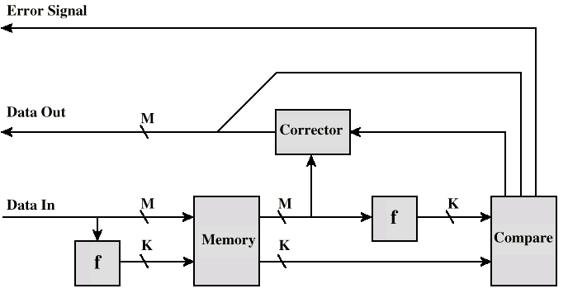
Process of Detecting and Correcting Errors
COMPUTER SYSTEM
When data are to be read into memory, a calculation, function f is performed on the data to produce a code
Both the code and the data are stored
If M –bit word of data is to be stored and the code is of length K bits, then the actual size of the stored word is M + K bits

Slide 28
Process of Detecting and Correcting Errors (Cont.)
COMPUTER SYSTEM
When the previous stored word is read out, the code is used to detect and possibly correct errors
A new set of K code bits is generated from the M data bits and compared with the fetched code bits

Slide 29
Process of Detecting and Correcting Errors (Cont.)
COMPUTER SYSTEM
Three results of the comparisons;
  No errors-the fetched data bits are sent out
  An error is detected-possible to correct, the data bits +error correction bits are fed out into a corrector, which produces a corrected set of M bits to be sent out
  An error is detected and connect be corrected, this condition is reported

Slide 30
Process of Detecting and Correcting Errors (Cont.)
CGMB143 COMPUTER SYSTEM
The codes are referred as error-correcting codes
A code is characterized by the number of bit errors in a word that it can correct and detect
The simplest error-correcting codes is the Hamming code

Slide 31
Hamming Code
Use to detect and correct one-bit change in an encoded code word
Consider the table which has 15 positions. Data is represented (stored) in every position except 1, 2, 4 and 8. These positions are used to store parity (error correction) bits

Slide 32
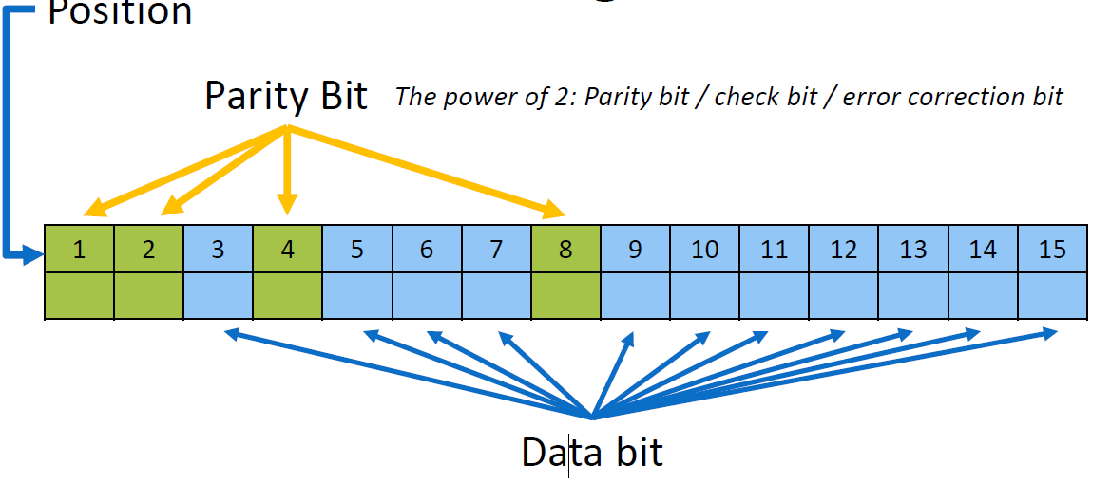
Hamming Code

Slide 33
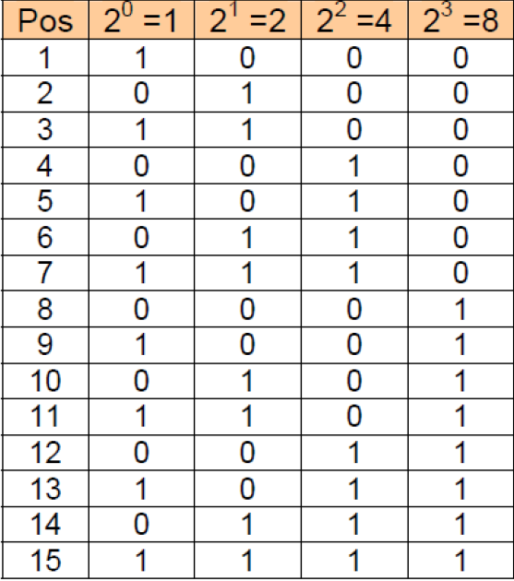
Hamming Code (Cont.)
Using the four parity (error correction bits) positions we can represent 15 values (1- 15)

Slide 34
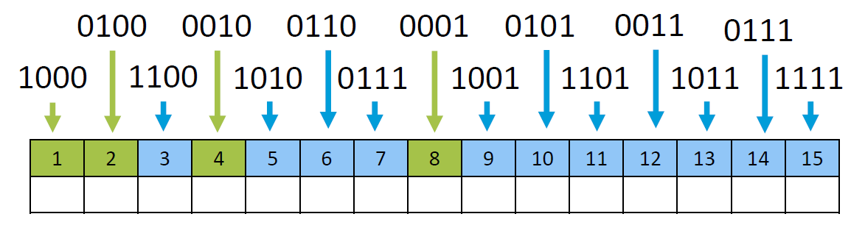
Hamming Code

Slide 35
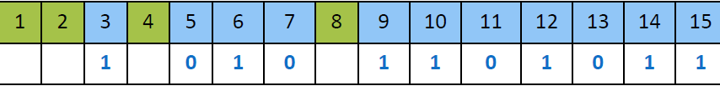
Example 1
Given 11-bit data as follows. Using the Hamming algorithm, find the parity bit (check code).
10101101011
Step 1: Data bit: 10101101011

Slide 36
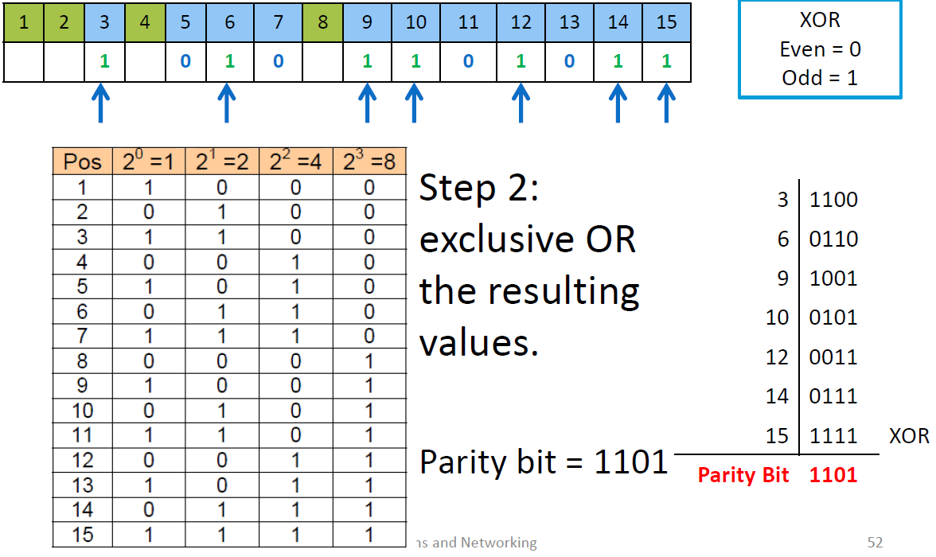

Slide 37
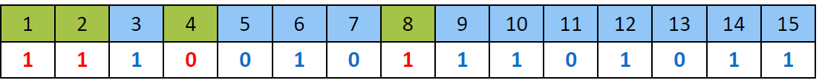
Example 1 (Cont.)
This is the encoded code word that would be sent.
The receiving side would re-compute the parity bits and compare them to the ones received.
If they were the same no error occurred
if they were different the location of the flipped bit is determined.

Slide 38
Exercise
Given 11-bit data as follows. Find the parity bit (check code).
  1. 1111 0000 111
  2. 0101 0101 010

Slide 39
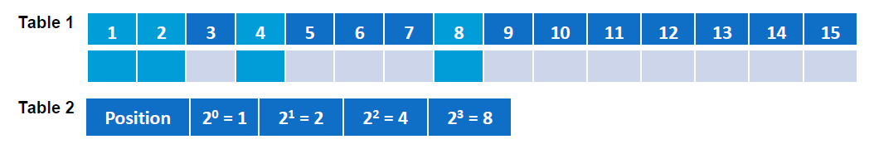
Exercise
Suppose an 11-bit data word stored in memory is 01010011001. Using the Hamming algorithm, determine what check bits (parity bits) would be stored in the memory with the given data word.
Use the Table 1 below to store the data in the memory and use the Table 2 below to get the binary representation of the number position.

Slide 40
Example 2
Given 11-bit data 10101101001 and its check code (parity bit) 1101. Verify the data given is error free. If there is an error, find its location.

Slide 41
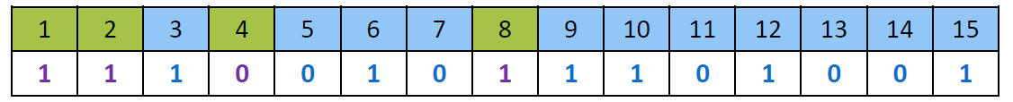
Example 2 (cont.)
Step 1: Data bit: 10101101001 ;Parity bit: 1101

Slide 42
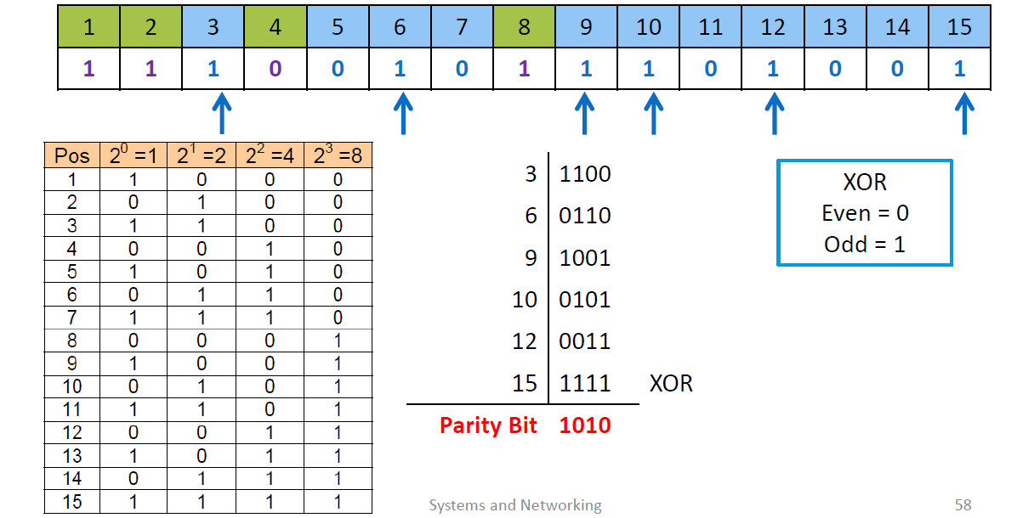
Example 2 (cont.)
Step 2: exclusive OR the resulting values.

Slide 43
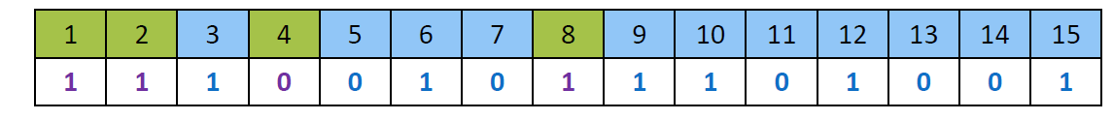
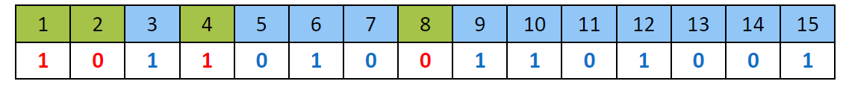
Example 2 (cont.)
Step 3: Compare
Sent/Received Parity Bit = 1101
New Calculated Parity Bit = 1010
1101 ≠ 1010 ← ERROR!

Slide 44
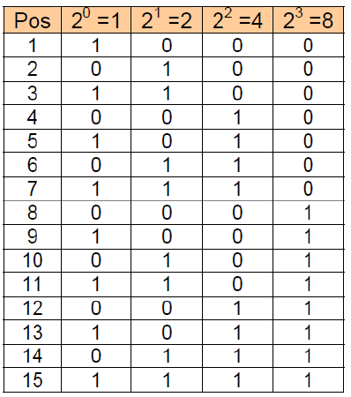
Example 2 (cont.)
Step 4: XOR
1101
1010 XOR
0111 = Position 14 was flipped

Slide 45
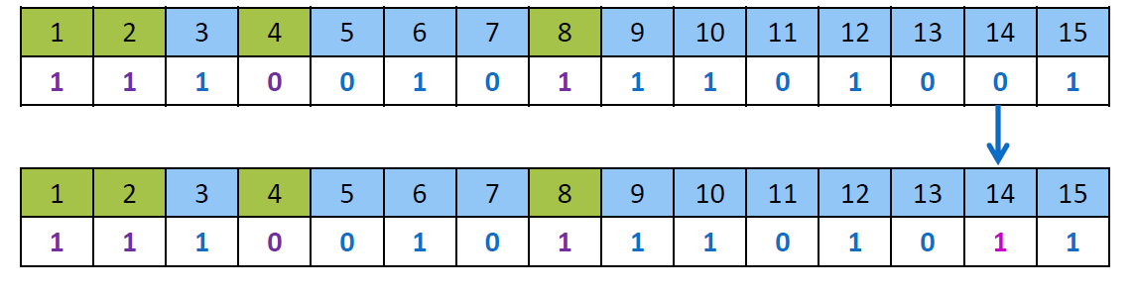
Example 2 (cont.)
Step 5: Change 1 to 0 for Position 14

Slide 46
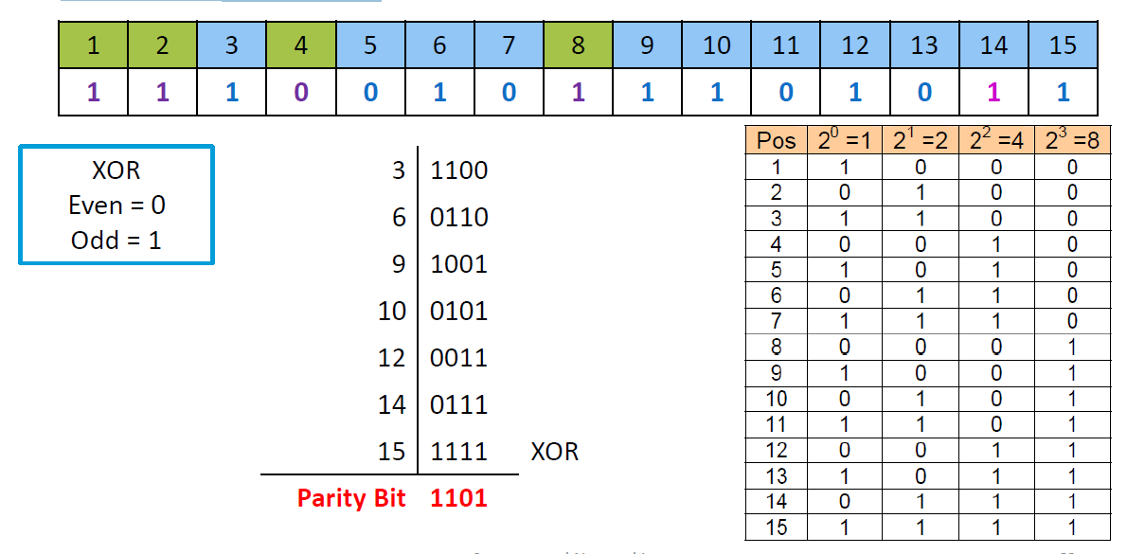
Example 2 (cont.)
Step 6: Verify

Slide 47
Exercise
Given 11-bit data and its check code (parity bit). Verify the data given is error free. If there is an error, find its location.
1. Data: 1000 1000 111; Parity bit: 1100
2. Data: 1000 1010 101; Parity bit: 0011

