Slide 1
CHAPTER 7 EXTERNAL MEMORY
CSNB153 COMPUTER SYSTEM
CSNB153 coMPUTER SYSTEM

Slide 2
Types of External Memory
COMPUTER SYSTEM
CSNB153
Magnetic Disk
Optical
Magnetic Tape

Slide 3
Magnetic Disk
COMPUTER SYSTEM
CSNB153

Slide 4
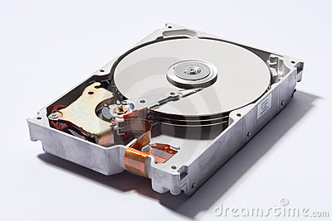
Magnetic Disk
CSNB153 COMPUTER SYSTEM
Disk
  A circular platter constructed of nonmagnetic material called substrate
    Aluminium (old)
    Glass (new)
  Coated with a magnetisable material

Slide 5
Magnetic Disk (Cont.)
CSNB153 COMPUTER SYSTEM
Glass
  Improved surface uniformity
    Increases reliability
  Reduction in surface defects
    Reduced read/write errors
  Better stiffness
  Greater ability to withstand shock and damage

Slide 6
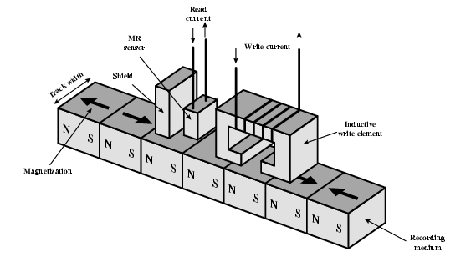
Magnetic Disk – Read/Write
CGMB143 COMPUTER SYSTEM
CSNB153 COMPUTER SYSTEM
Mechanisms
  Recording & retrieval via conductive coil called a head
  May be single read/write head or separate ones
  During read/write, head is stationary, platter rotates

Slide 7
Magnetic Disk – Read/Write (Cont.)
CSNB153 COMPUTER SYSTEM
Write
Read
Current through coil produces magnetic field
Pulses sent to head
Magnetic pattern recorded on surface below
Traditional
  Magnetic field moving relative to coil produces current
  Coil is the same for read and write
Contemporary
  Separate read head, close to write head
  The read head are consists of partially shielded magneto resistive (MR) sensor
  The MR has an Electrical resistance depends on direction of magnetization of the medium moving under it.
  High frequency operation
    Higher storage density and speed

Slide 8
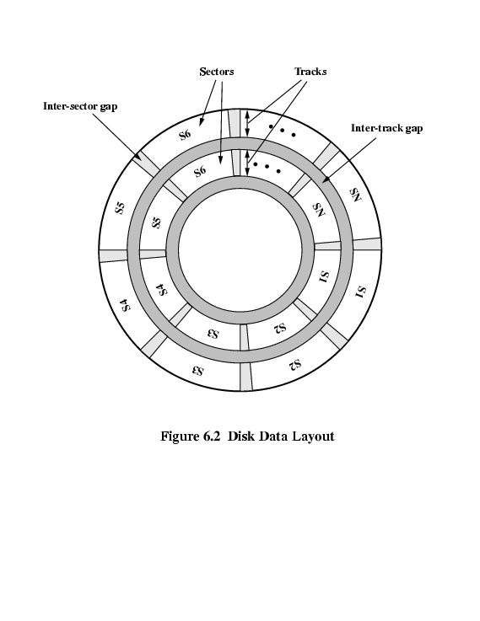
Magnetic Disk –
Organization, Formatting & Layout
COMPUTER SYSTEM
Term | Description
Head | A small device capable of reading from or writing to a portion of the platter rotating beneath it
Track | Organize data on the platter in a concentric set of rings
Width | Track width = head width
Gaps | separate the adjacent tracks
Sectors | Data are transferred to and from the disk in sectors

Slide 9
Magnetic Disk - Velocity
CSNB153 COMPUTER SYSTEM
Issue: Bit near centre of rotating disk passes fixed point slower than bit on outside of disk
Solution:
  Increasing the spacing between bits of information recorded in segments of the disk
  The info can then be scanned at the same rate by rotating the disk at a fixed speed known as constant angular velocity (CAV)

Slide 10
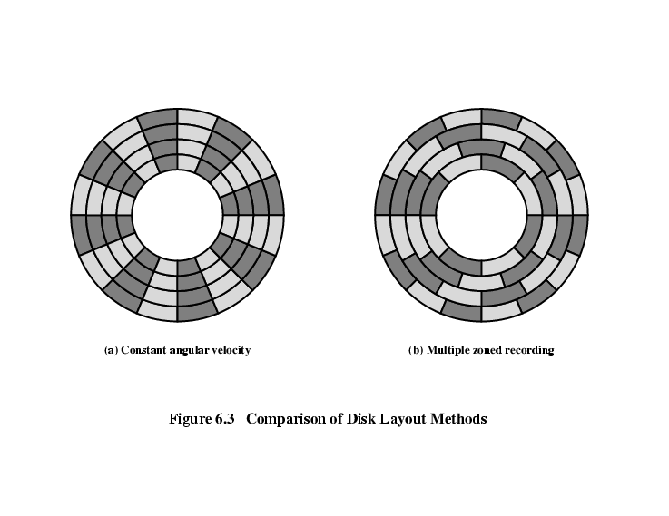
Magnetic Disk - Layout Methods Diagram
CGMB143 COMPUTER SYSTEM
CSNB153 COMPUTER SYSTEM

Slide 11
Magnetic Disk – Constant Angular Velocity
CGMB143 COMPUTER SYSTEM
CSNB153 COMPUTER SYSTEM
The disk is divided into a number of pie-shaped sectors and into a series of concentric tracks
Advantage of CAV:
  The individual blocks of data can be directly addressed by tracks and sectors
Disadvantage of CAV:
  The amount of data that can be stored on the long outer tracks is the only same as what can be stored on the short inner tracks

Slide 12
Magnetic Disk – Multiple Zone Recording
CGMB143 COMPUTER SYSTEM
CSNB153 COMPUTER SYSTEM
The surface is divided into a number of concentric zones –
  The number of bits per track is constant (Within the zone)
  Zones farther from the center contain more bits (since more sectors) than zones closer to the center
Advantage:
  Increase density
Disadvantage:
  Require complex circuitry

Slide 13
Magnetic Disk –
Physical Characteristics
CGMB143 COMPUTER SYSTEM
CSNB153 COMPUTER SYSTEM
Head motion
  Fixed head
    One read write head per track
    Heads mounted on fixed ridged arm
  Movable head
    One read write head per side
    Mounted on a movable arm

Slide 14
Magnetic Disk –
Physical Characteristics (Cont.)
CGMB143 COMPUTER SYSTEM
CSNB153 COMPUTER SYSTEM
Removable disk
  Can be removed from drive and replaced with another disk
  Provides unlimited storage capacity
  Easy data transfer between systems
Non-removable disk
  Permanently mounted in the drive

Slide 15
Magnetic Disk – Classifications
CGMB143 COMPUTER SYSTEM
CSNB153 COMPUTER SYSTEM
Head mechanism
#1 Traditional head
  Positioned a fixed distance above the platter-allowing an air gap
#2 head mechanism that actually comes into physical contact with the medium during R/W operation
  Used in floppy disk
    8”, 5.25”, 3.5”
    Small capacity
    Up to 1.44Mbyte (2.88M never popular)
    Slow
    Universal
    Cheap

Slide 16
Magnetic Disk - Performance
CGMB143 COMPUTER SYSTEM
CSNB153 COMPUTER SYSTEM
Depends on;
  Computer system
  OS
  Nature of the I/O channel
  Disk controller hardware

Slide 17
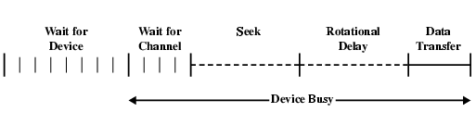
Magnetic Disk – Performance (Cont.)
CGMB143 COMPUTER SYSTEM
CSNB153 COMPUTER SYSTEM
General timing of disk I/O transfer
Seek time → Moving head to correct track
(Rotational) latency/delay → Waiting for data to rotate under head
Access time = Seek + Latency
Transfer rate-the time required for the transfer data

Slide 18
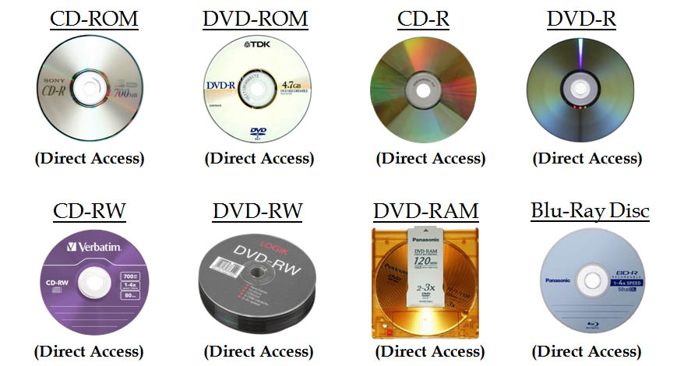
Optical Storage
CGMB143 COMPUTER SYSTEM
CSNB153 COMPUTER SYSTEM

Slide 19
Optical Storage
CGMB143 COMPUTER SYSTEM
CSNB153 COMPUTER SYSTEM
Originally for audio
650Mbytes giving over 70 minutes audio
The disk is formed from a resin such as polycarbonate.
Record data digitally (music/computer data)
Data recorded as a series of microscopic pits on the surface of the polycarbonate

Slide 20
Optical Storage (Cont.)
CGMB143 COMPUTER SYSTEM
CSNB153 COMPUTER SYSTEM
Organized in a single spiral track in a sequence of blocks
Sectors near the outside of the disk are the same length as those near the inside
Info is packed evenly across the disk in segments of the same size - scanned at the same rate by rotating the disk as a variable speed
The pits are then read by the laser as a constant linear velocity (CLV)

Slide 21
Optical Storage - Writing
CGMB143 COMPUTER SYSTEM
CSNB153 COMPUTER SYSTEM
Create a master disk – high-intensity laser
Use master to make a die to stamp out copies onto polycarbonate
Pitted surface - coated with a highly reflective surface (aluminium / gold)
Shiny surface - protected against dust and scratches by suing a top coat of clear acrylic
A label can be silkscreened onto the acrylic

Slide 22
Optical Storage - Reading
CSNB153 COMPUTER SYSTEM
Low-powered laser – retrieve information from CD
Laser - shines through the clear polycarbonate
Motor - spins the disk past it
Intensity of the reflected light of the laser changes as it encounters a pit
Lands - areas between pits
A land is smooth surface which reflects back at higher intensity
Change between pits and lands is detected by a photosensor -convert into a digital signal
The sensor tests the surface at regular intervals
The beginning or end of a pit represents a 1, when no change in elevation occur between intervals, a 0 is recorded

Slide 23
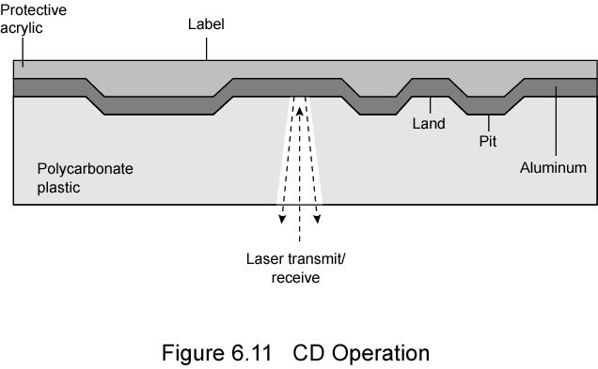
Optical Storage - Reading
CSNB153 COMPUTER SYSTEM

Slide 24
Optical Storage – Types
CSNB153 COMPUTER SYSTEM
CD-ROM
CD-R
CD-RW
DVD

Slide 25
Optical Storage – CD-ROM
CGMB143 COMPUTER SYSTEM
Appropriate for large amount of data
Removable
Disadvantages:
  Read only-cannot be updated
  The access time is longer compared to magnetic disk drive

Slide 26
Optical Storage – CD-R
CSNB153 COMPUTER SYSTEM
CD-Recordable
Write Once Read only Memory (WORM)
Compatible with CD-ROM drives

Slide 27
Optical Storage – CD-RW
CGMB143 COMPUTER SYSTEM
Erasable
Getting cheaper
Mostly CD-ROM drive compatible
Can be rewritten and can used as secondary storage similar to magnetic disk

Slide 28
Optical Storage – DVD
CSNB153 COMPUTER SYSTEM
Digital Video Disk
  Used to indicate a player for movies
    Only plays video disks
Digital Versatile Disk
  Used to indicate a computer drive
    Will read computer disks and play video disks

Slide 29
Optical Storage – DVD
CSNB153 COMPUTER SYSTEM
Technology
Multi-layer
Very high capacity (4.7G per layer)
Full length movie on single disk
  Using MPEG compression

Slide 30
Optical Storage – DVD (Cont.)
CGMB143 COMPUTER SYSTEM
High Definition
Designed for high definition videos
  Much higher capacity than DVD
    Shorter wavelength laser
      Blue-violet range
  Smaller pits
HD-DVD
  15GB single side single layer
Blu-ray
  Data layer closer to laser
    Tighter focus, less distortion, smaller pits
  25GB on single layer
  Available read only (BD-ROM), Recordable once (BR-R) and re-recordable (BR-RE)

Slide 31
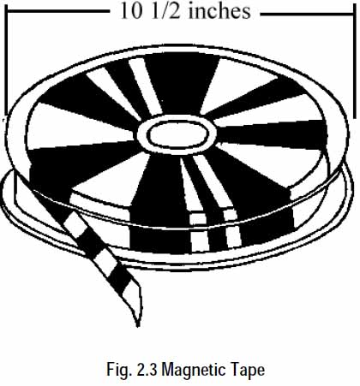
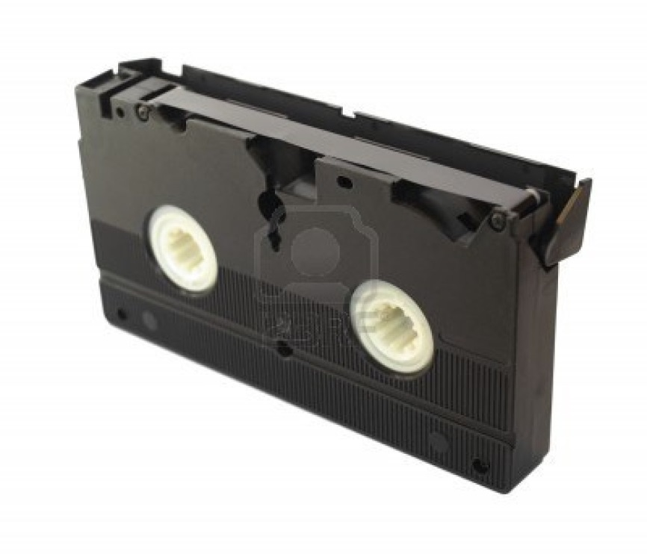
Magnetic Tape
CSNB153 COMPUTER SYSTEM

Slide 32
Magnetic Tape
CSNB153 COMPUTER SYSTEM
Tape system use the same reading/writing technique as disk system
Made from polyester tape coated with magnetizable material
Data on the tape are structured as a number of parallel tracks running lengthwise
Serial access
Slow
Very cheap
Backup and archive

