Slide 1
CHAPTER 9: Virtual Memory
CSNB153 COMPUTER SYSTEM
CSNB153 coMPUTER SYSTEM

Slide 2
Virtual Memory

Slide 3
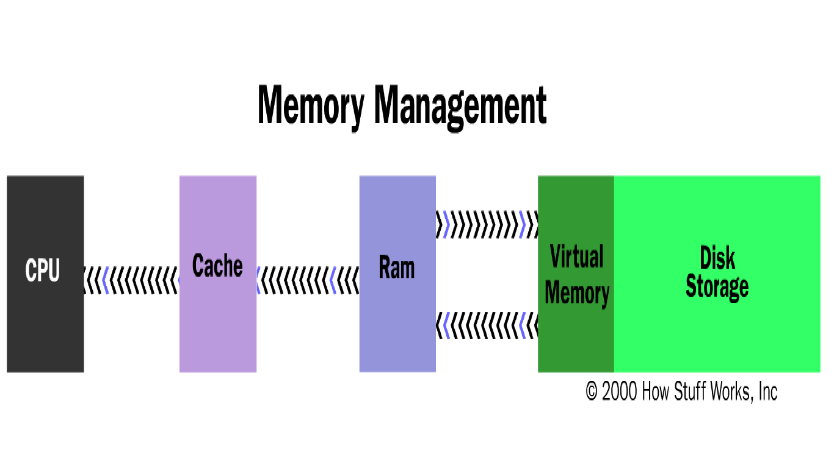
Memory management

Slide 4
Hardware and Control Structures
Two characteristics of paging and segmentation that leads to the breakthrough:
  1. Memory references are dynamically translated into physical addresses at run time
  2. A process may be broken up into pieces (pages or segment) that do not need to located contiguously in main memory.
→Hence: all pieces of a process do not need to be loaded in main memory during execution

Slide 5
Execution of a Program
The OS brings into main memory only a few pieces of the program.
The portion of process that is in main memory is called “Resident Set”.
An interrupt is generated when an address is needed that is not in main memory

Slide 6
Execution of a Program
Piece of process is brought into main memory by:
  OS issues a disk I/O Read request to bring into main memory the piece referenced
  Another process is dispatched to run while the disk I/O takes place
  An interrupt is issued when disk I/O complete
    this causes the operating system to place the affected process in the Ready state

Slide 7
Adv. of Breaking Up a Process
CGMB143 COMPUTER SYSTEM
1. More processes may be maintained in main memory
  Only load in some of the pieces of each process, there is room for more processes.
  With so many processes in main memory it is very likely a process will be in the Ready state at any particular time
    →efficient CPU utilization.

Slide 8
Types of Memory
Main Memory / Real memory
  Main memory where process executes.
Virtual memory
  Memory on disk
  Allows for effective multiprogramming and relieves the user of tight constraints of main memory.

Slide 9
Locality and Virtual Memory
To accommodate as many processes as possible, only a few pieces of each process is maintained in main memory.
But main memory may be full: when the OS brings one piece in, it must swap one piece out.
The OS must not swap out a piece of a process just before that piece is needed
If it does this too often this leads to trashing:
  The processor spends most of its time swapping pieces rather than executing user instructions

Slide 10
Principle of Locality
Principles of locality:
  →Program and data references within a process tend to cluster.
Hence: Only a few pieces of a process will be needed over a short period of time.
Possible to make intelligent guesses about which pieces will be needed in the future.
This suggests that virtual memory may work efficiently.

Slide 11
Support Needed for VM
1. Memory management hardware must support paging or segmentation or combination of paging and segmentation and/or segmentation.
2. OS must be able to manage the movement of pages or segments or pages and segments between secondary memory and main memory.

Slide 12
Paging

Slide 13
Paging
In simple paging each process has its own page table, and when all of its pages are loaded into memory, the page table for a process is created and loaded into memory.
Each page table entry contains the frame number of the corresponding page in memory.
With virtual memory scheme page table becomes more complex.

Slide 14
Paging
Each page table entry contains:
Present bit (P)
To indicate whether the page is in main memory or not.
  If it is in memory, the entry contains the frame number of the corresponding page in main memory.
  If it is not in memory, the entry may contain the address of that page on disk or the page number may be used to index another table to obtain the address of that page on disk.

Slide 15
Paging
2. A modify bit (M)
  Indicate if the page has been altered since it was last loaded into main memory
  If no change has been made, the page does not have to be written to the disk when it needs to be swapped out
3. Other control bits
  May be present if protection is managed at the page level
    a read-only/read-write bit
    protection level bit: kernel page or user page (more bits are used when the processor supports more than 2 protection levels)

Slide 16
Page Table Structure
The basic mechanism for reading a word from memory involves translation of a virtual or logical address consisting of frame number and offset, using a page table.
Page tables are variable in length (depends on process size)

Slide 17
Page Table Structure
Figure 8.3 suggests a hardware implementation.
  When a particular process is running, register holds the starting address of the page table for the process.
  The page number of a virtual address is used to index that table to get the frame number.
  Than combined it with offset of a virtual address to produce the desired physical address.

Slide 19
Page Table Structure
There is one page table for each of the process.
But each of process can occupy huge amounts of virtual memory.
Clearly the amount of memory devoted to page table alone could be unacceptable.

Slide 20
Page Table Structure
To overcome this problem, most virtual memory schemes store page tables in virtual memory rather than real memory.
So, page table is also subject to paging.
When a process is running at least part of its running, page table must be in memory.
Approach to organize the page table:
  1. Two level scheme
  2. Inverted Page Table Structure

Slide 21
Segmentation

Slide 22
Segmentation
Segmentation allow programmer to view memory as consisting of multiple address space or segment
Segment may be unequal dynamic size.
Memory references consists of a segment number and offset.
Each process has its own segment table

Slide 23
Segmentation
Each segment table entry contains:
  a present bit (P),
  modified bit (M)
  other control bits

Slide 24
Segmentation
If the segment is in main memory, the entry contains the starting address and the length of that segment.
Other control bits may be present if protection and sharing is managed at the segment level

Slide 25
Segmentation
The basic mechanism for reading a word from memory involves the translation of a virtual address consisting of a segment number and offset into physical address using segment table.
Size of the segment table depends on the size of the process and we can’t expect to hold it in register and it must be in memory to be accessed.

Slide 26
Segmentation
Fig. 8.12 suggests a hardware implementation of this scheme:
  When a particular process is running, a register holds the starting address of segment table for that process.
  The segment number of a virtual address is used to index that table and look for the corresponding memory address for the start of the segment.
  Then it is added to the offset portion on the virtual address to produce the desired physical address.

Slide 28
Combined Paging and Segmentation

Slide 29
Combined Paging and Segmentation
To combine their advantages some processors and OS page the segments.
Several combinations exists. Here is a simple one :
  User s address space (in memory) will be broken up into a number of segments.
  Each segment will be broken up into a number of fixed size pages (size must equal with memory frame)
From programmer’s point of view, a logical address still consists of a segment number and offset.

Slide 30
Combined Paging and Segmentation
From system’s point of view the segment offset is viewed as a page number and page offset for a page within the specified segment.
Each process has:
  one segment table
  several page tables: one page table per segment

Slide 31
Combined Paging and Segmentation
The virtual address consist of:
  a segment number: used to index the segment table who’s entry gives the starting address of the page table for that segment
  a page number: used to index that page table to obtain the corresponding frame number.
  an offset: used to locate the word within the frame

Slide 32
Combined Paging and Segmentation
Figure 8.13 suggests a structure to support combined paging/segmentation.
  For each process there is segment table and number of page tables., one per process segment.
  When a process is running, a register holds the starting address of the segment table for that process.
  Presented with a virtual address, the processor uses the segment number portion to index into the process segment to find the page table for that segment.

Slide 33
Combined Paging and Segmentation
  Then the page number portion of the virtual address is used to index the page table and look up the corresponding frame number.
  Then, combined it with the offset portion of the virtual address to produce physical address

Slide 35
Combined Paging and Segmentation
Segment table entry:
  Length field
  Base field - is the physical address of the page table of that segment.
  Other control bits is used for sharing and protection purposes.
  The present and modified bits are not needed because these matters are handled at the page table.

Slide 36
Combined Paging and Segmentation
Page table entry:
  Present bit (P)
  Modify bit (M)
  Other Control Bits
  Frame Number.
Protection and sharing info most naturally resides in segment table entry.
  Ex: a read-only/read-write bit, a kernel/user bit...

Slide 37
Operating System Software
Memory management software depends on whether the hardware supports paging or segmentation or both
Pure segmentation systems are rare.
Segments are usually paged – memory management issues are then those of paging
  → Thus concentrate on issues associated with paging
To achieve good performance we need a low page fault rate.

Slide 38
Fetch Policy

Slide 39
Fetch Policy
Determines when a page should be brought into memory.
Two common policies:
  1. Demand Paging
  2. Prepaging

Slide 40
Fetch Policy – Demand Paging
Only brings pages into main memory when a reference is made to a location on the page (paging on demand only).

Slide 41
Fetch Policy – Pre-Paging
Brings in more pages than needed
Locality of references suggest that it is more efficient to bring in pages that reside contiguously on the disk
Efficient not definitely established; the extra pages brought in are “often” not referenced.

Slide 42
Placement and Replacement Policy

Slide 43
Placement Policy
Determines where in real memory a process piece resides.
For pure segmentation systems:
  first-fit, next fit... are possible choices (a real issue)
For paging (and paged segmentation):
  the hardware decides where to place the page: the chosen frame location is irrelevant since all memory frames are equivalent (not an issue)

Slide 44
Replacement Policy
Deals with the selection of a page in main memory to be replaced when a new page is brought in.
This occurs whenever main memory is full (no free frame available). Occurs often since the OS tries to bring into main memory as many processes as it can to increase the multiprogramming level

Slide 45
Replacement Policy
Not all pages in main memory can be selected for replacement
Some frames are locked (cannot be paged out) known as Frame Locking:
  much of the kernel is held on locked frames as well as key control structures and I/O buffers
The OS might decide that the set of pages considered for replacement should be:
  limited to those of the process that has suffered the page fault
  the set of all pages in unlocked frames

Slide 46
Replacement Policy
The decision for the set of pages to be considered for replacement is related to the resident set management strategy:
  how many page frames are to be allocated to each process?
No matter what is the set of pages considered for replacement, the replacement policy deals with algorithms that will choose the page within that set.

Slide 47
Basic Replacement Algorithms
1. Optimal policy
2. Least Recently Used
3. First In First Out
4. Clock policy (not cover in the syllabus)

Slide 48
Basic Replacement Algorithms:
Optimal Policy
Selects for replacement that page for which the time to the next reference is the longest
Produce the fewest number of page faults Impossible to implement because need to have perfect knowledge of future events.

Slide 49
Basic Replacement Algorithms:
Least Recently Used
Replaces the page that has not been referenced for the longest time.
By the principle of locality, this should be the page least likely to be referenced in the near future.
Performs nearly as well as the optimal policy.
Each page could be tagged with the time of last reference. This would require a great deal of overhead.

Slide 50
Basic Replacement Algorithms:
First In First Out
Treats page frames allocated to a process as a circular buffer.
Simplest replacement policy to implement.
Page that has been in memory the longest is replaced.
These pages may be needed again very soon

