Slide 1
Computer Networking From LANs to WANs: Hardware, Software, and Security
Chapter 7
Network Applications

Slide 2
Objectives
To discuss on some network applications :
Web Service and HTTP
E-mail and SMTP
FTP
Telnet

Slide 3
WWW Service and HTTP
HTTP is the protocol used for communication between a Web browser and a Web server.
A Web address is specified using a URL (Uniform Resource Locator).
  Example: http://www.cisco.com/web-server.htm
The URL given above has three parts:
  http – the protocol or scheme
  www.cisco.com – the server name
  web-server.htm – the name of the file requested
The server name www.cisco.com first needs to be converted to IP address using DNS.

Slide 4
WWW Service and HTTP
The browser then sends a GET request to the server to ask for the file web-server.htm.
  GET is one of the message type defined by HTTP. There are also other message types. For example:
    POST: used to upload data that user put into forms on the Web site.
    PUT: used to upload resources or contents to the Web server.
Upon receiving the request, the server will reply with the requested file.
Once the file is received, the browser converts the HTML code and formats the page for the browser window.

Slide 5
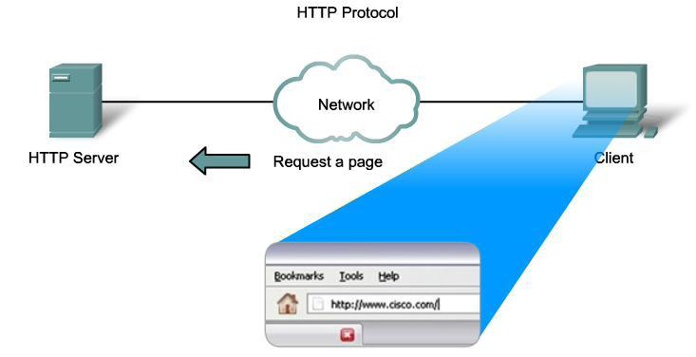
WWW Service and HTTP

Slide 6
WWW Service and HTTP
HTTP (port 80) is not a secure protocol.
  All HTTP messages are sent in clear text and can be easily intercepted and read.
For a more secure access to the Web server, the HTTP Secure (HTTPS / port 443) protocol is used.
  HTTPS uses authentication and encryption to secure data as it travels between client and server.
  It also specifies additional rules for passing data between the application layer and transport layer.

Slide 7
What Is E-Mail?
Personal communication tool used to send messages:
  To several recipients
  Containing text, graphics, multimedia audio and video files
  To a computer program
    Mailing list program or mail exploder
  Encrypted for security purposes

Slide 8
E-mail Services and SMTP/POP Protocols
Email requires several different applications / services and protocols.
  Applications / services:
    Mail User Agent (MUA) – at client part
    Mail Transfer Agent (MTA)
    Mail Delivery Agent (MDA)
  Protocols:
    Simple mail transfer protocol (SMTP)
    Post Office Protocol (POP)
A user writes and reads email using a mail user agent (MUA), or more commonly referred to as an email client.
at Server part

Slide 9
E-mail Services and SMTP/POP Protocols
An MUA has two main functions:
  To send email to a mail server.
  To retrieve email from a mail server.
To send email, a protocol called SMTP is used.
  This protocol is used to send email from a mail client to a mail server, and also to forward email between mail servers.
To retrieve email, the POP protocol can be used.
  Email retrieval can also be done using other protocols such as IMAP or Exchange.

Slide 10
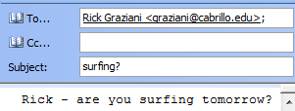

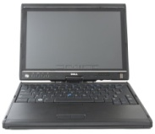
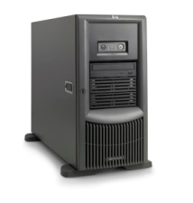
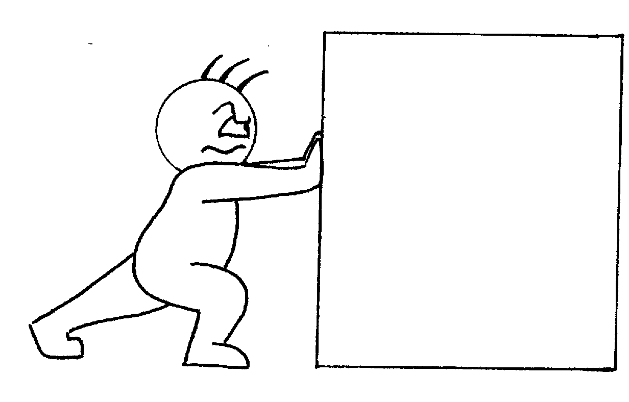
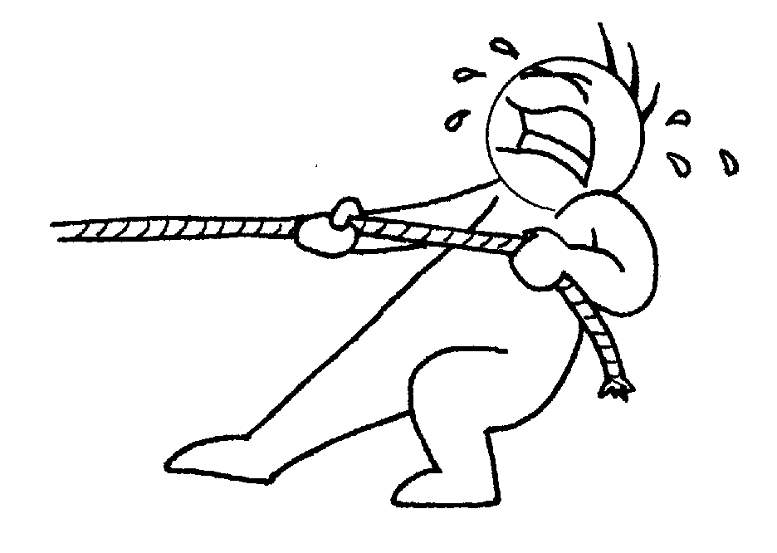
E-mail Services and SMTP/POP Protocols
MUA
MUA
User agent
Mail server
Mail server
User agent
SMTP
SMTP
POP3 IMAP
Sender
Protocol:
SMTP
Receiver
Protocol :
POP/IMAP/Exchange

Slide 11
E-mail Services and SMTP/POP Protocols
Examples of SMTP commands:
  HELO - Identifies the SMTP client process to the SMTP server process.
  EHLO - New version of HELO, which includes service extensions.
  MAIL FROM – Identifies the email sender.
  RCPT TO – Identifies the email receiver.
  DATA – Identifies the body of the email message.

Slide 12
E-mail Services and SMTP/POP Protocols
On an email server, there are two separate processes:
  Mail Transfer Agent (MTA)
  Mail Delivery Agent (MDA)
The MTA receives email from an email client or from another email server.
Based on the email header, the MTA will decide whether this email should be sent to a mailbox on the server or should be forwarded to another email server.

Slide 13
E-mail Services and SMTP/POP Protocols
If the email should be sent to a local mailbox, the MTA would then send the email to the MDA.
  The task of an MDA is to accept email from MTA and places it into the appropriate users’ mailboxes.
  The MDA can also resolve final delivery issues such as:
    Virus scanning
    Spam filtering
    Return-receipt handling.
If the email is for a user not on the local server, the MTA routes the email to the MTA on the appropriate server.

Slide 14
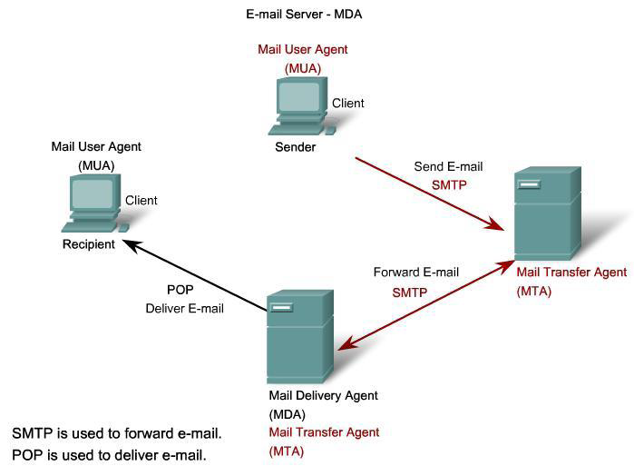
E-mail Services and SMTP/POP Protocols
Email Server: MTA
Is this recipient in my list of recipients?
No. Forward email to another server
SMTP/POP3 Server
Recepient@domain.com
SMTP/POP3 Server

Slide 15
E-mail Services and SMTP/POP Protocols
Is this recipient in my list of recipients?
NO. Forward email to another server
Is this recipient in my list of recipients?
YES. Place email in recipient’s mailbox

Slide 16
E-Mail Error Messages
Two common errors
  Incorrectly specifying mailbox name
  Incorrectly specifying computer name
Message generated and sent to user

Slide 17
File Transfer Protocol (FTP)
  FTP is an application for performing file transfer between a client and a server
  An FTP client is an application that runs on a computer that is used to push and pull files from a server running the FTP daemon (ftpd).
  FTP transfers files efficiently and reliably among host computers
  Allows convenience of remote file storage capabilities

Slide 18
FTP Client and Server
  File Transfer Protocol (FTP)
    Uses connection-oriented TCP for guaranteed reliability
  Text file
    Contains ASCII text characters
  Binary file
    Contains any number of binary digit combinations
FTP requires two connections between the client and the server:
  For commands and replies – port 21
  For the actual file transfer – port 20

Slide 19
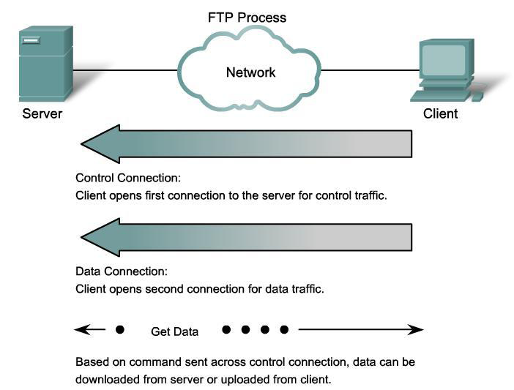
FTP

Slide 20
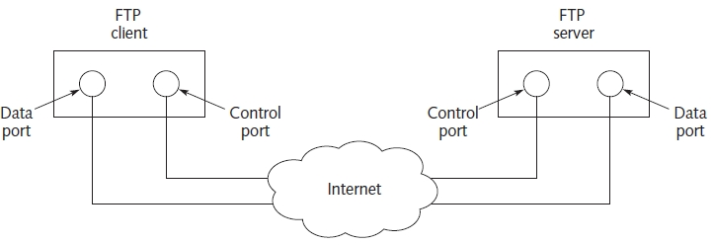
FTP Clients and Servers
FTP client-server application
  Client and server both use two ports
  FTP server port 20: data transfers
  FTP server port 21: control
  FTP client: any port above 1024
Figure 13-1 FTP client-server interaction

Slide 21
FTP Client
Is provided for many hardware types and operating systems
Anonymous FTP
  Allows public access to files stored on the FTP server
Authenticated FTP
  Requires valid username and password to access private files on the FTP server
Starting a Windows FTP client program:
  Command Prompt window
  Run option on the Start menu

Slide 22
Secure FTP
FTP information transmitted in plain text
  Not secure
Communication between client and server
  Requires private and secure transmissions
Secure shell (SSH)
  Network protocol using encrypted communication channel between network devices
Server fingerprint
  Information about server SSH key
  Enables encrypted communications channel

Slide 23
FTP Servers
Operate on server class computer systems (typically)
Installed as a service
  Ports 20 and 21 by default
  FTP server started automatically when system booted
  Gracefully stopped when system shut down
Responsibilities
  Allows server access
  Authenticates users (including anonymous FTP)
  Provides server file structure access
  Sets file transfer parameters

Slide 24
Telnet Services and Protocol
Telnet allows users to remotely access another device (host, router, switch).
A connection using Telnet is called a Virtual Terminal (VTY) session, or connection.
Telnet uses software to create a virtual device that provides access to the server’s command line interface (CLI).
Most operating systems include a Telnet client that can be accessed from the command prompt.
  There are also other Telnet clients such as Putty, Teraterm, Hyperterm and Minicom.

Slide 25
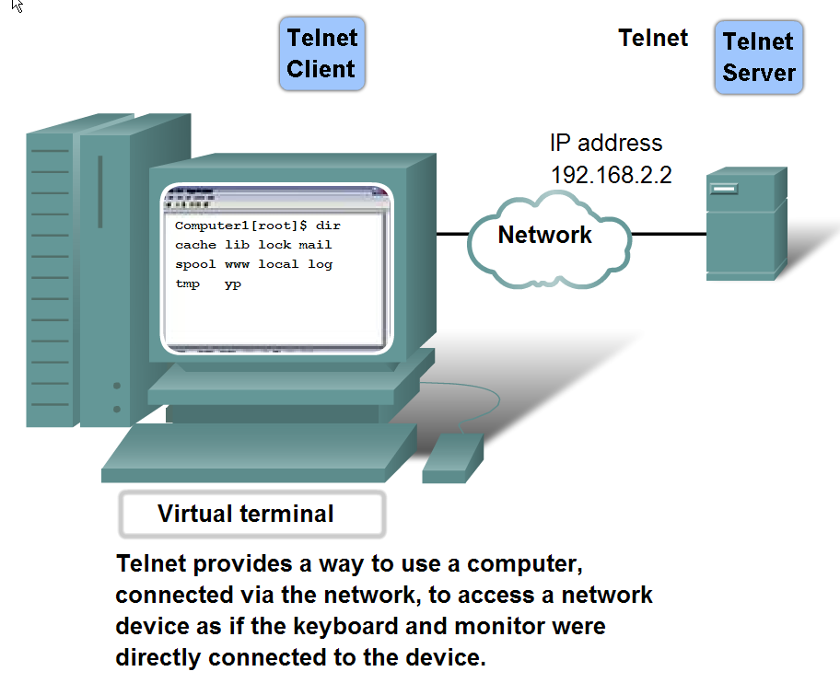
Telnet Services and Protocol

Slide 26
Telnet Services and Protocol
To support Telnet client connections, the server runs a service called the Telnet daemon.
One of the tasks of the Telnet daemon is to authenticate the user before the user can have access to the server’s command line.
  This ensures only authorized users can have access to the server.

Slide 27
Telnet Services and Protocol
Sample Telnet protocol commands include:
  Are You There (AYT)
    Enable the user request that something appear on the terminal screen to indicate that the VTY session is active.
  Erase Line (EL)
    Deletes all text from the current line.
  Interrupt Process (IP)
    Suspends, interrupts, aborts, or terminates the process to which the Virtual Terminal is connected.

Slide 28
Telnet Services and Protocol
Although Telnet supports authentication, it does not perform any encryption.
  Data is sent in clear text and can be easily read.
For security purpose, most people nowadays use Secure Shell (SSH) protocol for remote login instead of Telnet.
  SSH provides the structure for secure remote login and other secure network services such as secure FTP (SFTP).
  SSH encrypts data before transmission.
  It also provides a stronger authentication method.

Slide 29
Summary
SMTP specifies exchange e-mail
  Between computers using TCP
E-mail address
  Unique Internet address
  Two parts
    Mailbox name and computer host name
E-mail sent using SMTP. E-mail received using POP3
IMAP protocol
  Provides access to electronic messages on mail servers

Slide 30
Summary
FTP and Telnet
  Client-server applications
FTP provides capability to copy files between computers
  Text file contain ASCII text characters
  Anonymous FTP and authenticated FTP
Telnet provides bidirectional, byte-oriented service
  Remote computer access
Server fingerprint SSH key encrypts network communications

