Slide 1
Computer Networking From LANs to WANs: Hardware, Software, and Security
Chapter 8
The Internet

Slide 2
Objectives
Describe the basic organization of the Internet
Internet versus intranet
Network address translation (NAT)
Virtual Private Networks (VPN)

Slide 3
The Organization of the Internet
The internet is organized into several top-level domain categories
The name of an Internet host shows the category of the top-level domain.
  E.g. mimos.com domain – name of company
  uniten.edu domain – name of educational institution
Each domain is registered on appropriate root servers
  E.g. mimos.com is known by .com root server
By using DNS, domain name associated with an IP address will be resolved
Growing Internet popularity - Shortage of available networks

Slide 4
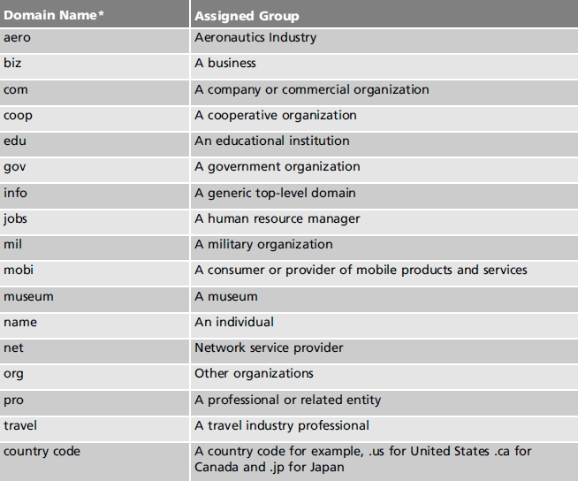
Table 15-1 Common top-level domain names

Slide 5
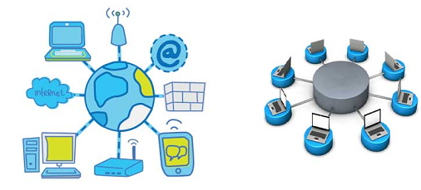
Internet vs Intranet

Slide 6
Internet
Internet is a world-wide/global system of interconnected computer networks.
Internet uses the standard Internet Protocol (TCP/IP)
Every computer in internet is identified by a unique IP address (e.g. 192.228.102.3) which identifies a computer location
A special computer DNS (Domain Name Server) is used to give name to the IP Address so that user can locate a computer by a name.
For example, a DNS server will resolve a name http://www.uniten.edu.my to a particular IP address to uniquely identify the computer on which this website is hosted.
Internet is accessible to every user all over the world.

Slide 7
Intranet
Intranet is system in which multiple PCs are networked to be connected to each other.
PCs in intranet are not available to the world outside of the intranet.
Usually each company or organization has their own Intranet network and members/employees of that company can access the computers in their intranet.
E.g. Uniten’s portal
Each computer in Intranet is also identified by a IP Address, which is unique among the computers in that Intranet.

Slide 8
Network Address Translation (NAT)
As the popularity of the Internet grew, and as the number of the Internet grew, the available networks dropped.
There are a methods to share an internet connection among multiple clients.
One of them is Network Address Translation

Slide 9
Network Address Translation (NAT)
Network Address Translation (NAT)
  Is a technique where multiple network devices on a local network (also called the inside network) to be mapped to IP addresses on an external network
  Internal IP addresses mapped on a rotating basis
  NAT table:
    Contains the known mappings
    Initialized with a set of translations

Slide 10
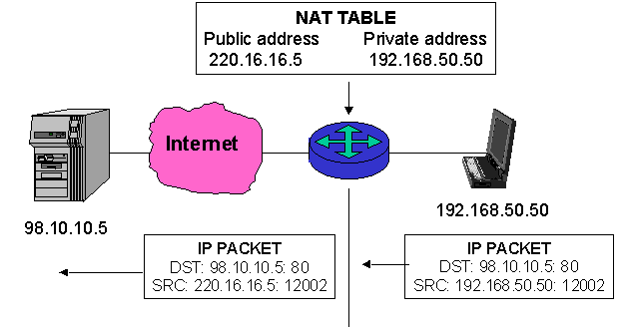
Network Address Translation (NAT)
  Advantages of NAT:
    Reduces number of outside IP addresses required
    Enhances security
    Hides internal IP addresses
Cengage Learning: Computer Networking from LANs to WANs

Slide 11
Virtual Private Networks
VPN allows for remote private LAN to communicate securely through untrusted public network such as Internet.
Only authorized network members access data.
Uses IP tunneling protocol and security services that are transparent to private network users
Private LAN that connected to the Internet also can connect to other LANs by combining tunneling, encryption, authentication (offer the highest level of security
Tunneling
  Data transferred through the public network in an encapsulated form
    All data including sender, destination addresses enclosed within a packet

Slide 12
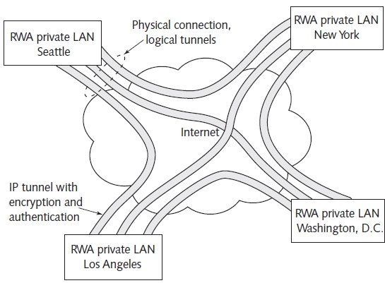
Figure 15-7 RWA Software VPN (logical view)
RWA: Routing Wavelength Assignment

Slide 13
Virtual Private Networks
There are VPN protocols to secure the transport of data traffic over a public network infrastructure:
  IPSec (IP Security)
  SSL (Secure Socket Layer) and TLS (Transport layer Security)
  PPTP(Point to Point Tunneling Protocol)
  L2TP (Layer 2 Tunneling Protocol)

Slide 14
Virtual Private Networks
IP Security (IPSec)
    IPSec includes tunneling, encryption and authentication
    Purpose: to secure communication over internet
    How it works:
      Offer a solution to data privacy, integrity and authentication that is network independent, application independent, and supports all IP services (HTTP, FTP, SNMP, etc).

Slide 15
Virtual Private Networks
Support only tunneling protocol
Point-to-Point Tunneling protocol (PPTP)
  Tunneling protocol to connect a remote client to a private server over the Internet.
  Easy to setup
  Low overhead and thus good speeds
  Low encryption - not secured

Slide 16
Virtual Private Networks
Layer 2 Tunneling Protocol (L2TP) is a protocol used to tunnel data communications traffic between two sites over the Internet.
Supported on most modern devices and OSes.
Easy to setup on MAC and Windows.
Does not do any encryption by itself so need to use IPsec for encryption.

Slide 17
Virtual Private Networks
Advantages of using PPTP over L2TP and IPSec :
  PPTP does not require digital certificates
  PPTP can be used by all versions of Windows and many other Operating System (OS), i.e. UNIX/Linux, Netware, Mac OS
  PPTP clients can be located behind NAT
VPN using PPTP or L2TP provides capabilities :
  User authentication, address management, data encryption, encryption management and support multiple protocols to be delivered.

Slide 18
Summary
Internet is a world-wide/global system of interconnected computer networks.
Intranet is system in which multiple PCs are networked to be connected to each other.
NAT-Is a technique where multiple network devices on a local network (also called the inside network) to be mapped to IP addresses on an external network
VPN allows private LAN secure communication

